Slide 1

SEC290
Fundamentals of Infrastructure Security
This project covers fundamentals of infrastructure security.
It includes activities such as configuring firewall rules, deploying Snort sensors for network intrusion detection, exploring SSL encryption, analyzing traffic to detect attacks, exploiting Microsoft vulnerabilities, and conducting live memory analysis.
Final Project
Branden Mata

Slide 2

Course Project
SEC290
Fundamentals of Infrastructure Security
Module 1 Manual Vulnerability Analysis (on a test VM network)

Slide 3
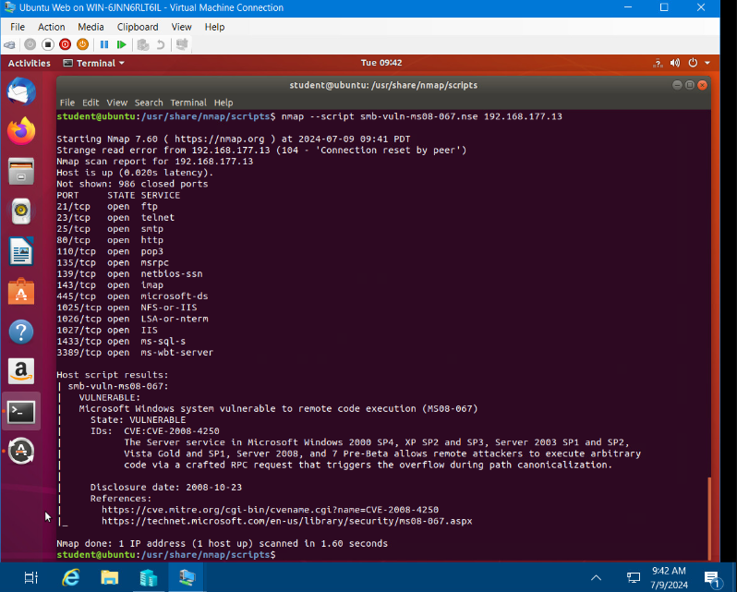
Microsoft Windows Bulletin MS08-067 vulnerability
Take a screenshot of the output in Part 3, Step 2.
It should show that a vulnerability exists on the test VM.

Slide 4
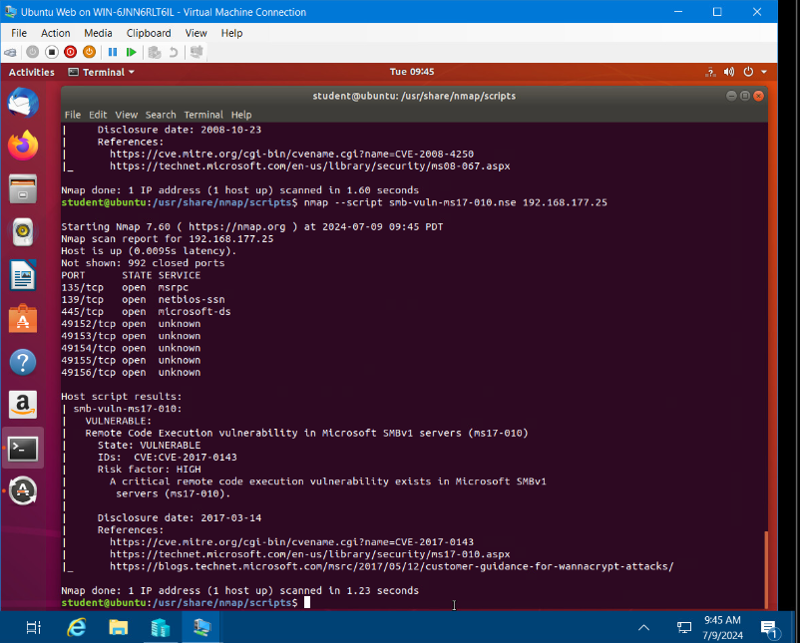
Microsoft Windows Bulletin MS17-010 vulnerability
Take a screenshot of the output of the nmap command in Part 4.
It should show that a vulnerability exists on the test VM.

Slide 5
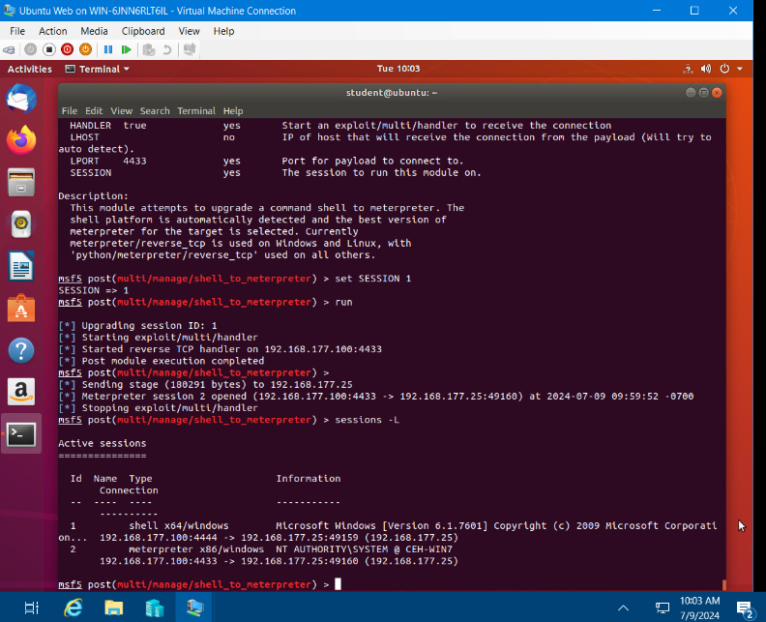
meterpreter session command output
Take a screenshot of the output of the meterpreter session commands in Part 5, Step 19 or Step 20.

Slide 6
Course Project
SEC290
Fundamentals of Infrastructure Security
Module 2 Intrusion Analysis using Wireshark

Slide 7
Basic attack analysis
Look at captures no. 20 and 22. (You can use the “Go” link at the top of the Wireshark screen to quickly go to a specific capture) Both packets are ICMP traffic but there are subtle differences between them. Compare the time-to-live and data field sizes in the two packets. What differences do you see?
  The differences that I see in the time-to-live and data field sizes in the two ICMP traffic packets are:
  ICMP Packet 20: Source IP: 192.168.25.1 Destination: 192.168.25.50 (Echo request) length: 98 time-to-live: 64
  ICMP Packet 22: Source IP: 192.168.50 Destination: 192.168.25.1 (Echo request) length: 74 time-to-live: 128
Do a little Internet research to discover which operating systems use the specific values in their ping commands. What operating system generated the echo request in capture 20?
  The operating system that generated the echo request in capture 20 is: Unix/Linux – TTL Value = 64
Review packet no. 37 and beyond, what do you think is taking place here?
  After reviewing packet no. 37 and beyond, some bits and flags are set in the traffic. I think what is taking place is a pattern emerging. Flags: (SYN) derives from source port : 46646 and (RST, ACK) destinations are to port 46646.
Look at capture 22846. What is suspicious about the flag settings in this packet?
  The suspicious flag setting is the (FIN) flag set for experts being targeted.
What is the IP address of the host being targeted?
  The IP address of the host being targeted from Packet 22846 is: 192.168.25.200

Slide 8
References
Module 2 Project Video
https://www.yeahhub.com/identify-operating-system-using-ping-command/

Slide 9
Course Project
SEC290
Fundamentals of Infrastructure Security
Module 3 Open SSL

Slide 10
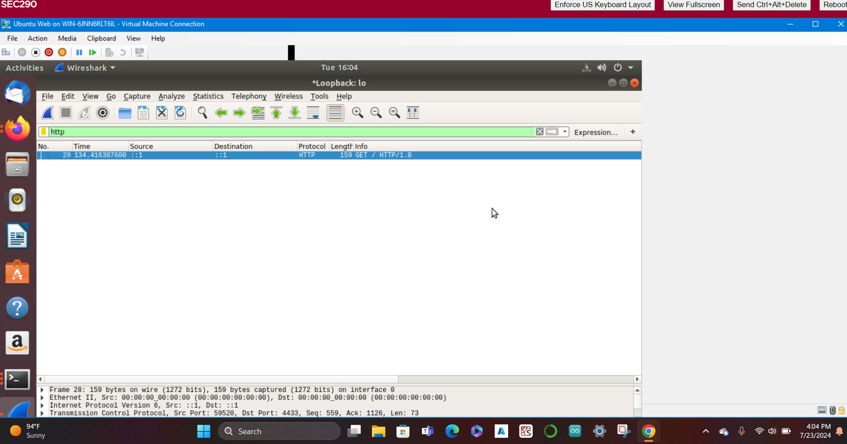
Creating and testing an SSL/TLS file
Take a screenshot of the output in Step 20.
It should show the GET request in the Info column.

Slide 11
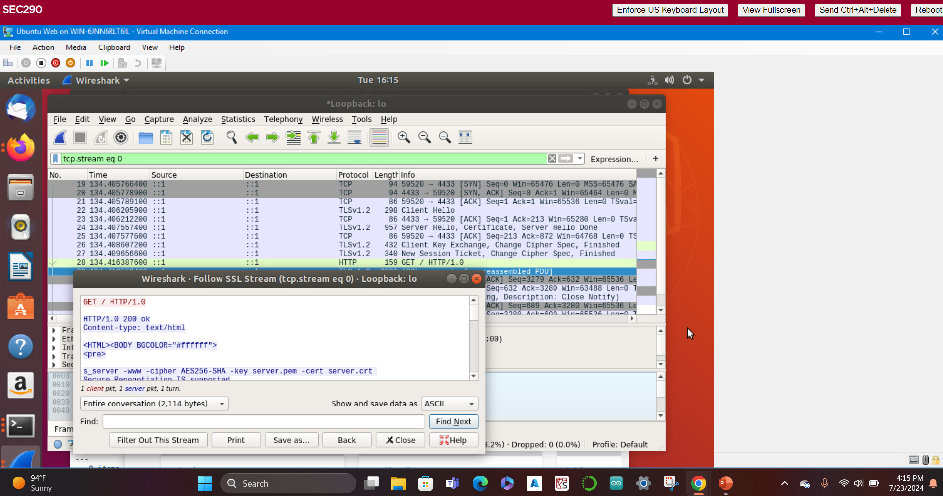
Creating and testing an SSL/TLS file cont’d
Take a screenshot of the output in Step 22.
It should show the decrypted SSL stream.

Slide 12
References
Module 3 - Project Video
Module 3 - Open SSL step-by-step guide

Slide 13
Course Project
SEC290
Fundamentals of Infrastructure Security
Module 4 Snort
Branden Mata

Slide 14
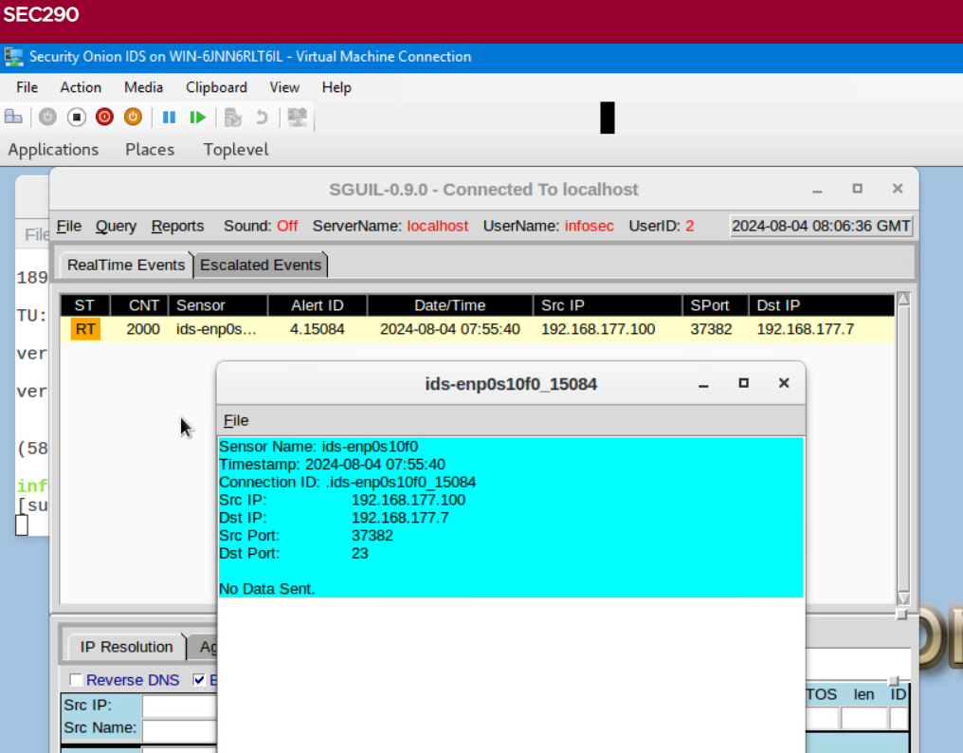
Testing Snort rules
Take a screenshot of the output in Part 1 Step 17.
It should show the transcript of the XMAS scan alert.

Slide 15
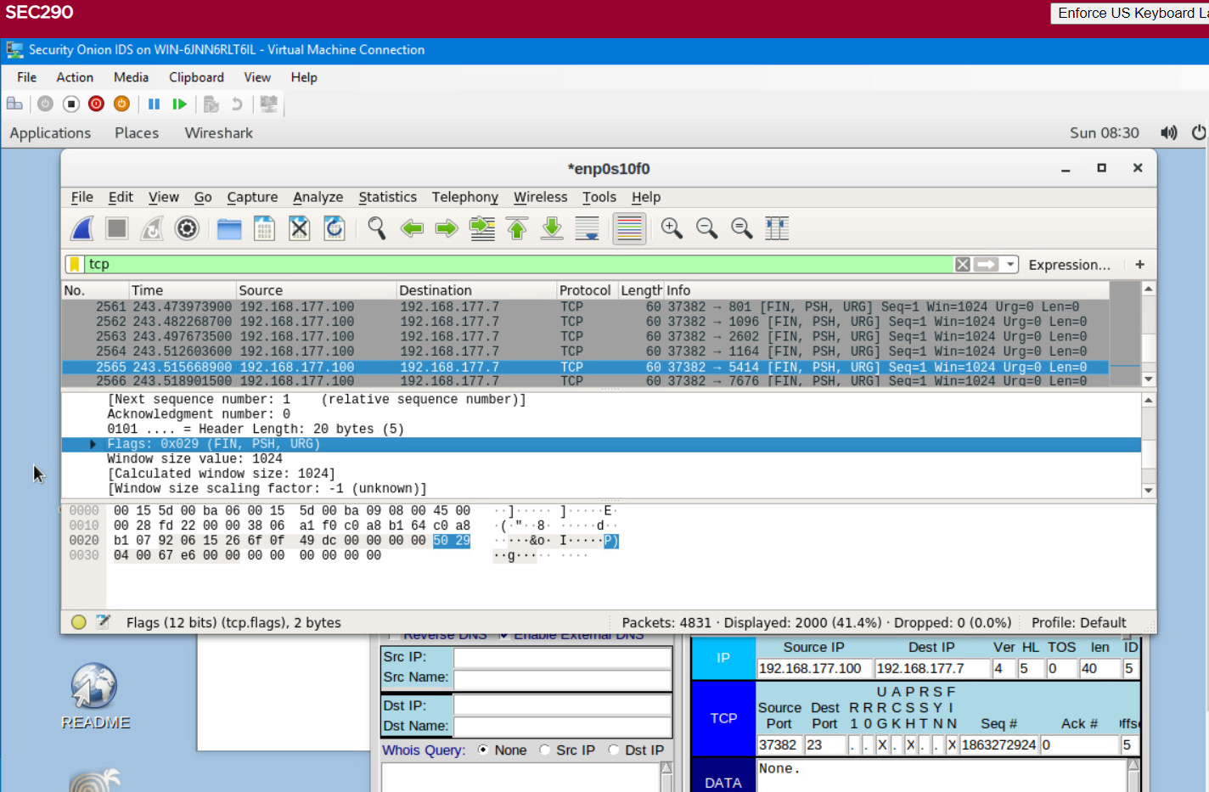
Testing Snort rules (cont’d)
Take a screenshot of the output in Part 1 Step 20.
It should show the TCP packets generated by the XMAS scan.

Slide 16
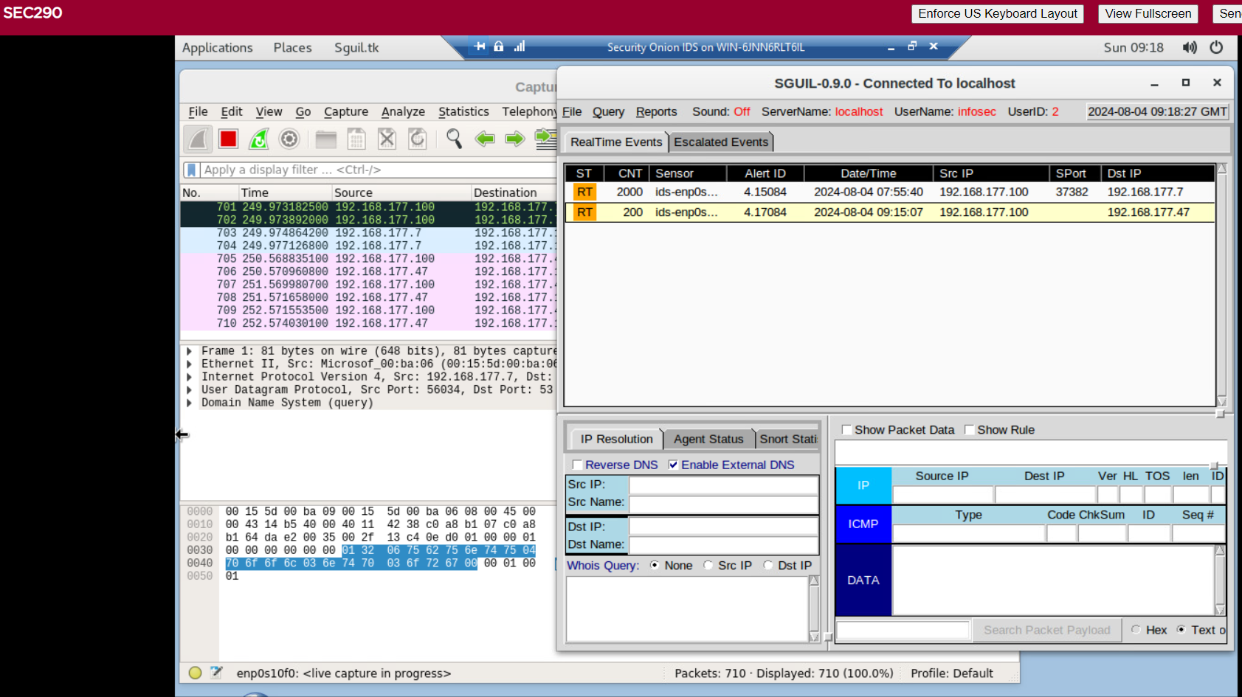
Creating Snort rules
Take a screenshot of the output in Part 2 Step 7.
It should show the ping activity alert.

Slide 17
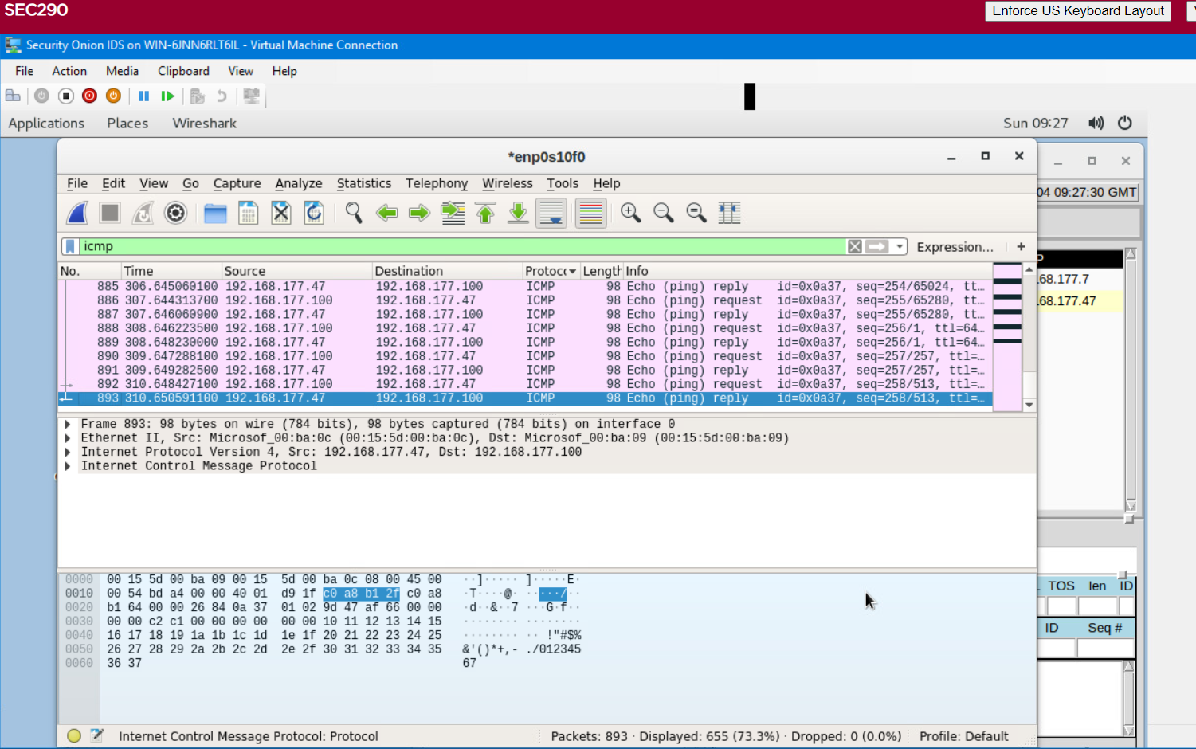
Creating Snort rules (cont’d)
Take a screenshot of the output in Part 2 Step 8.
It should show the ICMP packets generated by the ping activity.

Slide 18
Course Project
SEC290
Fundamentals of Infrastructure Security
Module 5 Live Memory Analysis

Slide 19
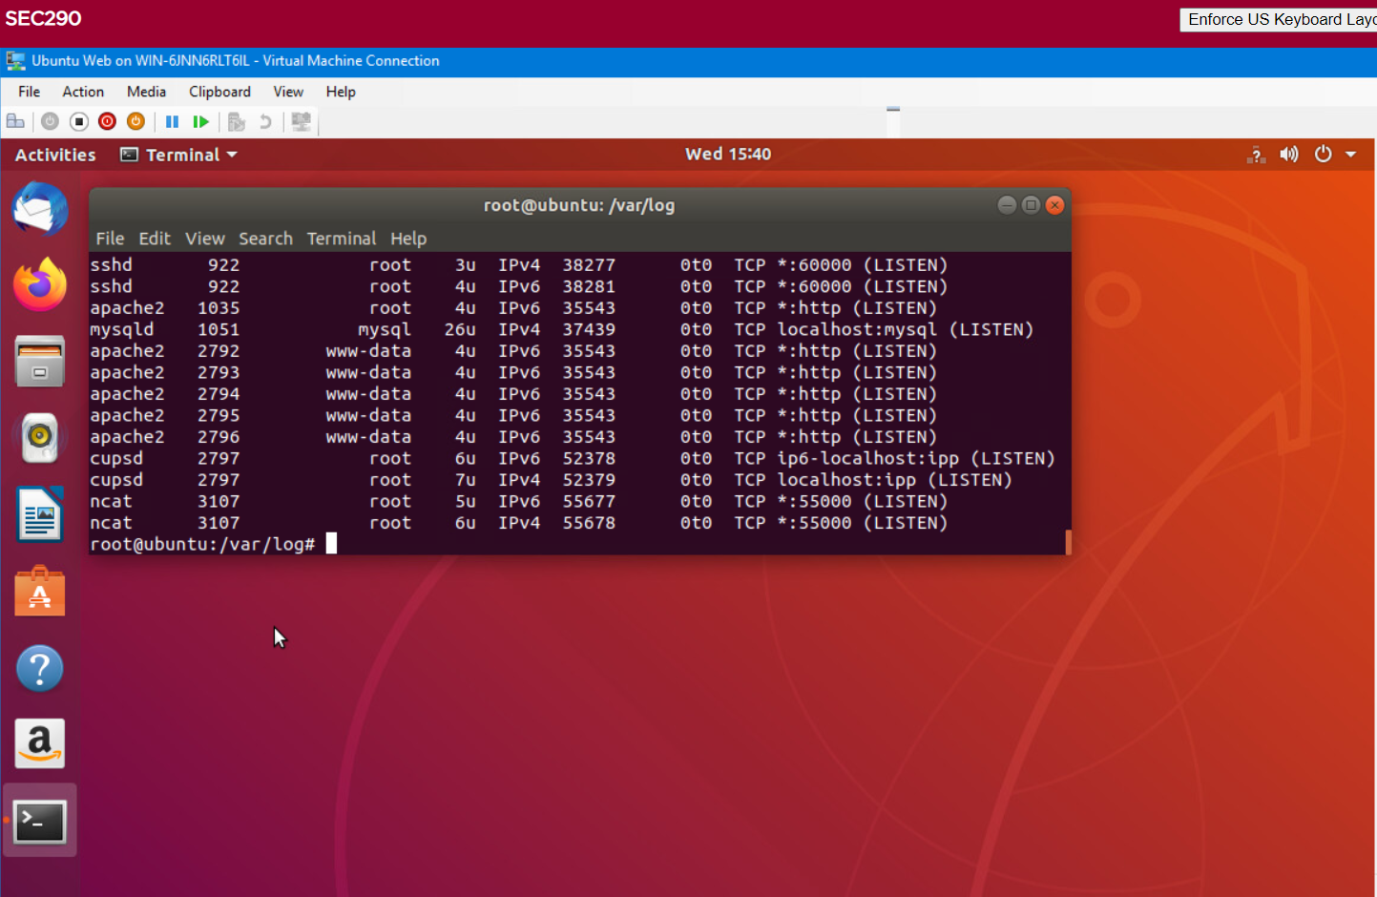
Linux Processes
Take a screenshot of the output in Part 1, Step 16.
It should show port 55000 open for both IPv4 and IPv6.

Slide 20
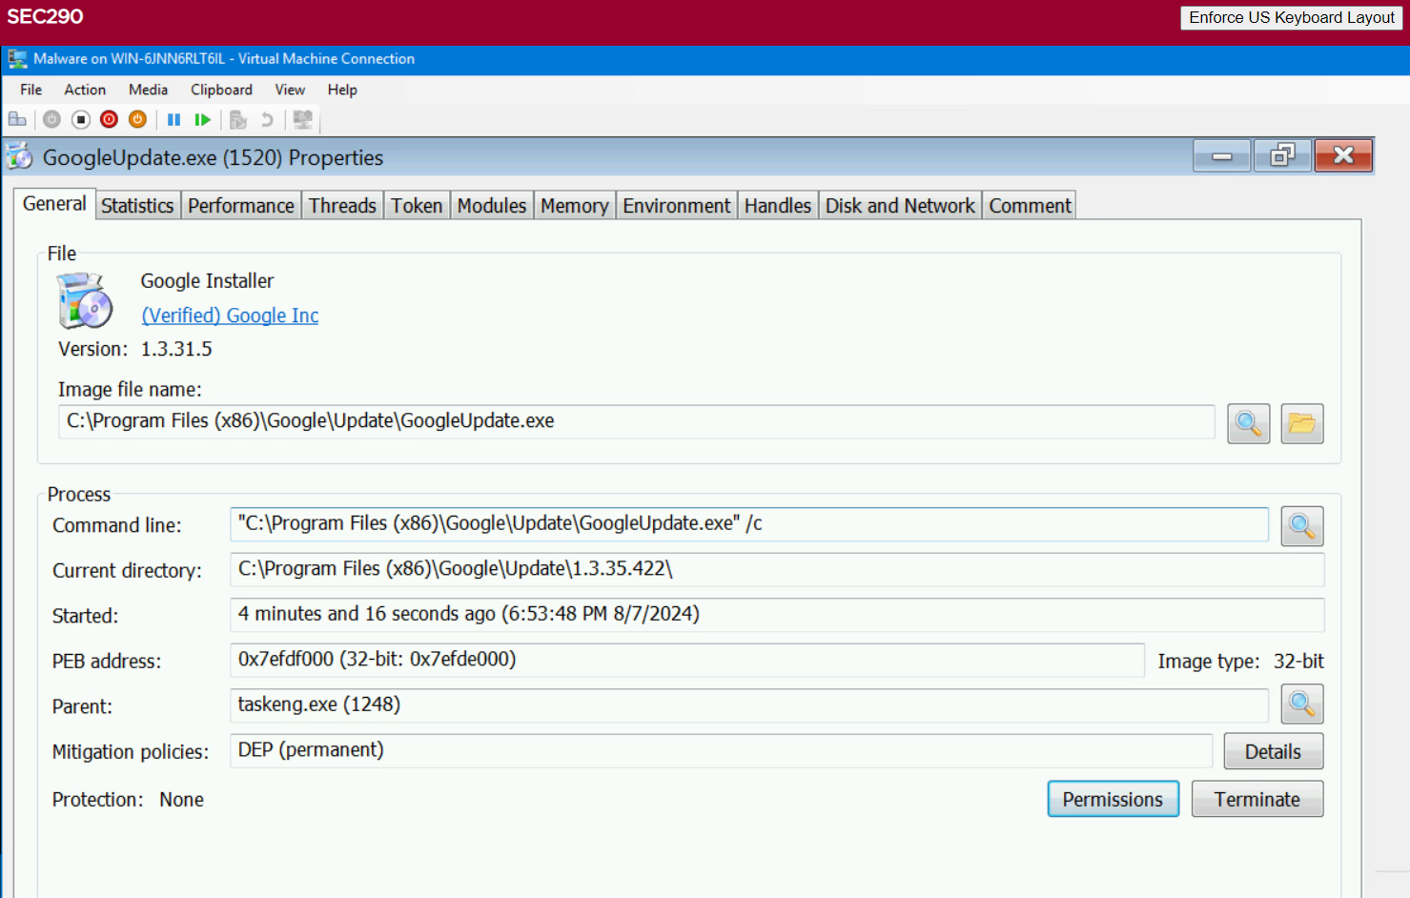
Process Hacker
Take a screenshot of the output in Part 2, Step 5.
It should show properties of a chosen process.

Slide 21
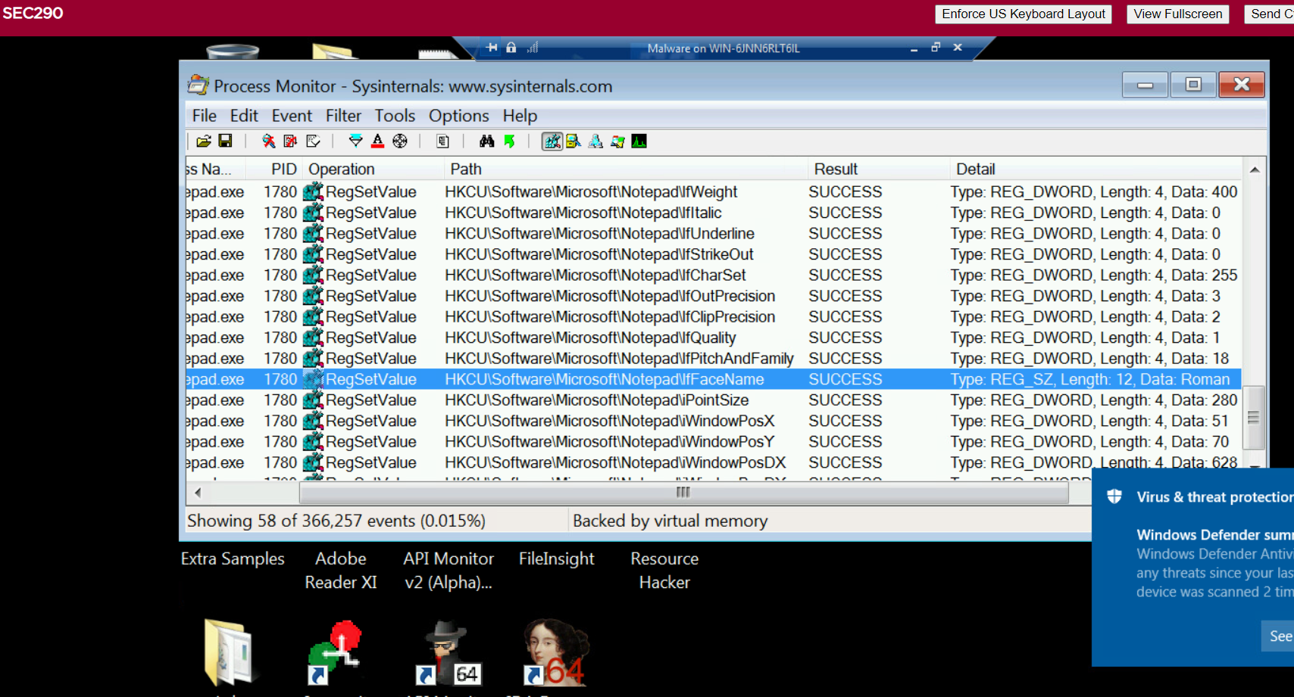
Process Monitor
Take a screenshot of the output in Part 3, Step 13.
It should show ifFaceName in the Path column and Data: Roman in the Detail column.

Slide 22
References
Module 5 Project Video
DeVry Modules Step-by-step guide

Slide 23
Course Project
SEC290
Fundamentals of Infrastructure Security
Module 6 Firewall

Slide 24
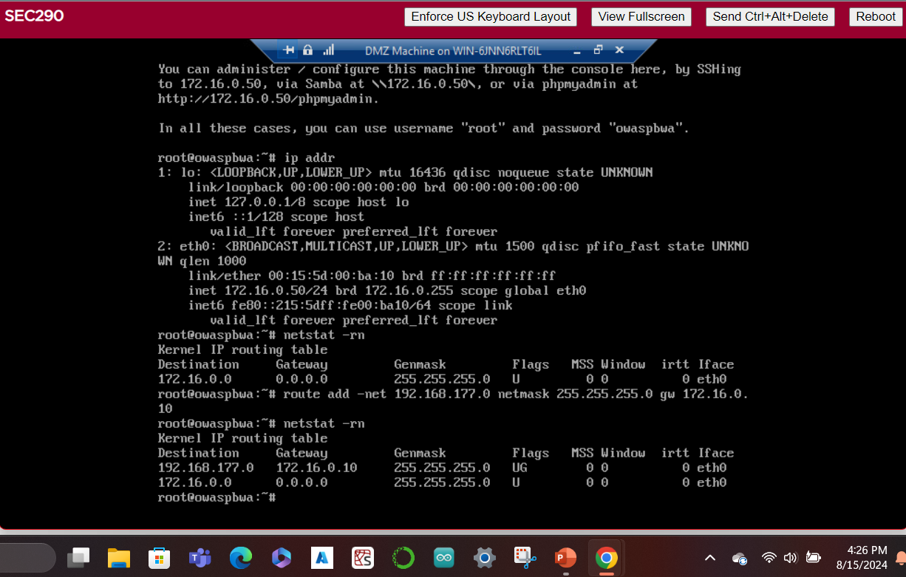
Time-based Access
Take a screenshot of the output in Part 1 Step 21.
It should show the output of the DMZ Route Table.

Slide 25
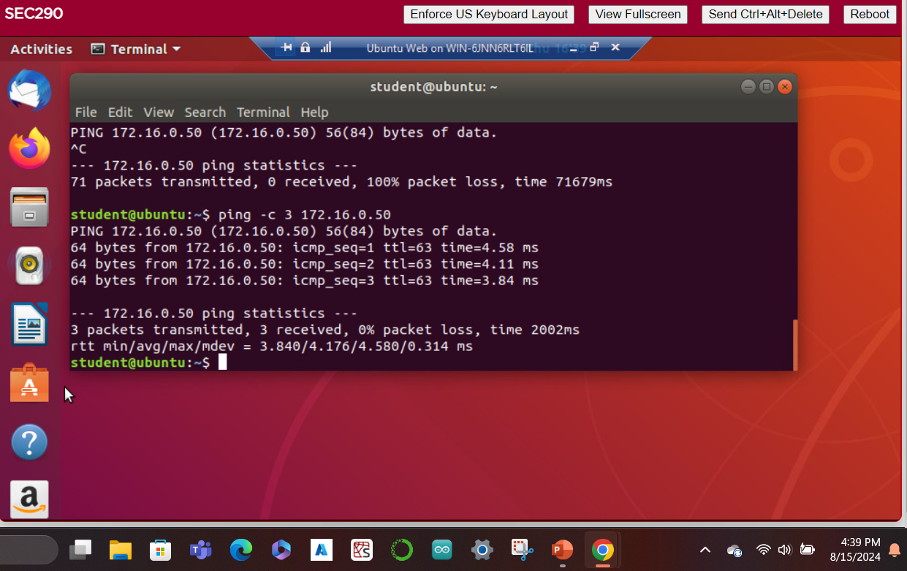
Time-based Access
Take a screenshot of the output in Part 1 Step 26.
It should show a successful ping from the Ubuntu Web VM and the DMZ VM.

Slide 26
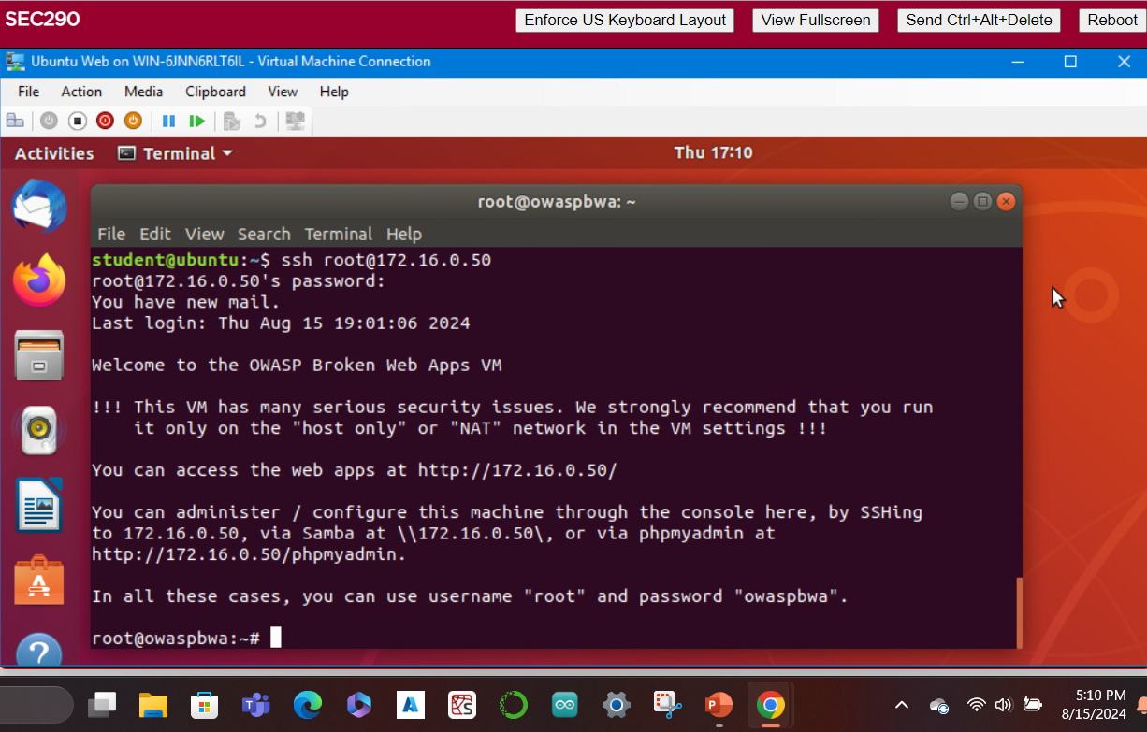
Time-based Access
Take a screenshot of the output in Part 1 Step 34.
It should show two time-based access rules in the FORWARD chain

Slide 27
References
Module 6 Project Video
Module 6: Firewall Step-by-step guide

Slide 28
Challenges
Completing all three Snort activities (testing Snort rules and creating Snort rules)
Navigating through all three intrusion analyses (basic attack analysis, web attack and advanced analysis)

Slide 29
Career Skills Obtained
Maintain a secure system utilizing principles of technology.
Troubleshoot cybersecurity attacks utilizing principles of technology.
Identify unknown problems utilizing mathematical and scientific methods, software, and/or equipment.
Perform various system tests and experimentation.
Analyze problems utilizing mathematical and scientific methods, software, and/or equipment.
Utilize relevant information and appropriately cite sources to learn, produce, and create.

Slide 30

Conclusion
This project covered the fundamentals of infrastructure security.
It included activities such as configuring firewall rules, deploying Snort sensors for network intrusion detection, exploring SSL encryption, analyzing traffic to detect attacks, exploiting Microsoft vulnerabilities, and conducting live memory analysis

