Slide 1
NETW211
Final Project
All Modules
Branden Mata

Slide 2
Introduction
The project covers the fundamentals of cloud computing that complements IoT.
The design and development process of building a system in the Azure Cloud includes Virtual Machine (VM) launch, Virtual Network (VNet) configuration, VM instance security, cloud storage, and cloud monitoring.
This foundation empowers the learning of emerging technologies, including (IoT) Internet of Things, and prepares me for my future career in Information Technology.

Slide 3
Virtual Machine (VM) Instances

Slide 4
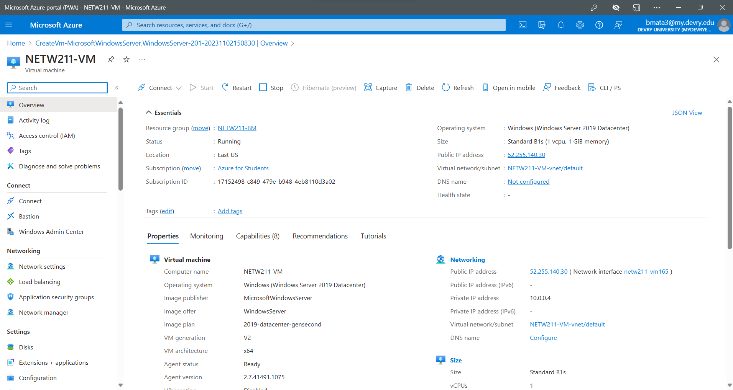
Deploying a VM in Azure
This screenshot should show the NETW211VM page with information such as the resource group name, subscription, public IP address, etc.
This screenshot should also show your DVU ID information in the top right corner of the Azure Portal.

Slide 5
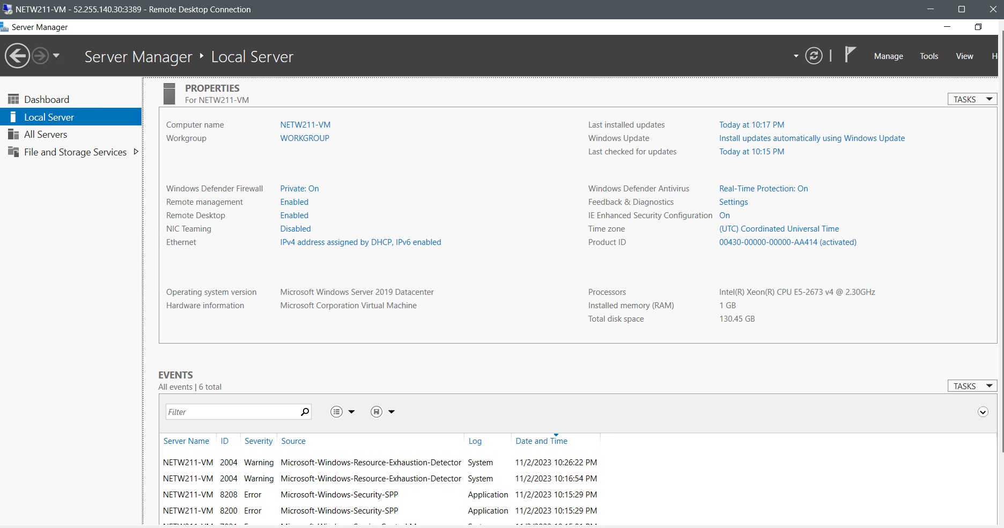
Connecting to the VM
This screenshot should show the PROPERTIES for NETW211VM page, including the computer name, operating system version, hardware information, etc.
This screenshot should also show the EVENTS section with the Date and Time information.

Slide 6
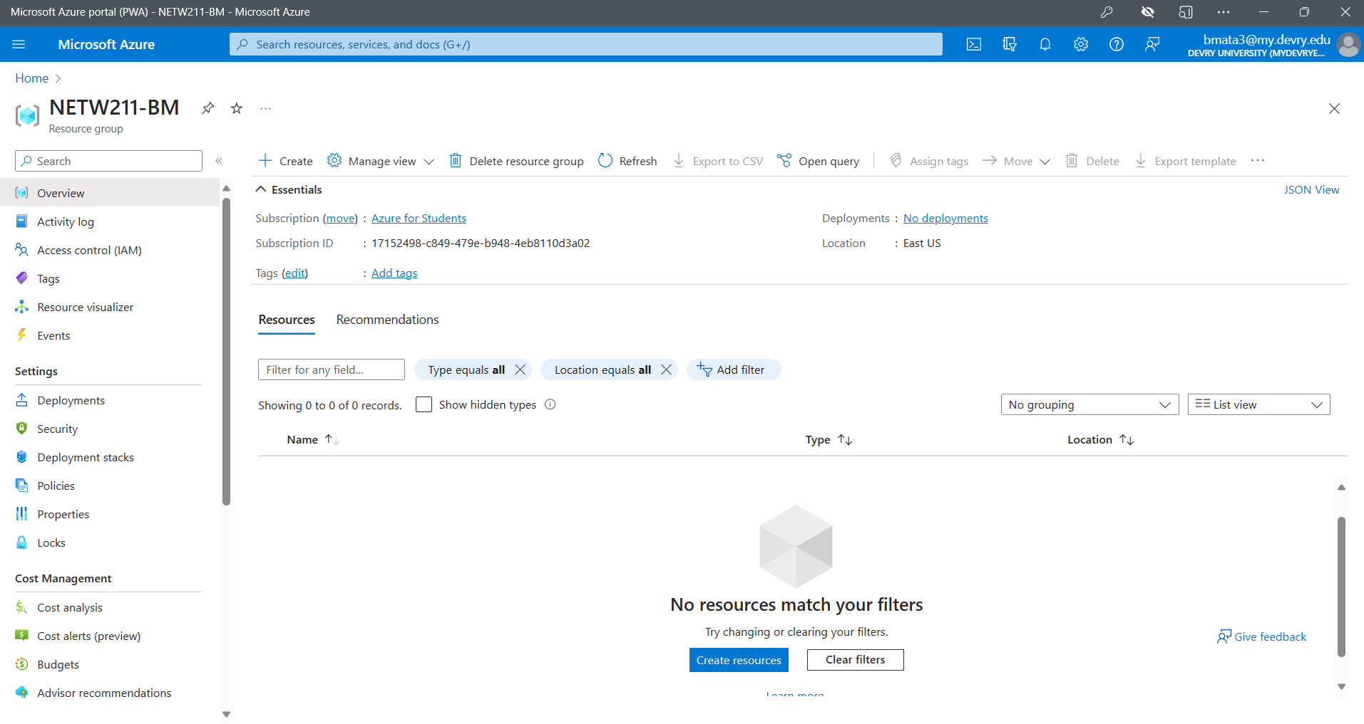
Deleting
the VM
This screenshot should show the NETW211-XX (Your Initials) Resource groups page, with the “No resources match your filters” message.
This screenshot should also show your DVU ID information in the top right corner of the Azure Portal.

Slide 7
Azure VNet and Subnets

Slide 8
Creating a VNet with Two Subnets
1. With a /24 network prefix, how many usable IPv4 host addresses are there? [hint: you learned this in NETW191]
Answer here:
/24 | 255.255.255.0 | 254
2. Given the answer above, why is the number of available IP addresses for Subnet0 (10.0.0.0/24) or Subnet1 (10.0.1.0/24) is 251 when you create an Azure VNet? [hint: where did the missing addresses go?]
Answer here:
Number of virtual networks that Azure Route Server can support: 250
All public IP addresses can be used in DNAT rules and they all contribute to available SNAT ports.

Slide 9
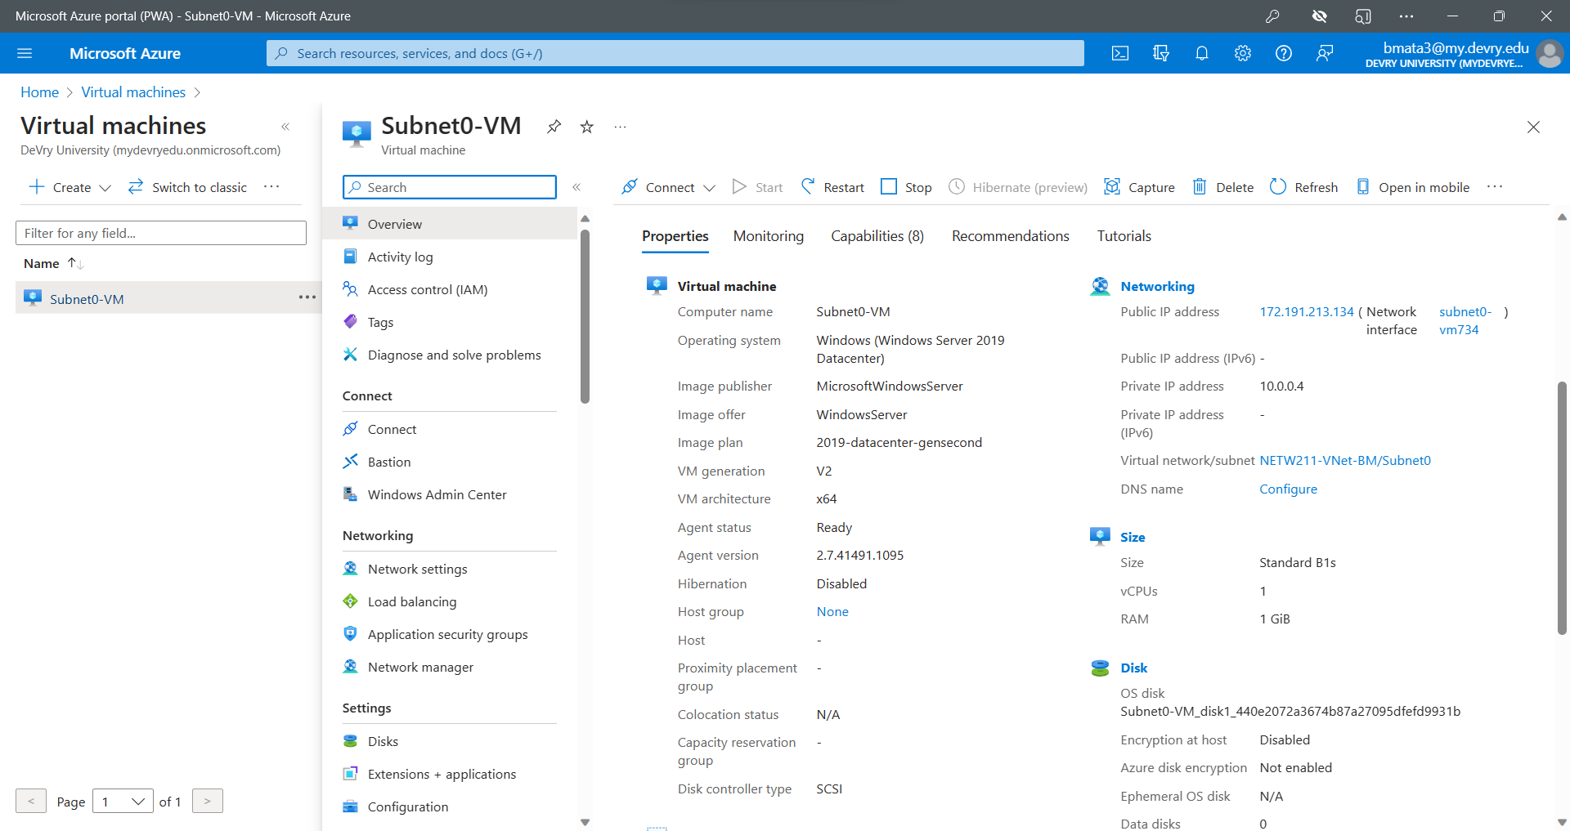
Deploying VMs into Subnets
(1 of 3)
This screenshot should include the Properties section of the Subnet0-VM page, showing the networking and size information of the VM.
This screenshot should also show your DVU email in the top right corner of the Azure Portal.

Slide 10
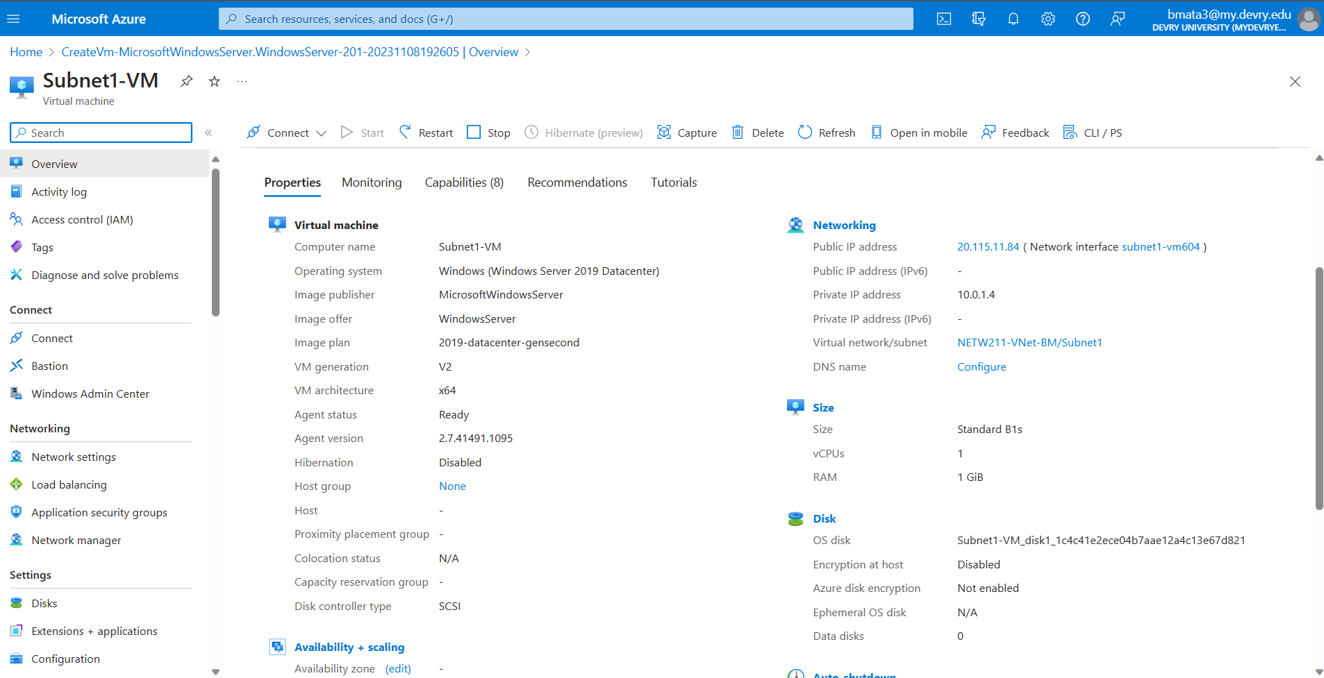
Deploying VMs into Subnets
(2 of 3)
This screenshot should include the Properties section of the Subnet1-VM page, showing the networking and size information of the VM.
This screenshot should also show your DVU email in the top right corner of the Azure Portal.

Slide 11
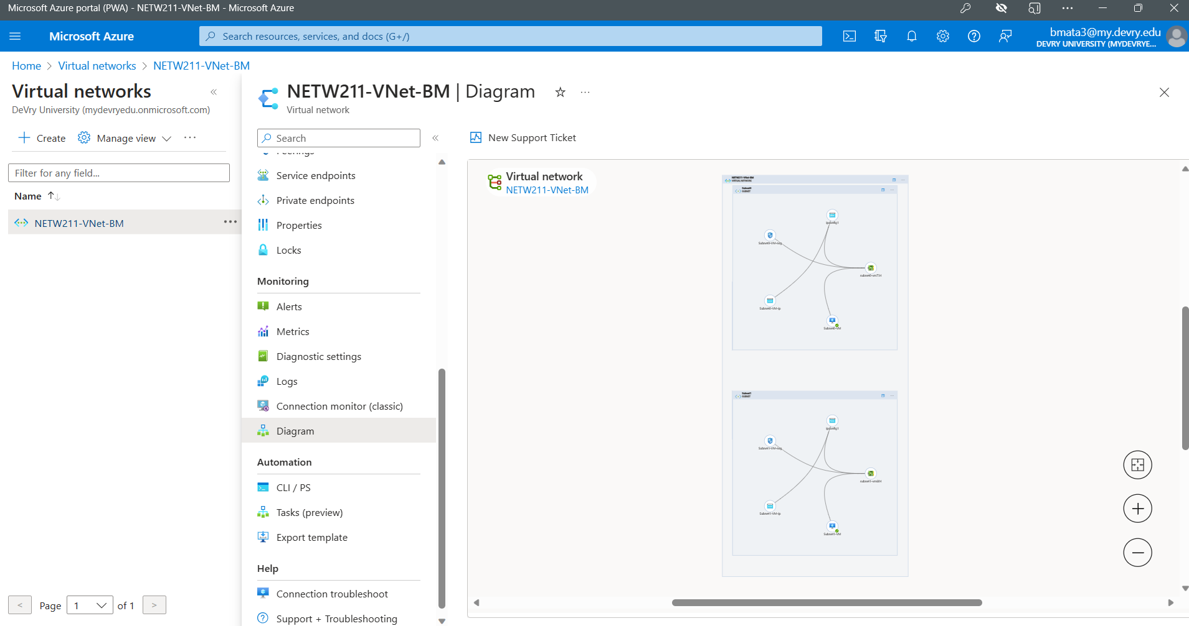
Deploying VMs into Subnets
(3 of 3)
This screenshot should show the topology diagram of your VNet (NETW211-VNet-Your Initials) with two subnets (Subnet0 and Subnet1) and one VM in each subnet (Subnet0-VM and Subnet1-VM).
This screenshot should also show your DVU email in the top right corner of the Azure Portal.

Slide 12
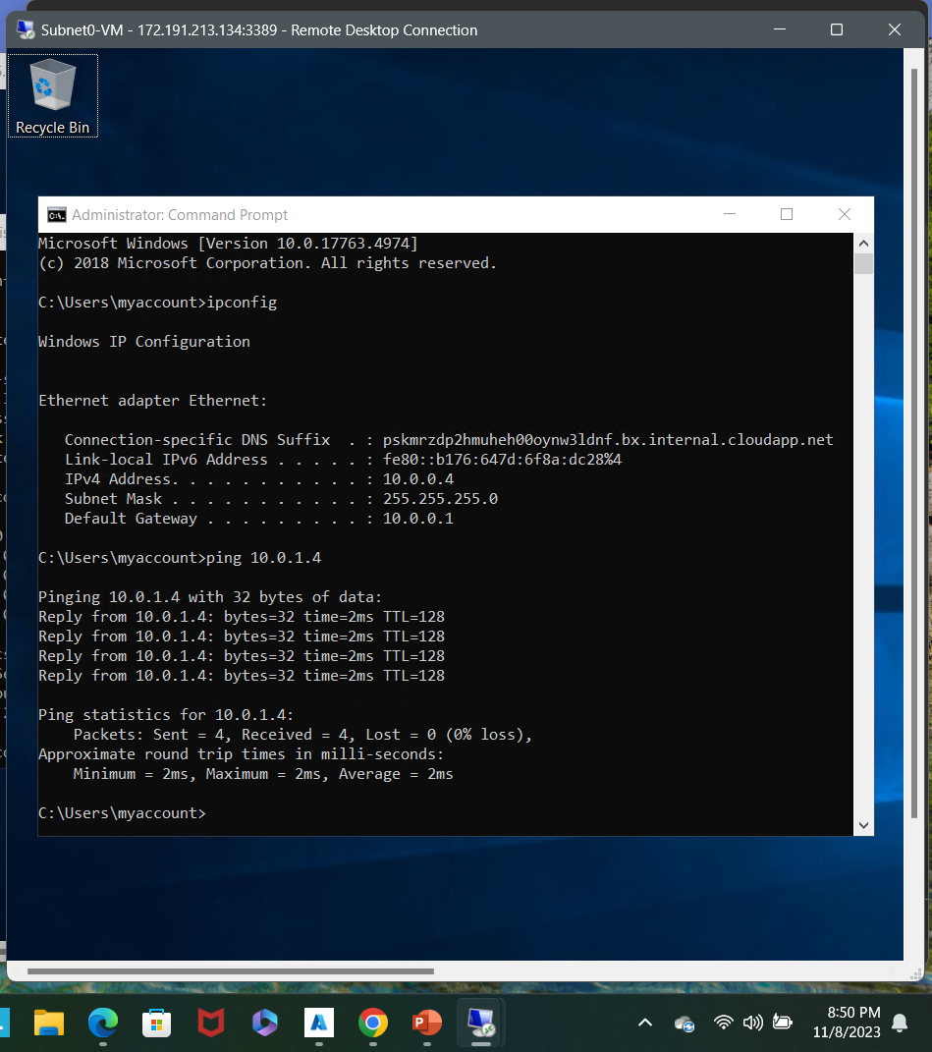
Verifying Connectivity between VMs
(1 of 2)
This screenshot should show the ipconfig and ping x.x.x.x results in the command prompt window of Subnet0-VM.
This screenshot should also show the Date/Time information in the bottom right corner of your desktop.

Slide 13
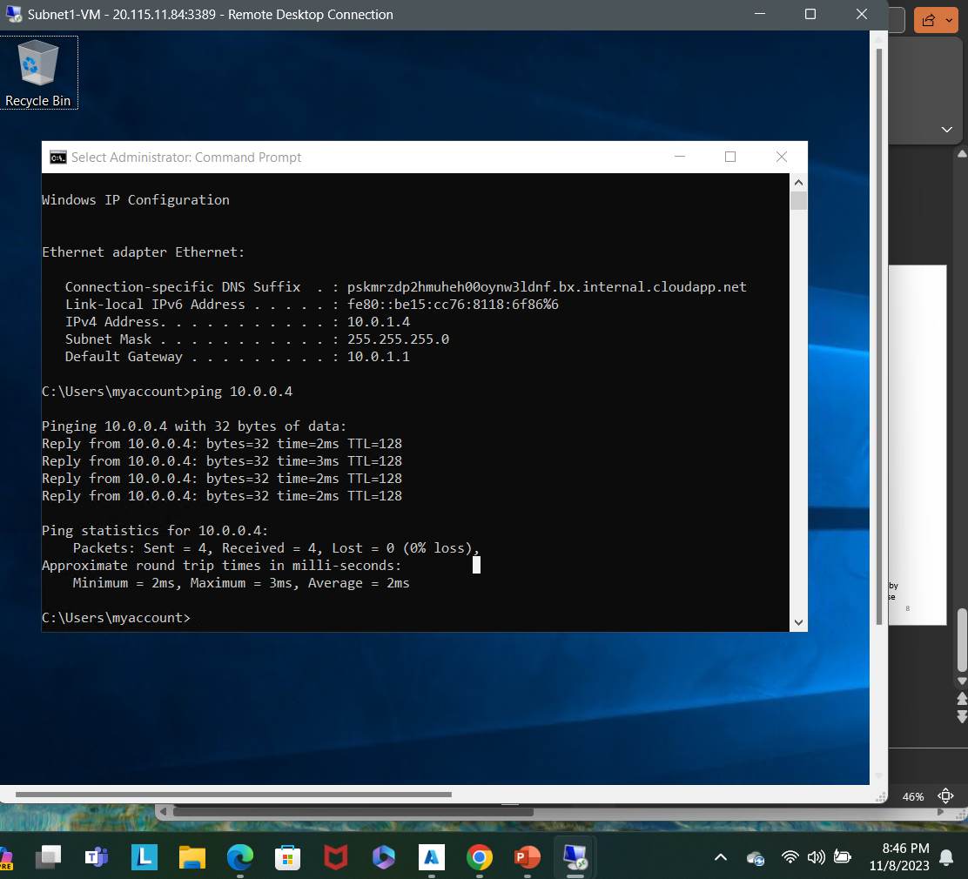
Verifying Connectivity between VMs
(2 of 2)
This screenshot should show the ipconfig and ping x.x.x.x results in the command prompt window of Subnet1-VM.
This screenshot should also show the Date/Time information in the bottom right corner of your desktop.

Slide 14
Azure VM Security

Slide 15
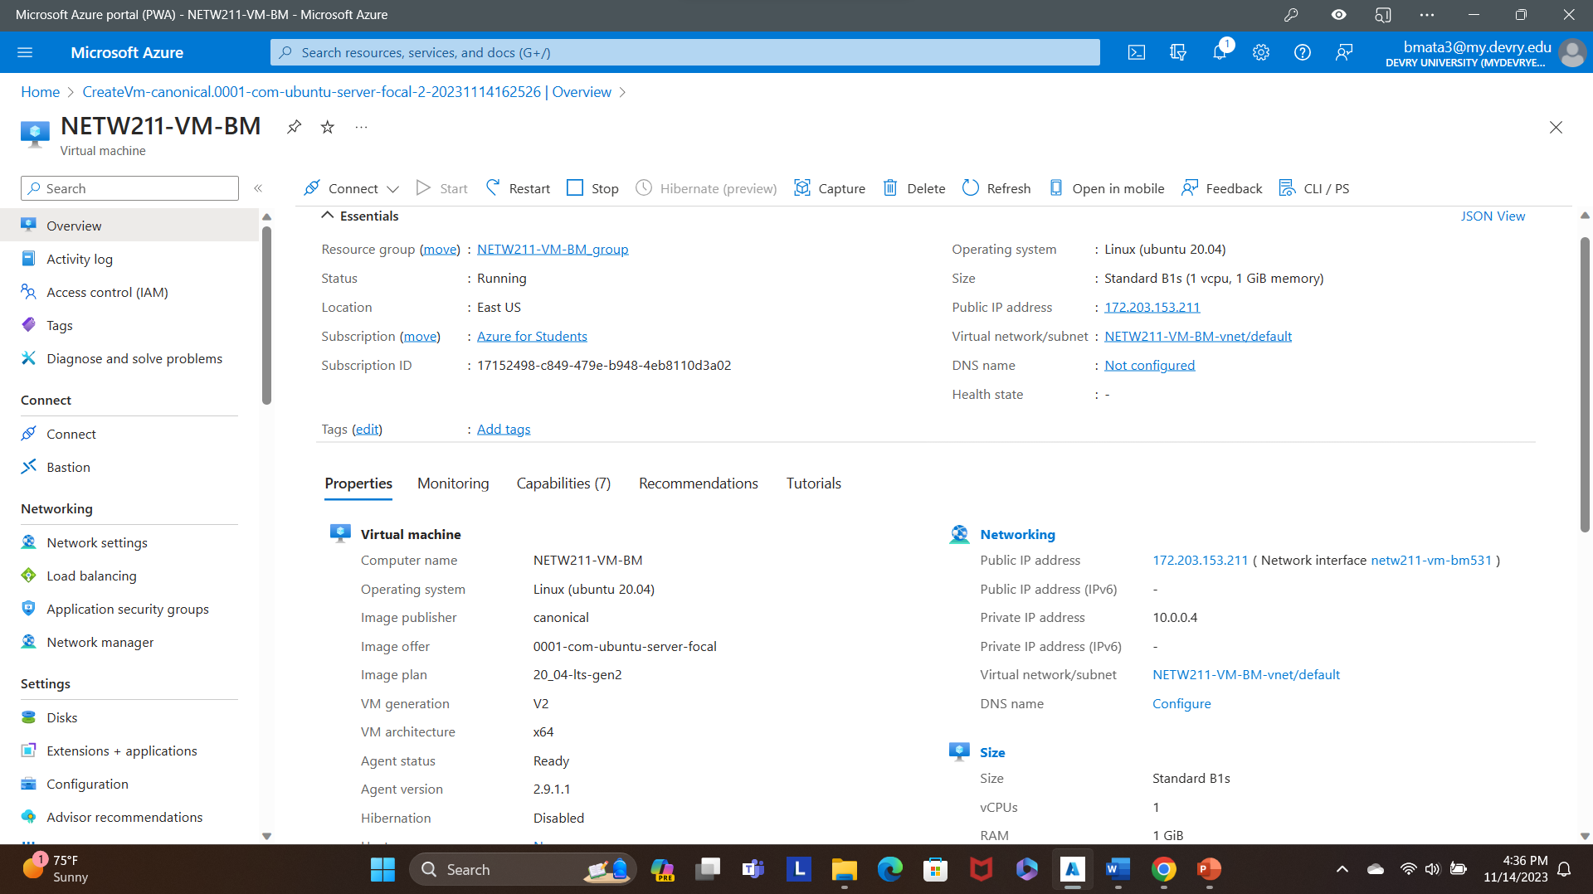
Launching a VM
This screenshot should show the NETW211-VM-Your Initials page, with information such as the resource group name, subscription, public IP address, etc.
This screenshot should also show your DVU email in the top right corner of the Azure Portal.

Slide 16
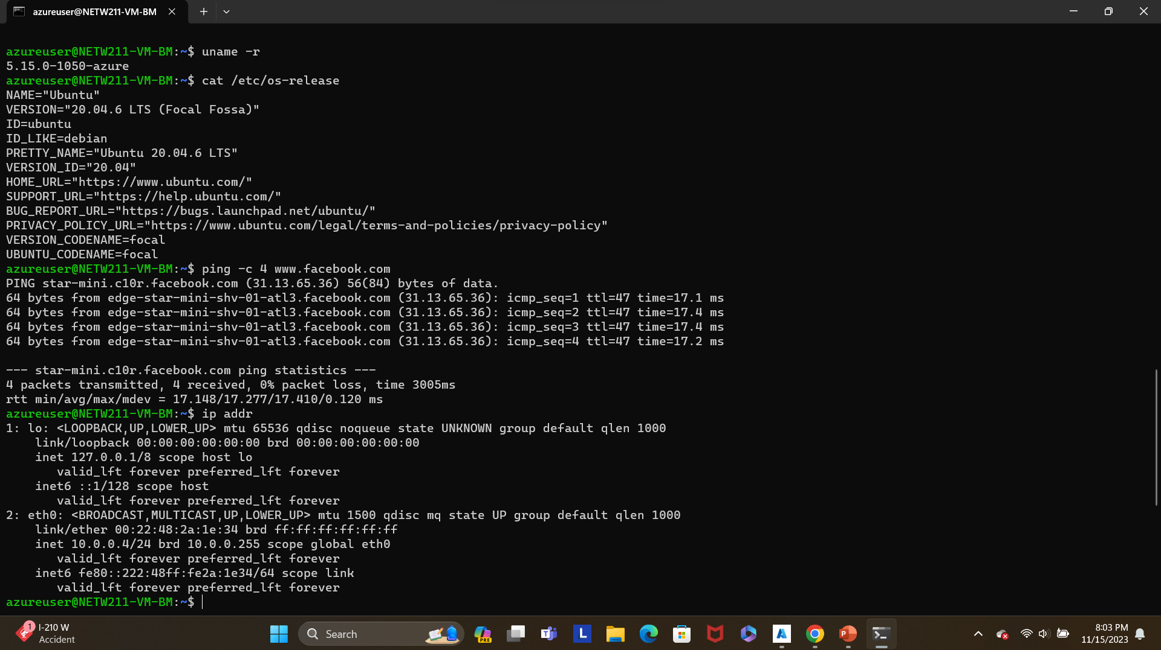
Connecting
to the VM
via SSH
This screenshot should include the azureuser@NETW211-VM-Your Initials window showing the IPv4 address of the VM in the Azure cloud.
Issue the date command in the same terminal window to include the system date and time in the screenshot.

Slide 17
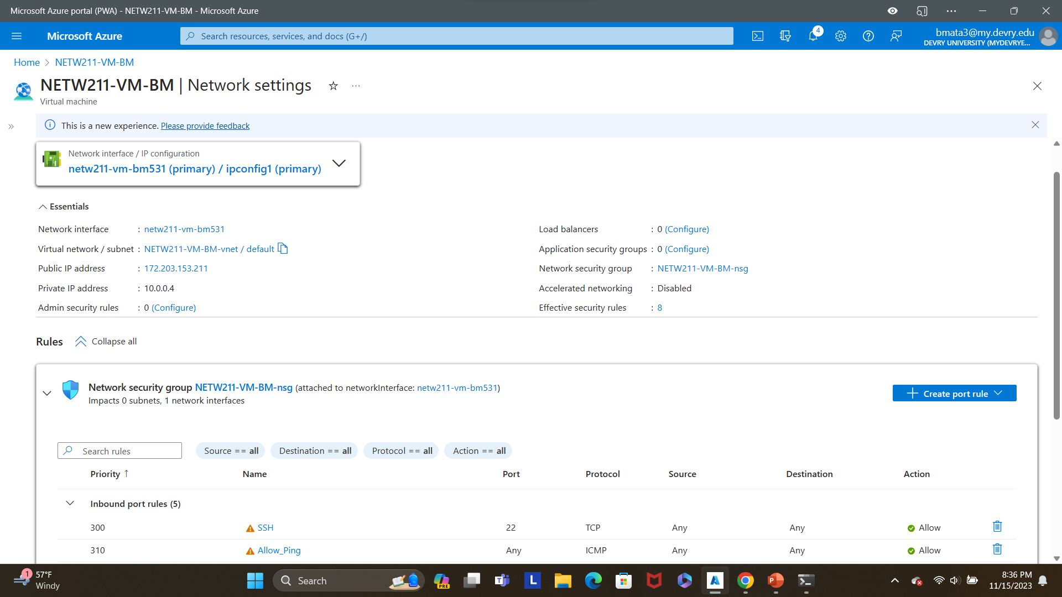
Configuring an NSG 1 of 2
This screenshot should show the Inbound port rules section with the newly added Allow_Ping rule.
This screenshot should also show your DVU email in the top right corner of the Azure Portal.

Slide 18
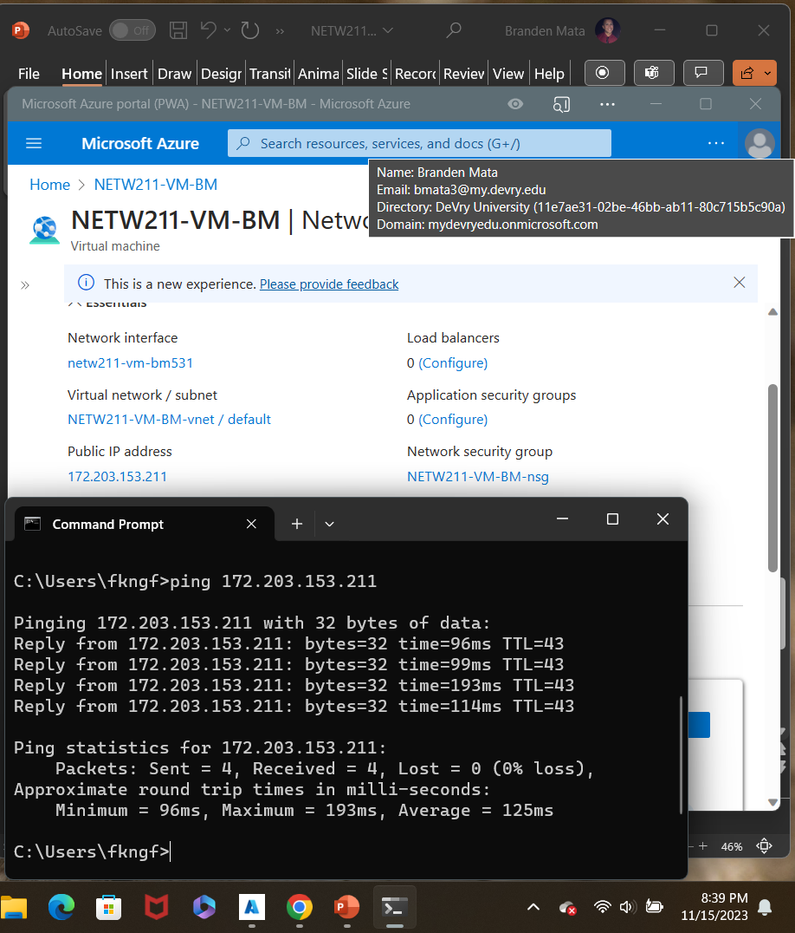
Configuring an NSG 2 of 2
This screenshot should show the successful ping result from your local computer to the VM in the Azure cloud.
Issue the date /t and time /t commands in the same command window to include the system date and time in the screenshot. Use the date command on a Mac computer.

Slide 19

Cloud Storage

Slide 20
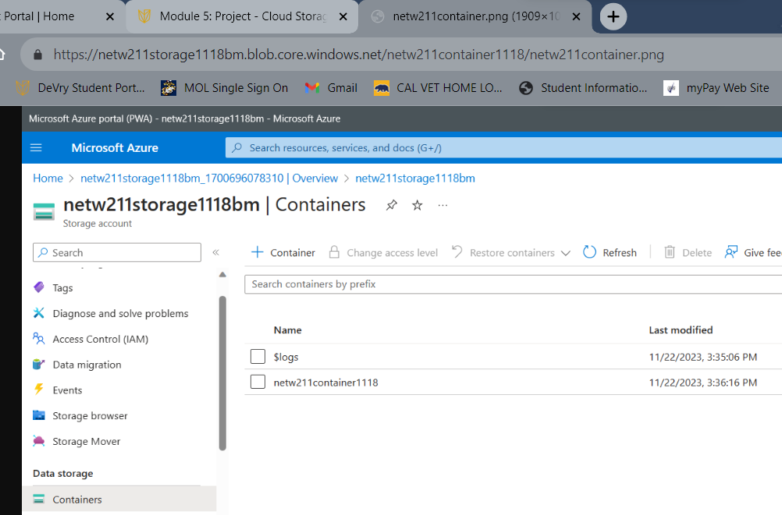
Uploading and Accessing a File
This screenshot should show the browser window with the image uploaded from your local computer and the URL on top of the window.
This screenshot should also show the Last modified property of the uploaded image.

Slide 21
Creating Blob Snapshots 1 of 2
1. What does the access tier setting do? What are the Azure blob storage access tiers?
[hint: in the Azure portal, on the Upload blob page, under Advanced, click the ? circle above the Access tier box.]
Answer here:
Hot tier - An online tier optimized for storing data that is accessed or modified frequently. The hot tier has the highest storage costs, but the lowest access costs.
Cool tier - An online tier optimized for storing data that is infrequently accessed or modified. Data in the cool tier should be stored for a minimum of 30 days. The cool tier has lower storage costs and higher access costs compared to the hot tier.
Cold tier - An online tier optimized for storing data that is rarely accessed or modified, but still requires fast retrieval. Data in the cold tier should be stored for a minimum of 90 days. The cold tier has lower storage costs and higher access costs compared to the cool tier.
Archive tier - An offline tier optimized for storing data that is rarely accessed, and that has flexible latency requirements, on the order of hours. Data in the archive tier should be stored for a minimum of 180 days.

Slide 22
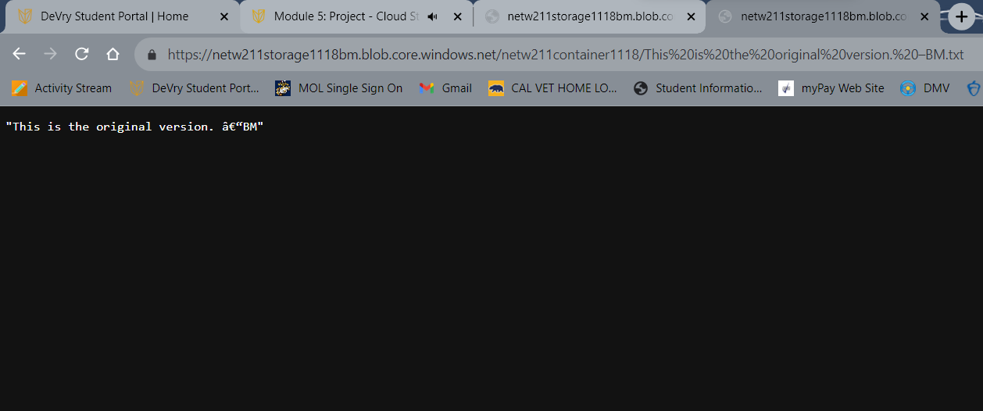
Creating Blob Snapshots
2 of 2
This screenshot should show the browser window with the “This is the original version. –Your Initials” message and the URL on top of the window.

Slide 23
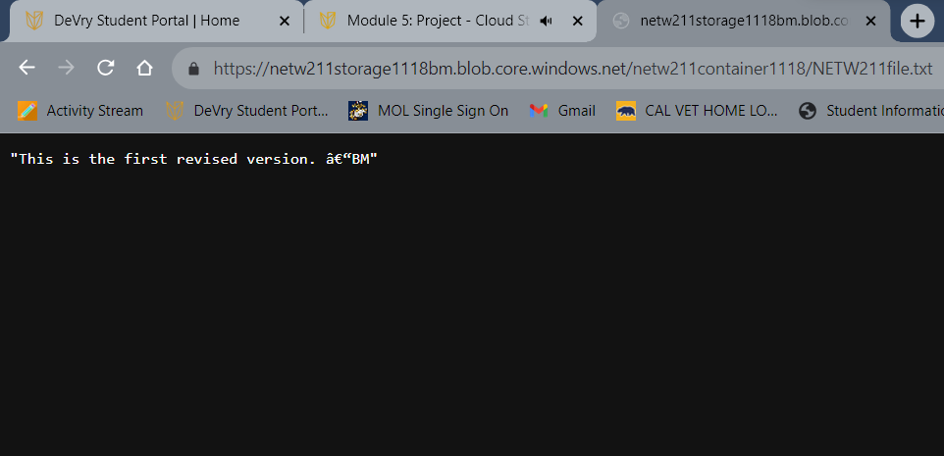
Enabling Blob Versioning
This screenshot should show the browser window with the “This is the first revised version. –Your Initials” message and the URL on top of the window.

Slide 24
Cloud Monitoring

Slide 25
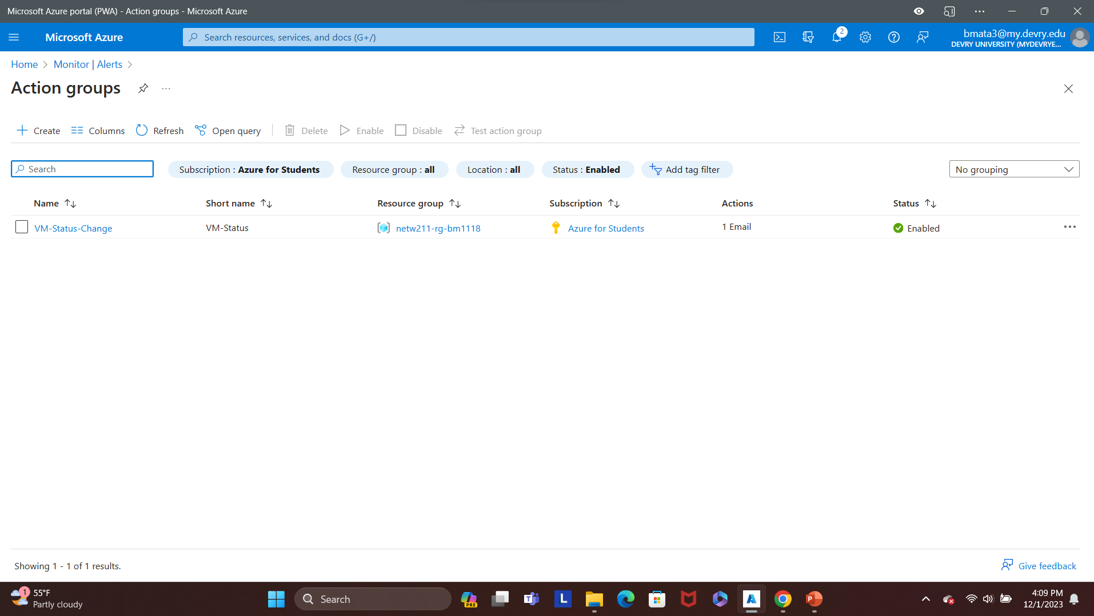
Setting up an Action Group and Notifications
This screenshot should show the “VM-Status-Change” action group on the Manage actions page.
This screenshot should also show your DVU email in the top right corner of the Azure Portal.

Slide 26
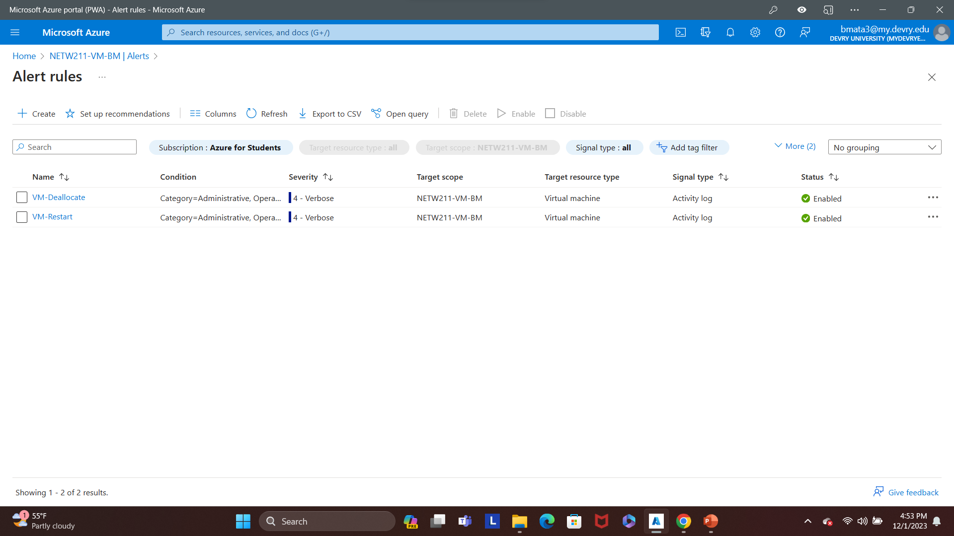
Setting up Alert Rules
This screenshot should show the Alert rules window showing the VM-Deallocate and VM-Restart rules.
This screenshot should also show your DVU email in the top right corner of the Azure Portal.

Slide 27
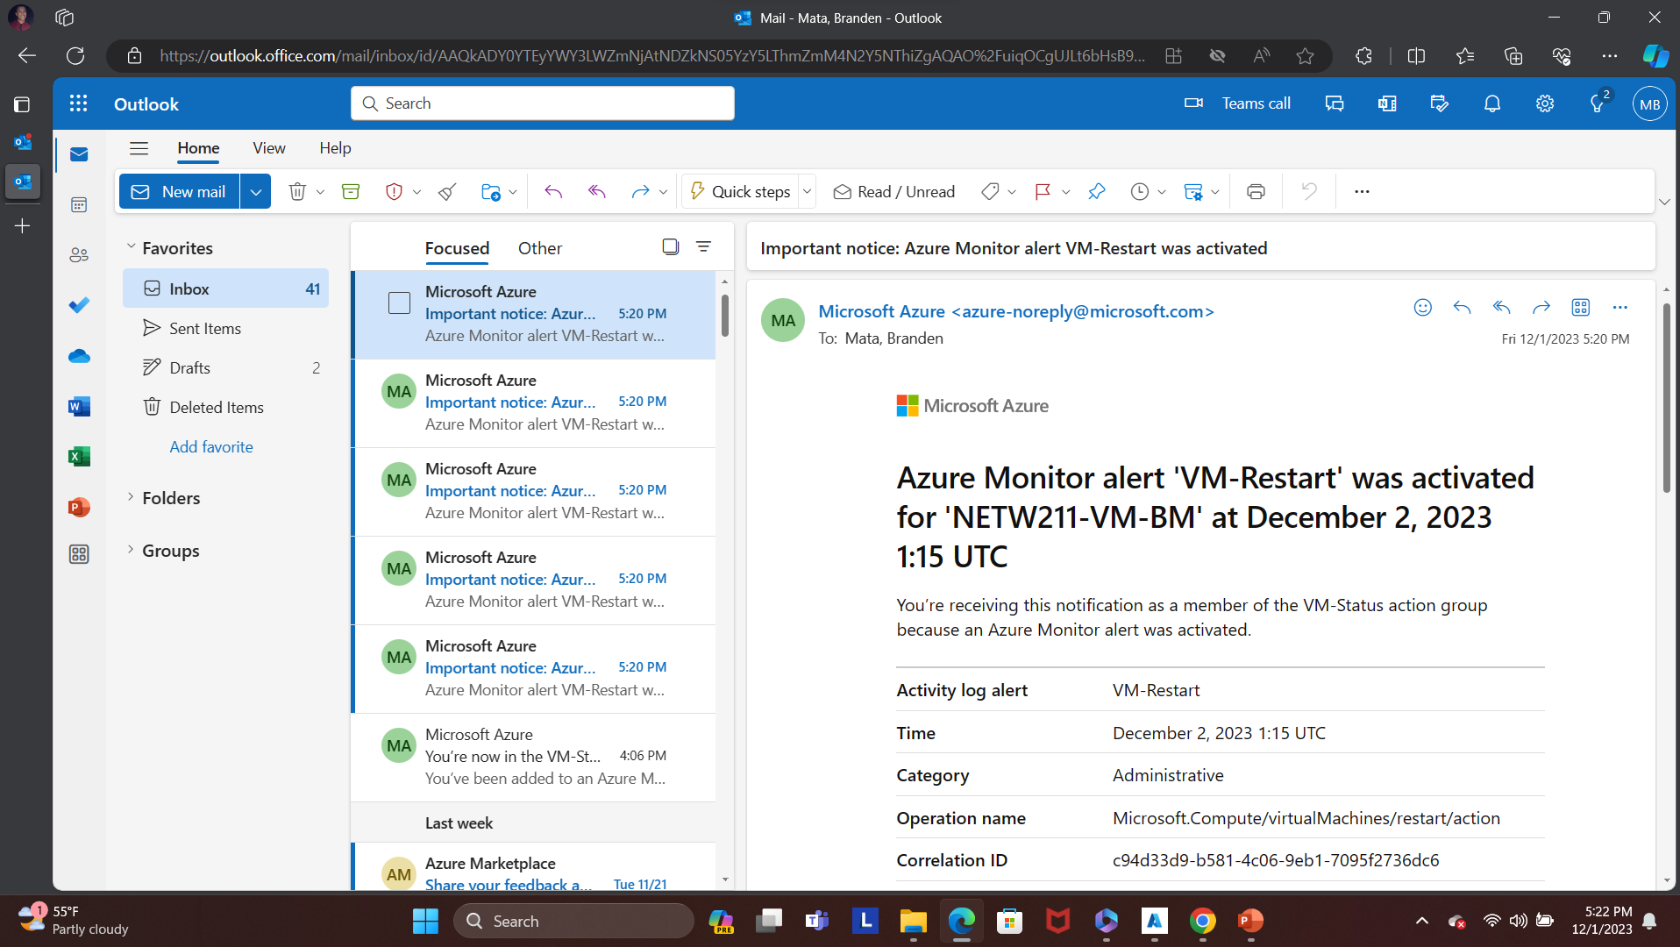
Testing Alerts
1 of 2
This screenshot should show the ‘VM-Restart’ was activated email message with the date and time of the alert.

Slide 28
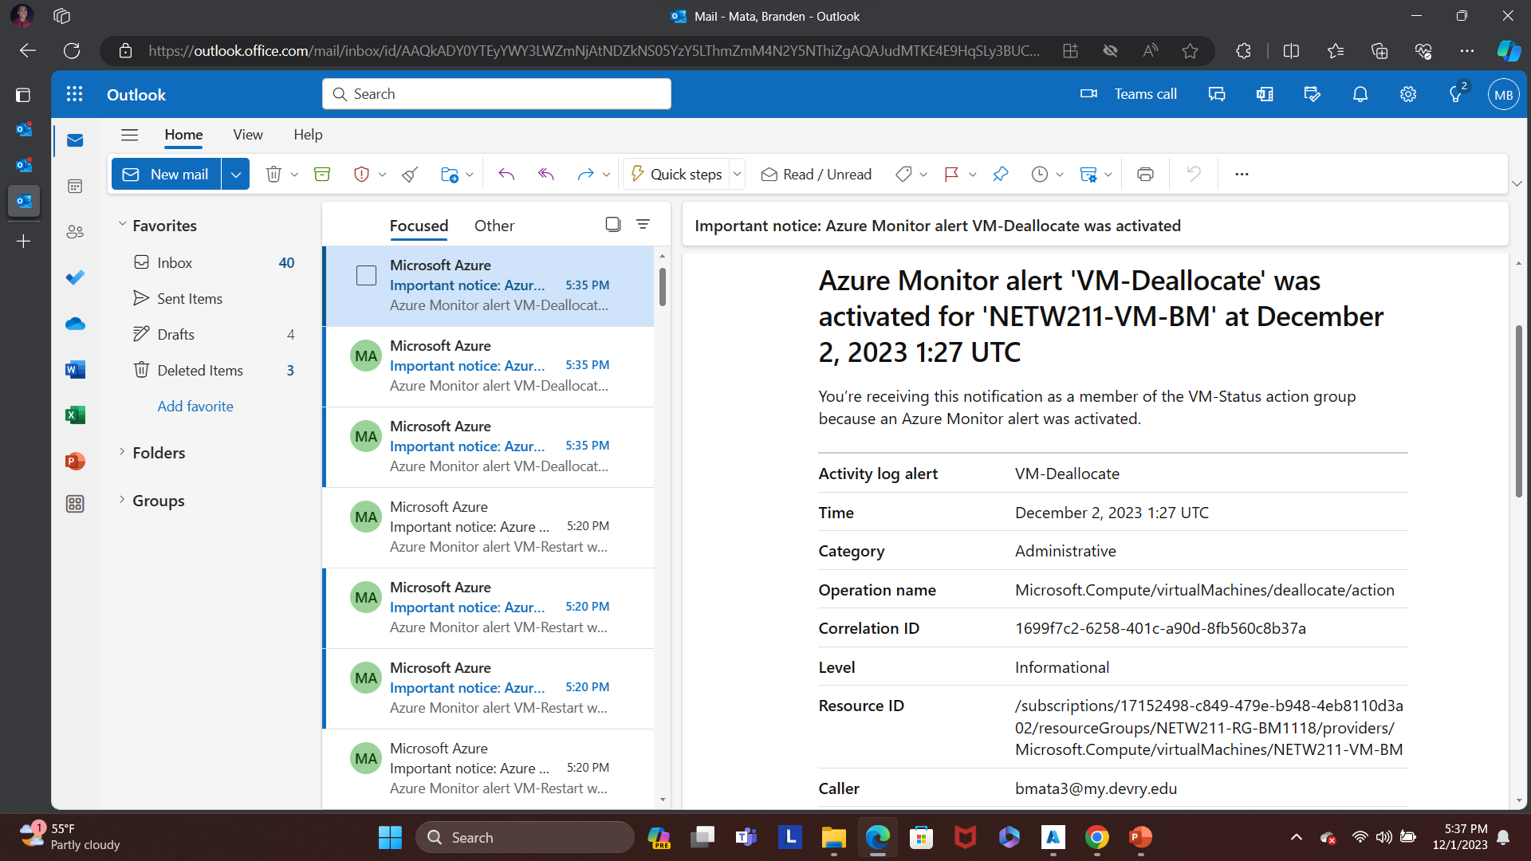
Testing Alerts 2 of 2
This screenshot should show the ‘VM-Deallocate’ was activated email message with the date and time of the alert.

Slide 29
Challenges
Deploying VMs into Subnets
Learning the Azure blob storage access tiers
Creating Blob Snapshots

Slide 30
Career Skills Obtained
Plan a network on a cloud platform utilizing principles of technology
Identify unknown problems utilizing mathematical and scientific methods, software, and/or equipment.
Perform various system tests and experimentation.
Evaluate alternative solutions to problems.
Analyze problems utilizing mathematical and scientific methods, software, and/or equipment.
Demonstrate communication skills in various environments and contexts.
Utilize relevant information and appropriately cite resources to learn, produce, and create.

Slide 31
Conclusion
The Internet of Things is growing exponentially.
New technologies and applications are being developed on a regular basis.
It is important to stay current with the skills required for this evolving job market.

Slide 32
References
Module 2,3,4,5,6 Project Videos
Course Project Rubric
Hot, Cool, and Archive access tiers for blob data, https://docs.microsoft.com/en-us/azure/storage/blobs/access-tiers-overview
Azure Blob Storage Access Tiers, https://devry.percipio.com/courses/c7ef0333-8560-403f-a004-9c5c843866b0/videos/2658bbe6-ee97-438b-a376-fbb079c3b3a0
IP Subnet Calculator, https://www.calculator.net/ip-subnet-calculator.html
Azure Virtual Network frequently asked questions, https://docs.microsoft.com/en-us/azure/virtual-network/virtual-networks-faq

