Slide 1

CEIS101 Course Project Smart Home automation And Security System
Presented By: Branden Mata

Slide 2
Introduction
Develop a smart home automation and security system by:
Designing the prototype in Tinkercad
Building the hardware with Tech Core Kit
Programming within Arduino IDE
The smart home system will encompass various devices to monitor the home:
Door sensor to check whether the door is open or closed
Distance sensor to monitor for a possible home intruder
Automated lights that turn on when it is dark
Water level sensor to monitor for possible flooding
Temperature and humidity sensor to monitor the weather conditions

Slide 3

Circuit Simulation In Tinkercad

Slide 4
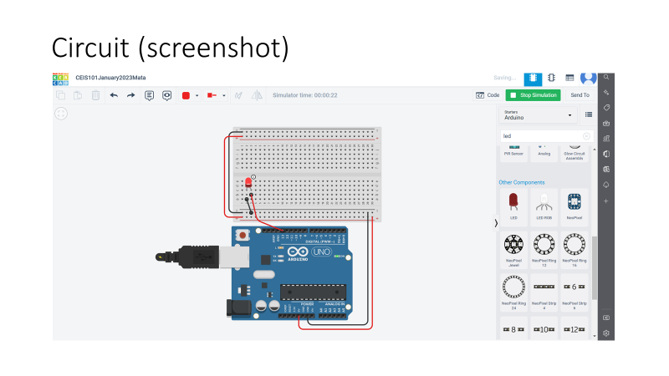

Slide 5
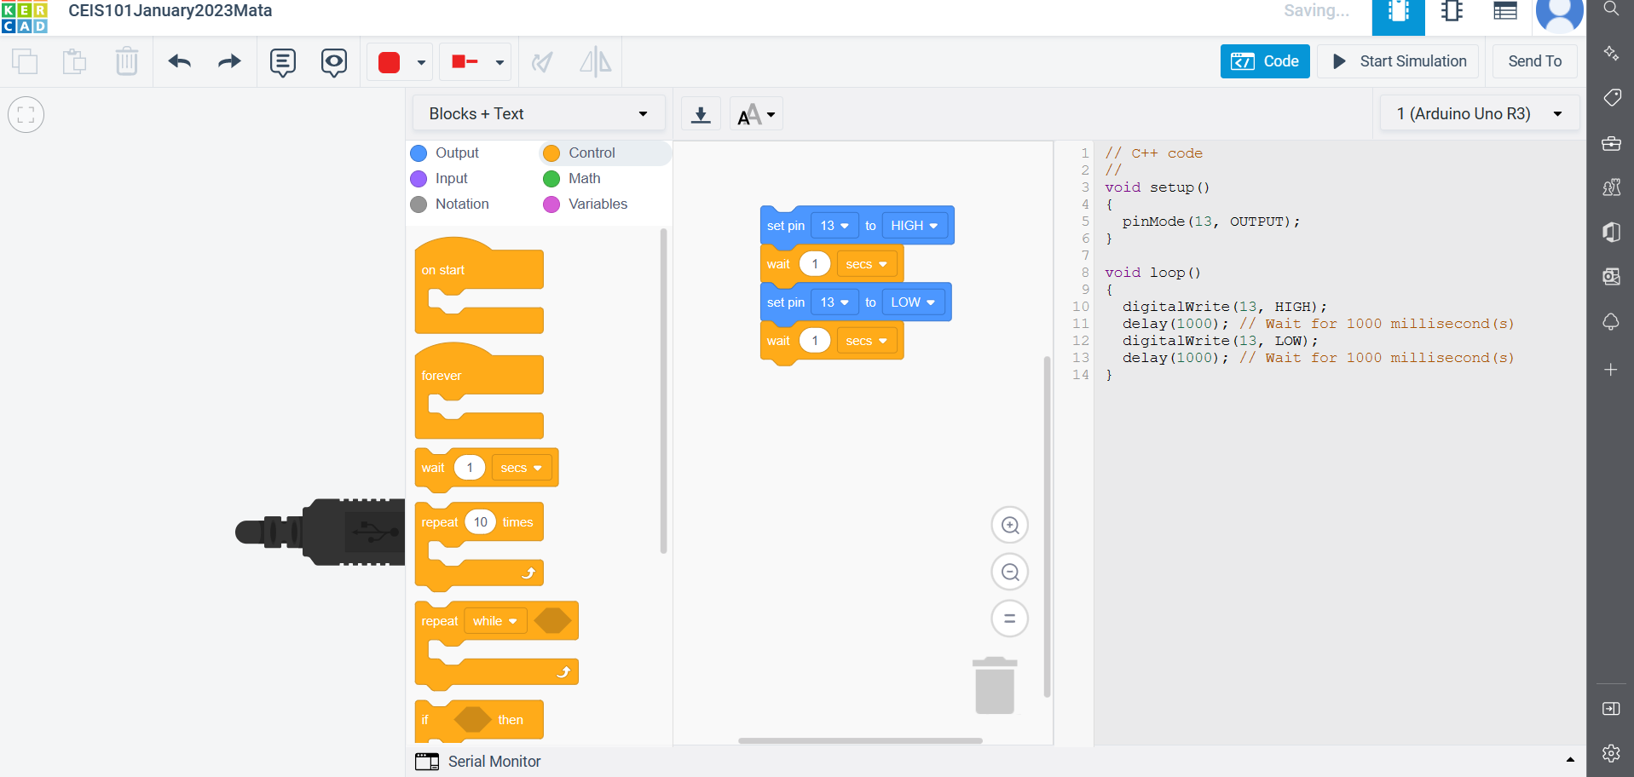
Code (screenshot)

Slide 6
Inventory Of parts, circuit building, and displaying messages

Slide 7
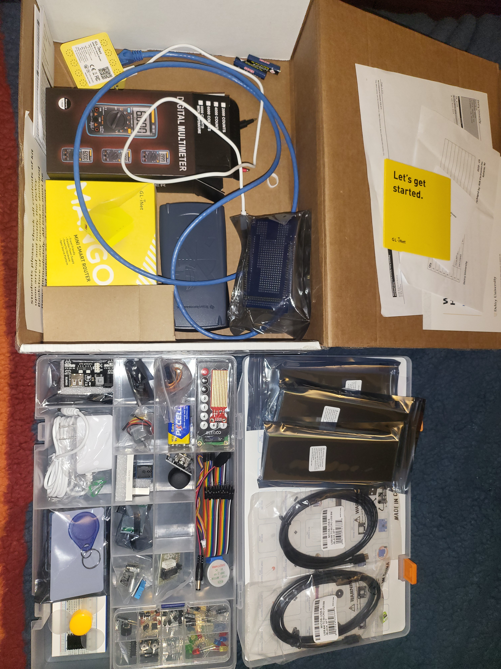
Inventory of IOT KIT (Picture)
Uctronics Kit
ESP32 (2)
LCD Modules (2)
Breadboards (3)
Mini Router
Patch Cable
Digital Multi Meter
USB to Micro USB (2)

Slide 8
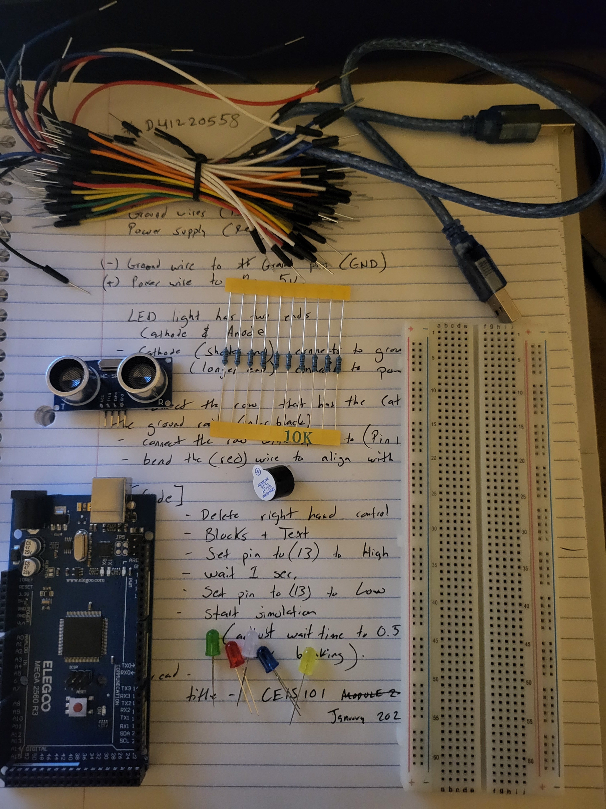
Organization of project components (Picture)
Arduino Mega 2560
Breadboard
Resistor 10kΩ
LEDs
Ultrasonic Sensor
Passive Buzzer
Photoresistor
Wires
USB Type B cable

Slide 9
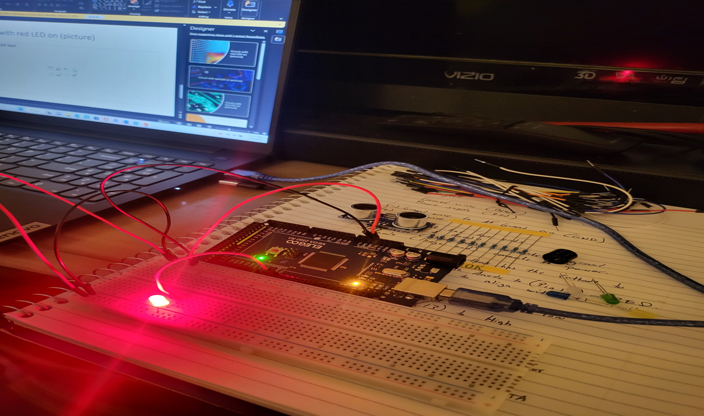
Circuit With Red on (Picture)

Slide 10
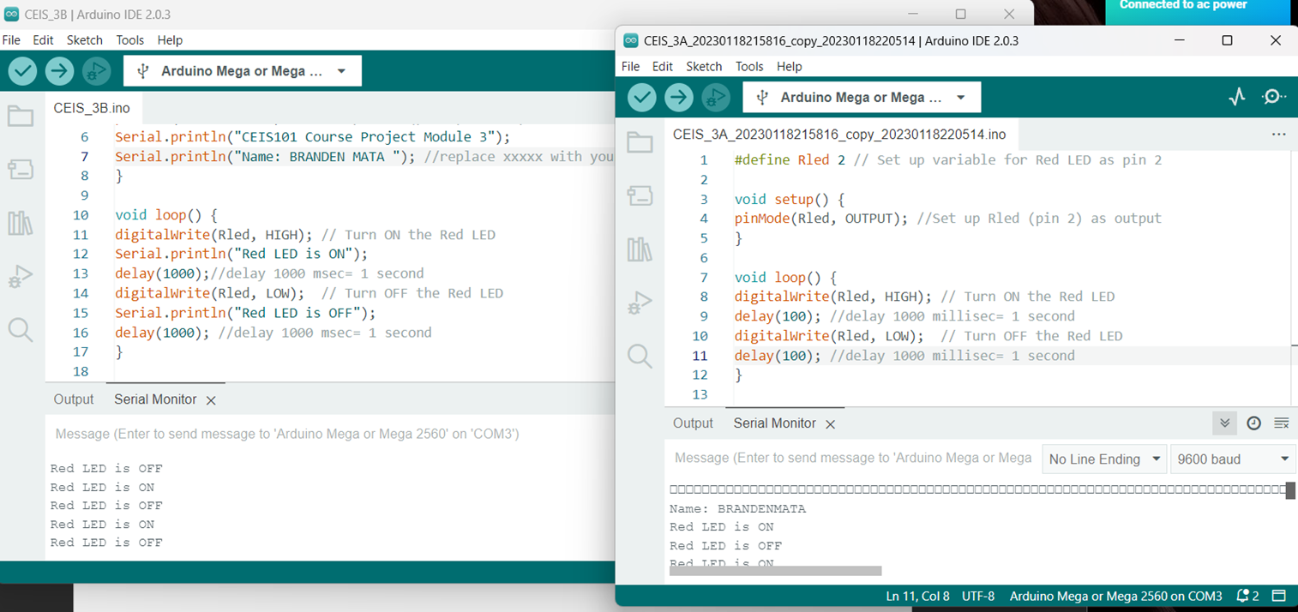
Serial Monitor (Screenshot)

Slide 11
Adding Door sensor to smart home system

Slide 12
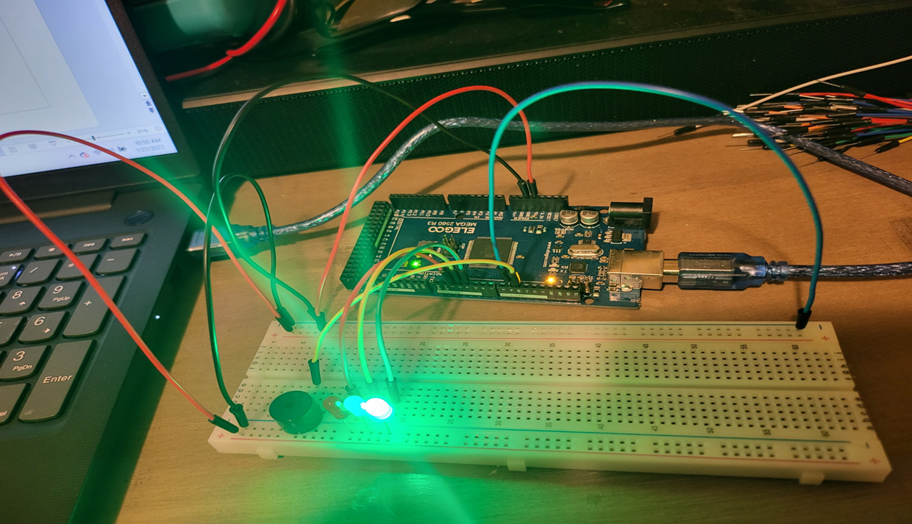
Circuit of door closed with Green LED ON (picture)

Slide 13
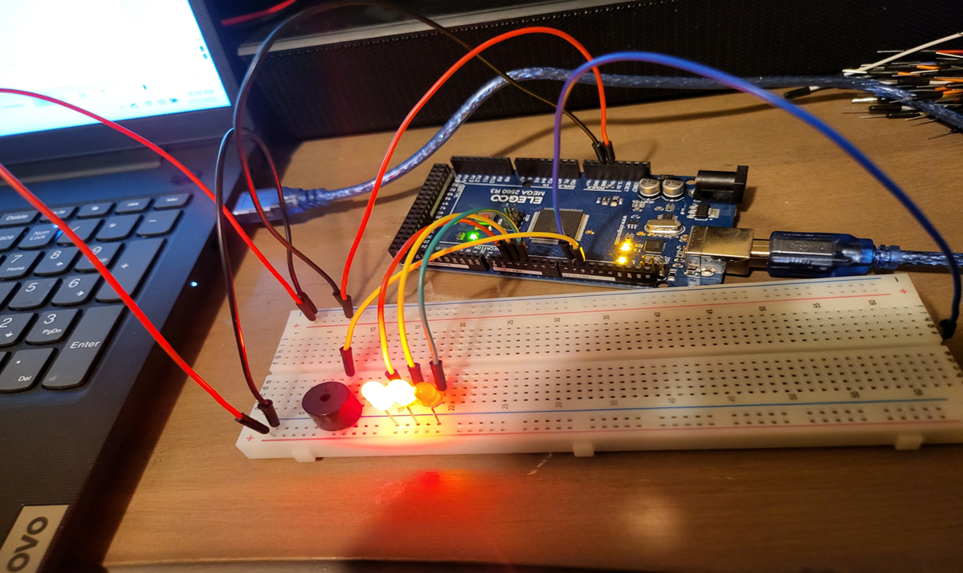
Circuit of door open with Green LED OFF (picture)

Slide 14
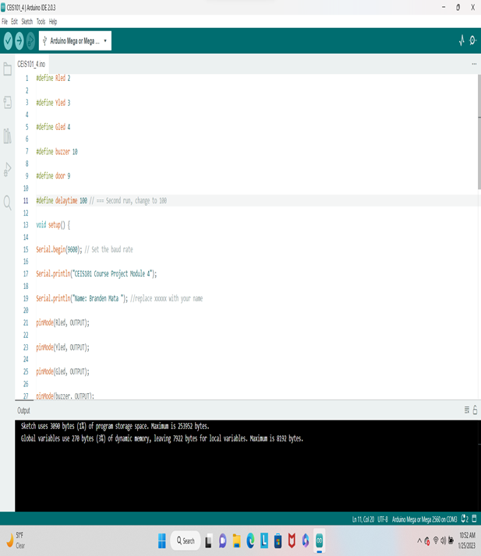
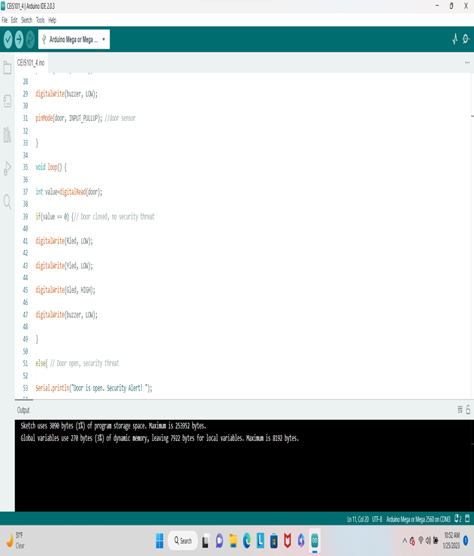
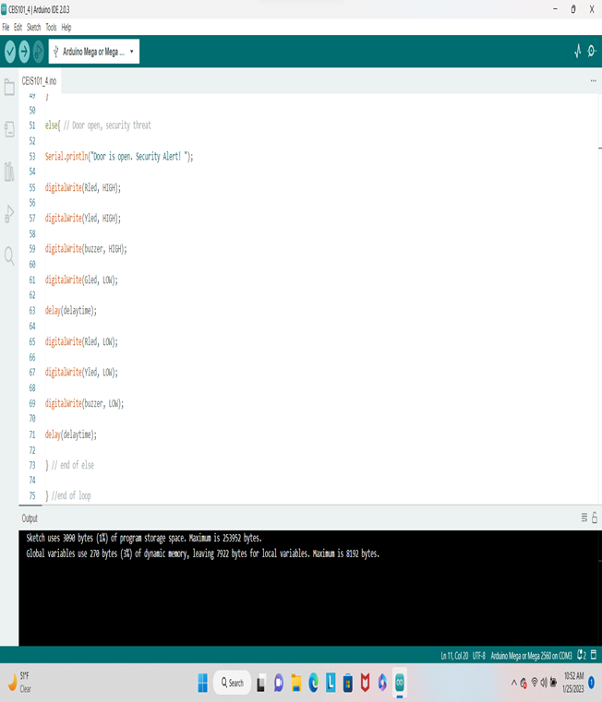
Arduino code (screenshots)

Slide 15
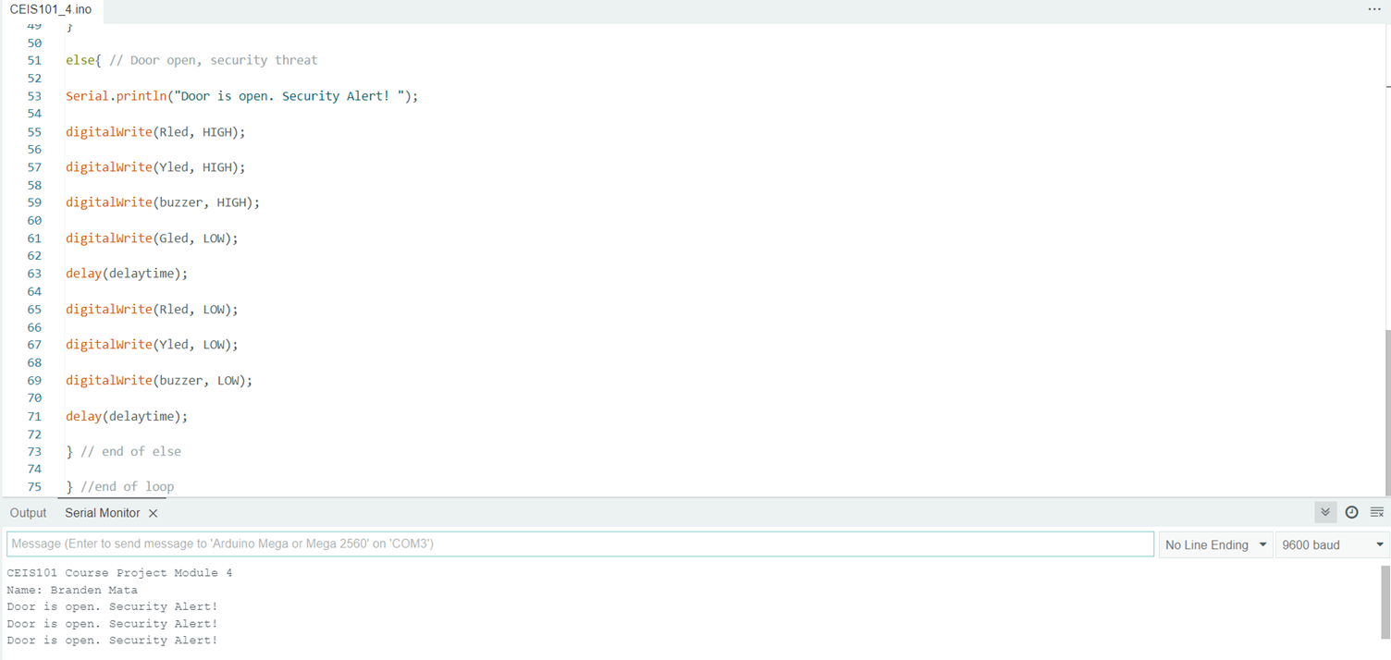
Serial Monitor (screenshot)

Slide 16
Adding Distance Sensor to Smart Home System and Conducting Data Analysis

Slide 17
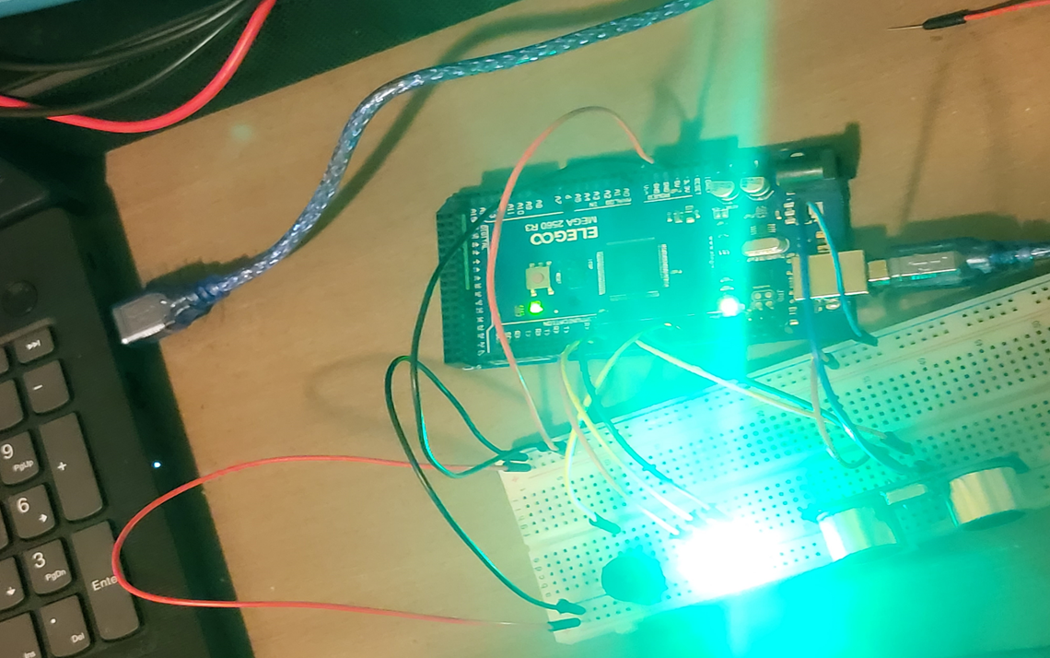
Circuit with green LED on (picture)

Slide 18
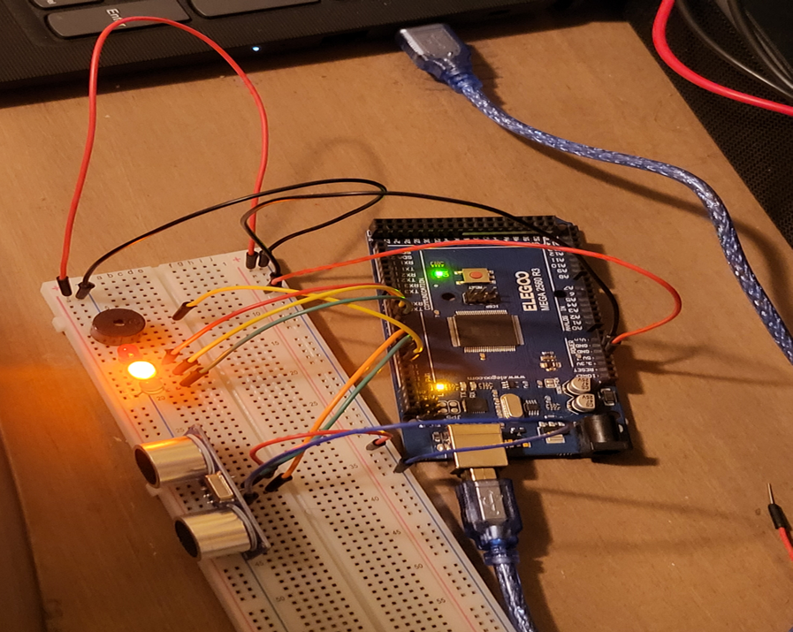
Circuit with yellow LED on (picture)

Slide 19
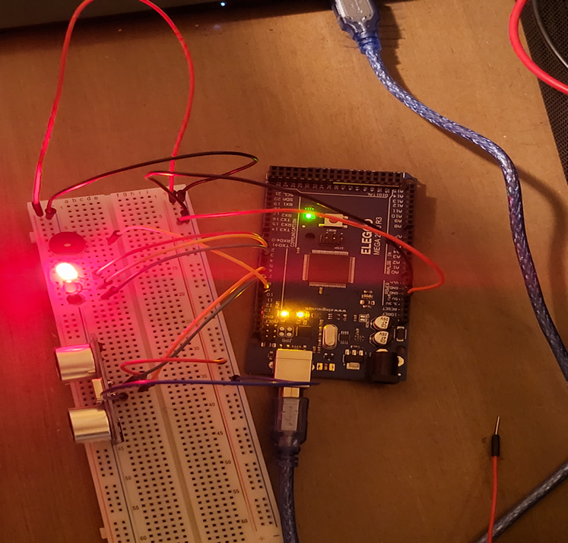
Circuit with red LED on (picture)

Slide 20
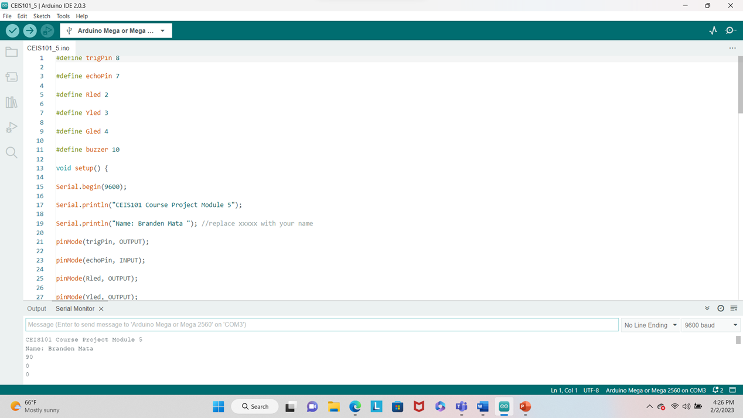
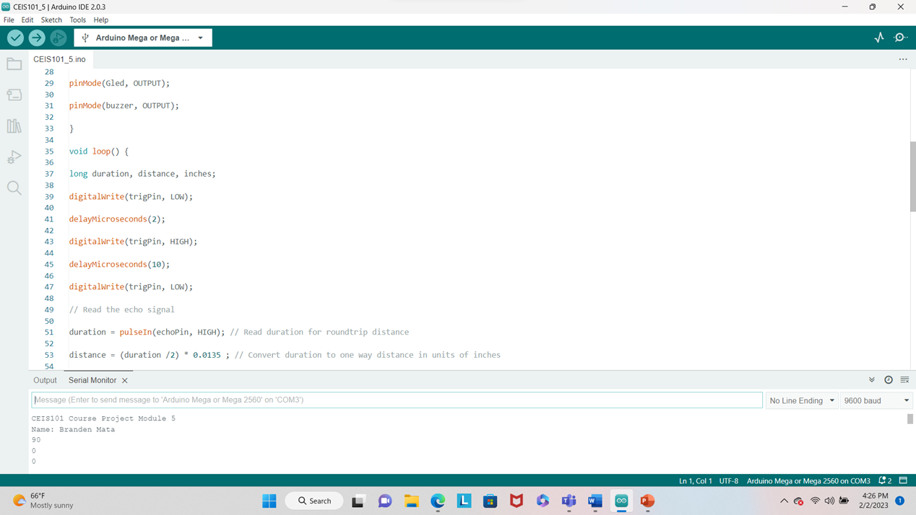
Arduino Code (screenshots)

Slide 21
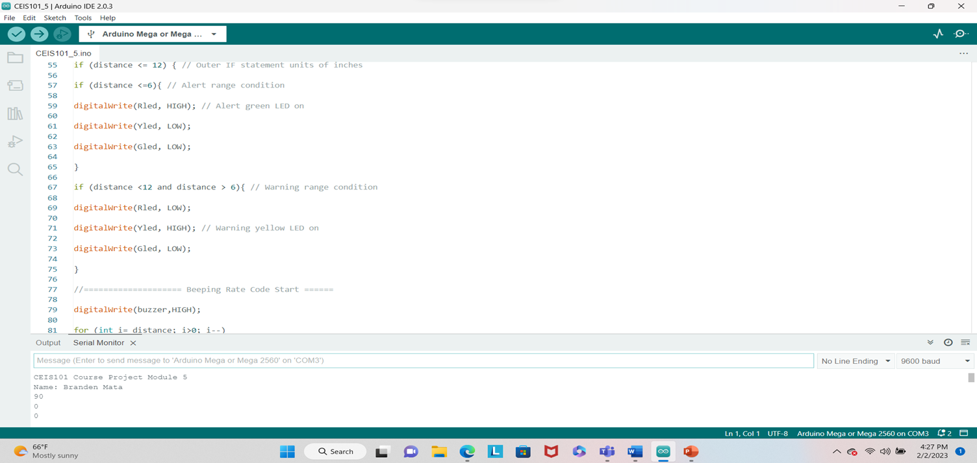
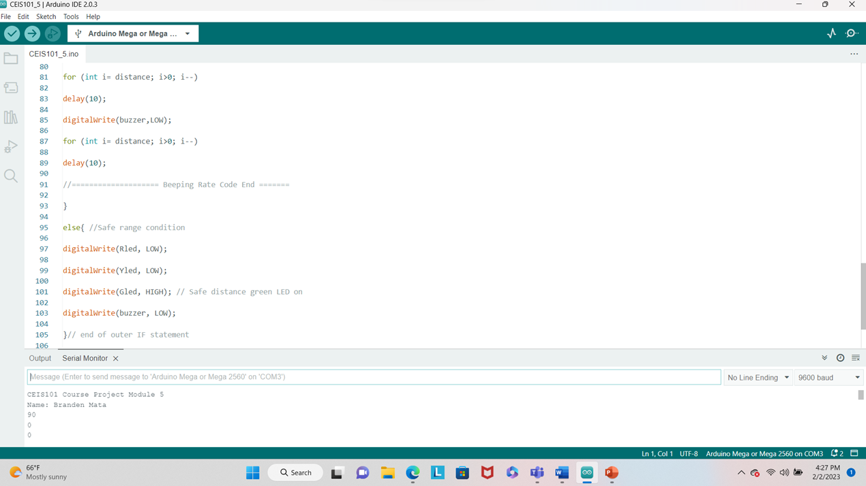
Arduino Code (screenshots)

Slide 22
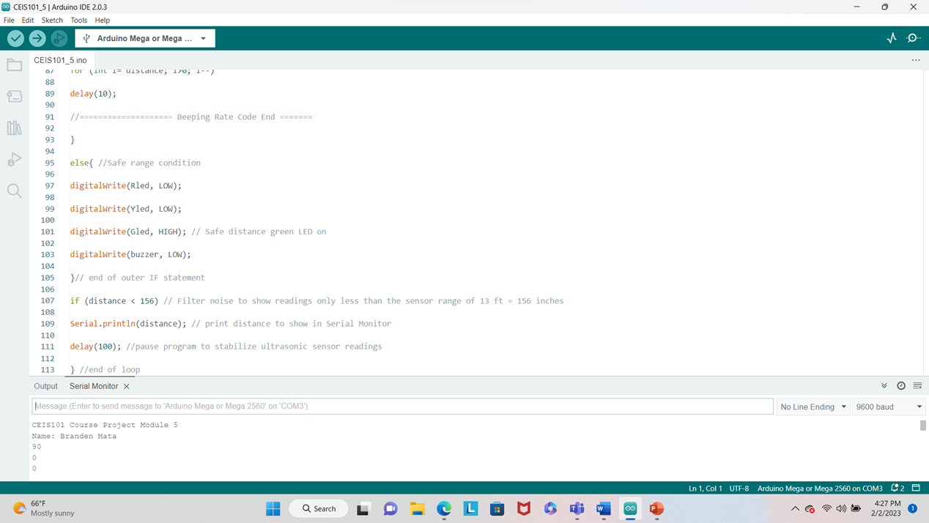
Arduino Code (screenshots)

Slide 23
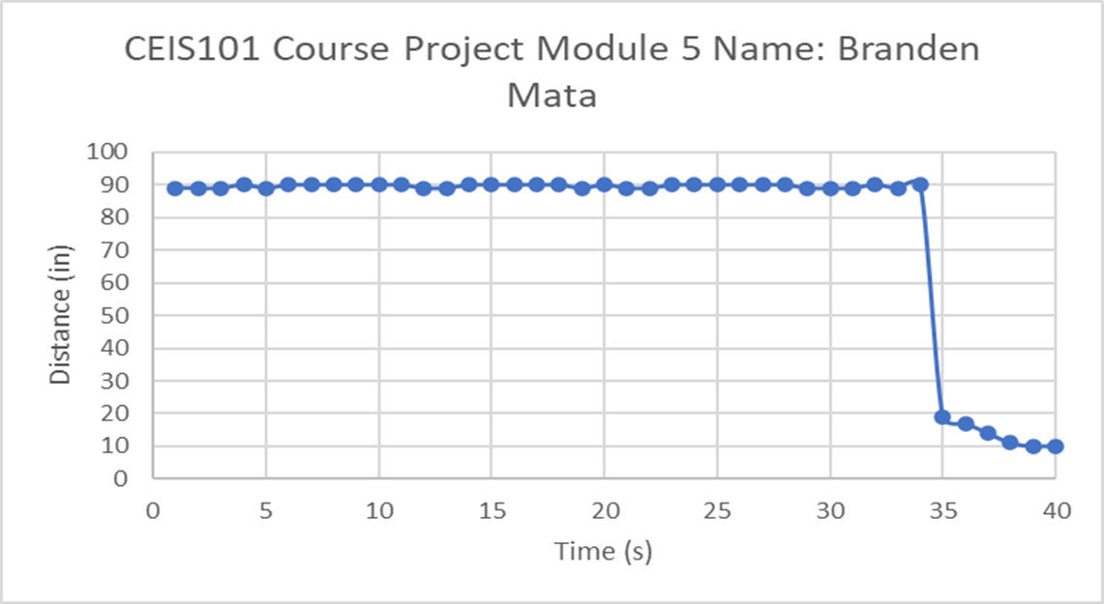
Plot of data (graph from Excel)

Slide 24
Adding Automated Light to Smart Home System

Slide 25
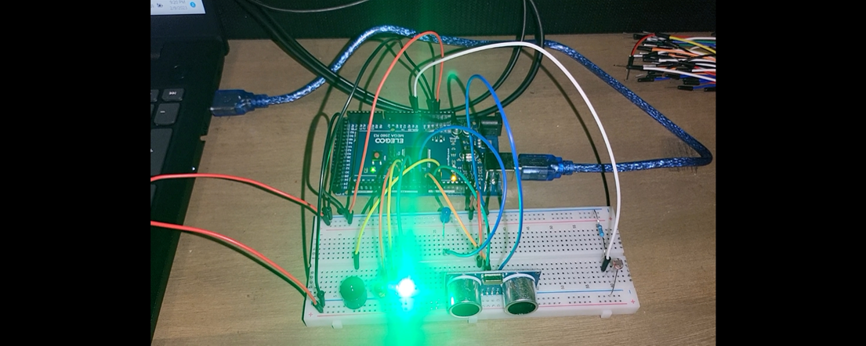
Circuit with automated LED off (picture)

Slide 26
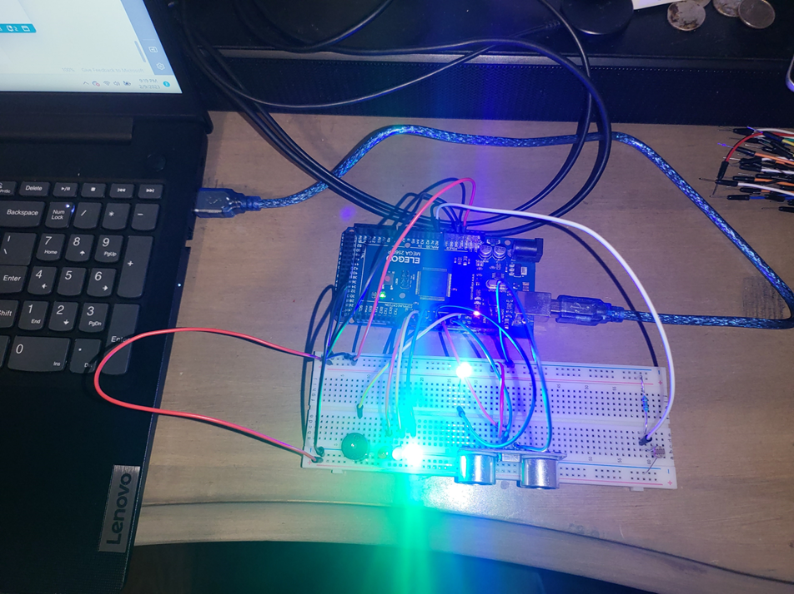
Circuit with automated LED on (picture)

Slide 27
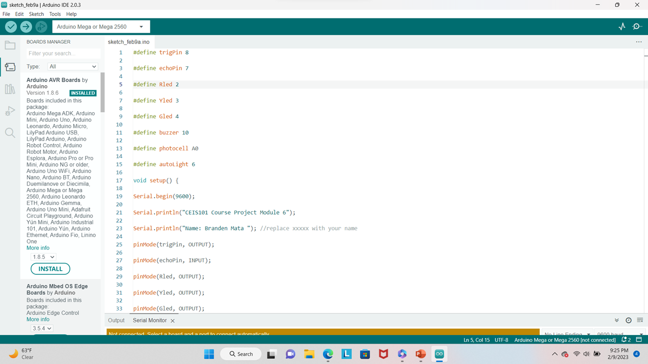
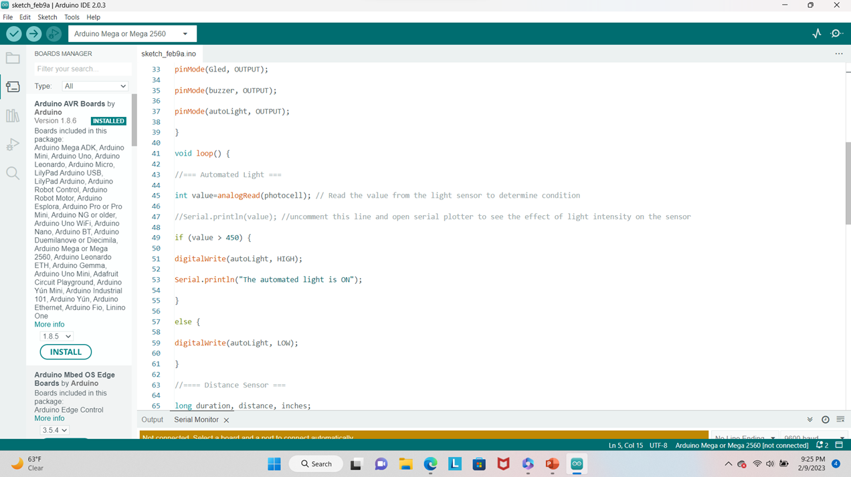
Arduino Code (screenshots)

Slide 28
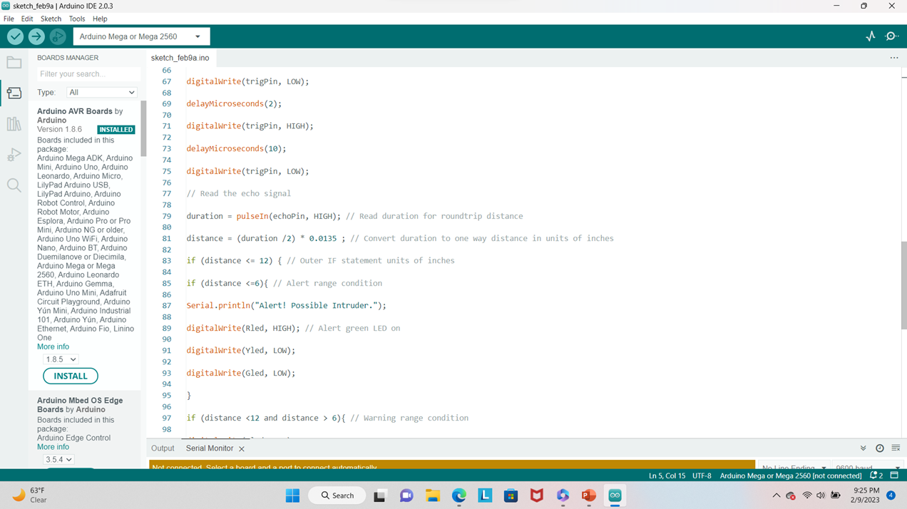
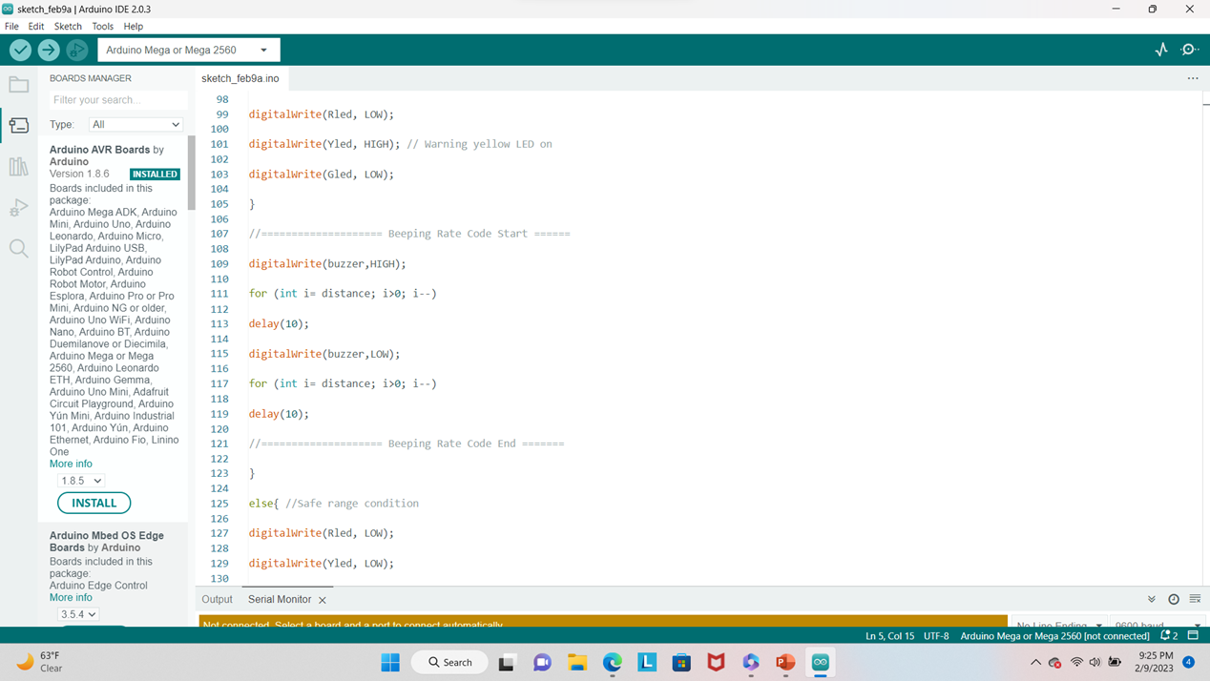
Arduino Code (screenshots)

Slide 29
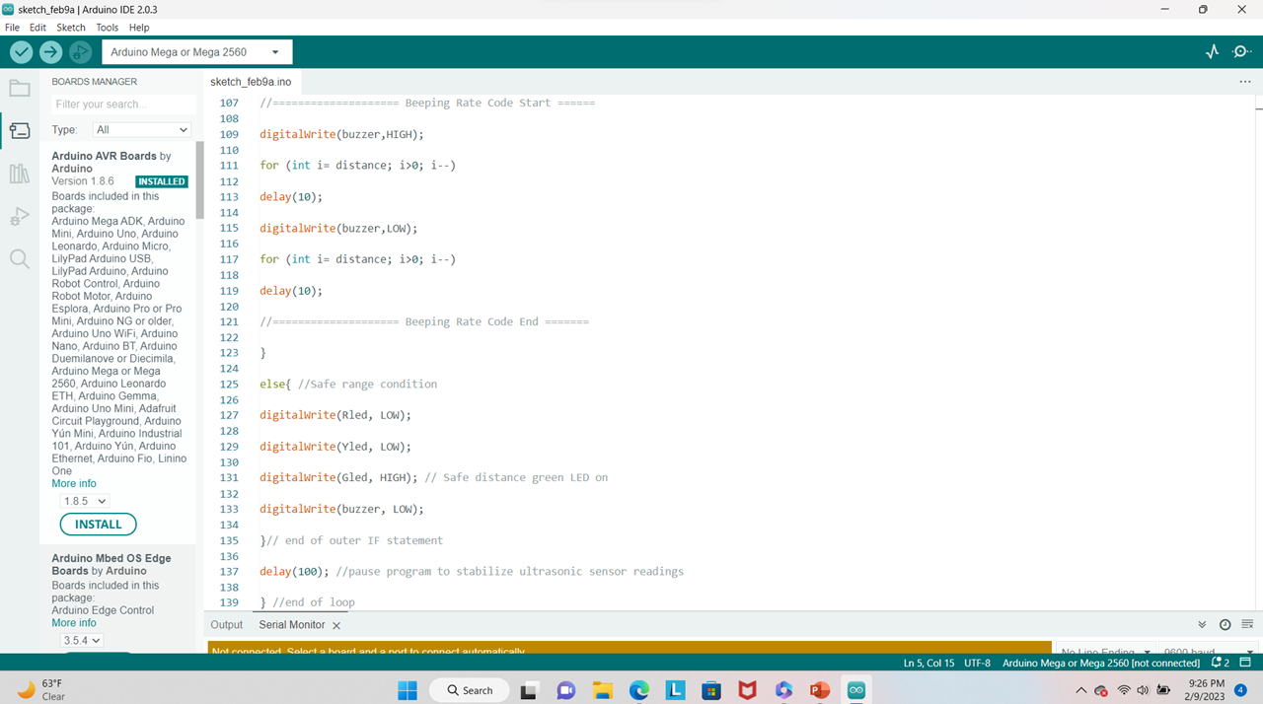
Arduino Code (screenshots)

Slide 30
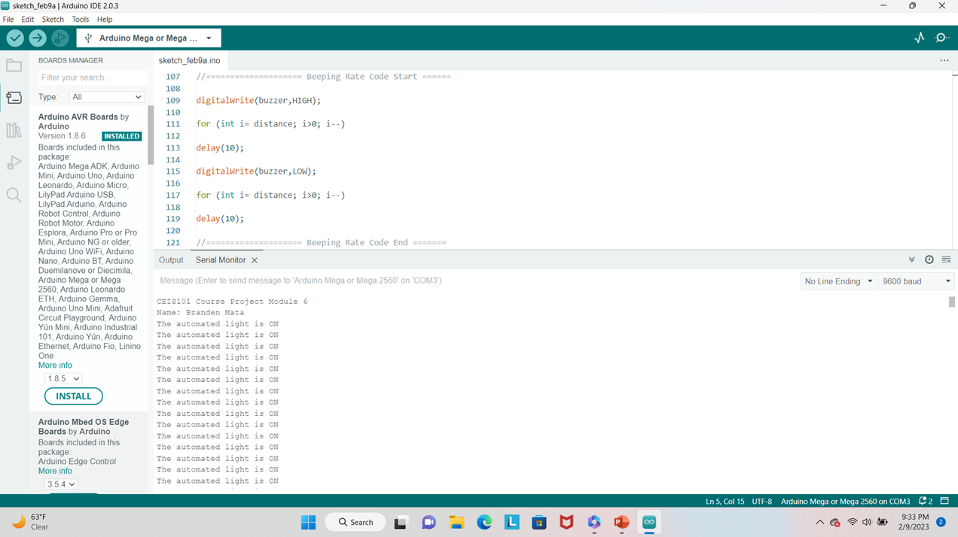
Serial Monitor (screenshot)

Slide 31
Adding water level sensor And DHT-11 Sensor to smart home security system

Slide 32
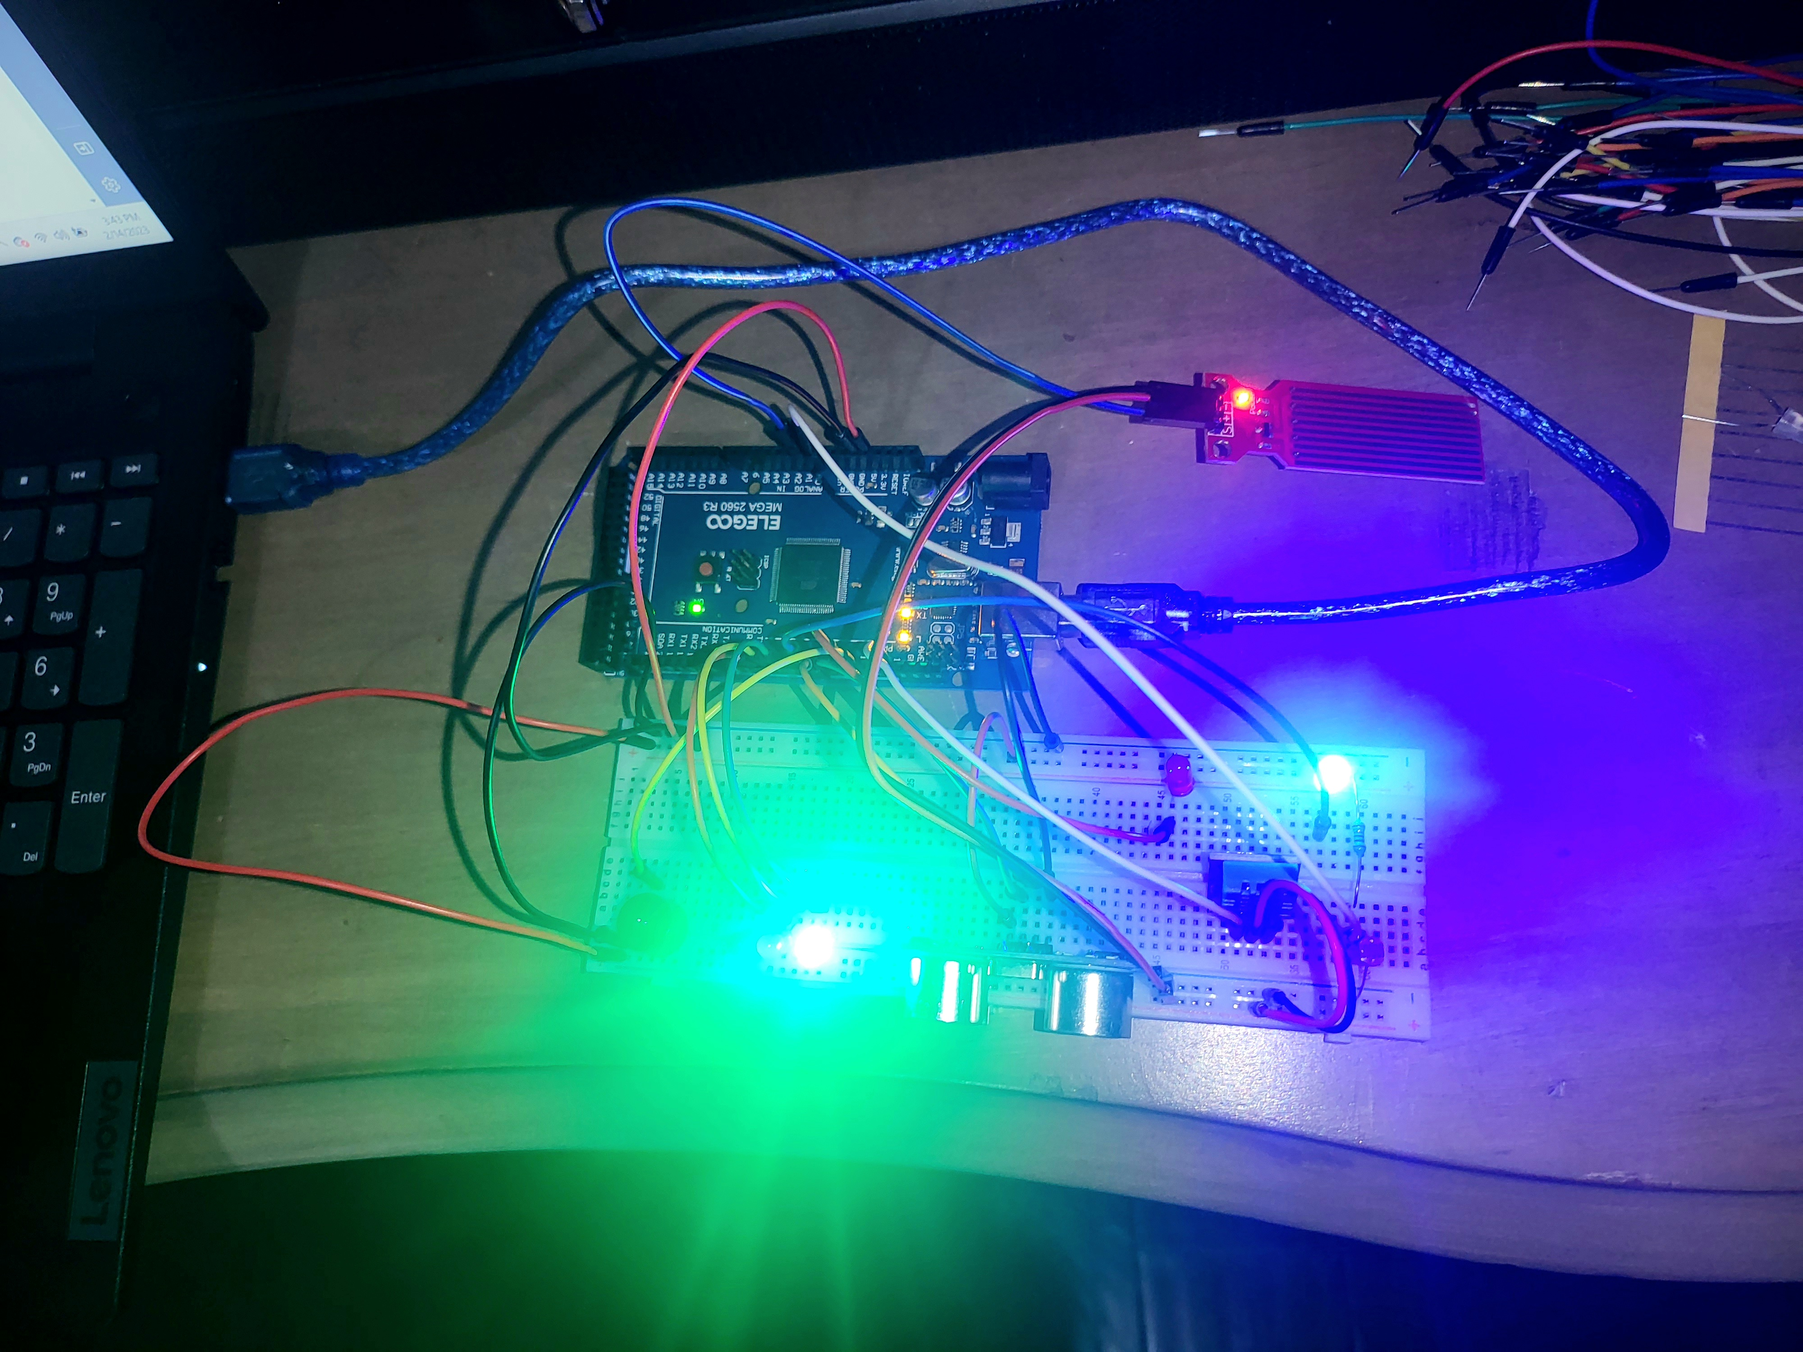
Circuit (Picture)

Slide 33
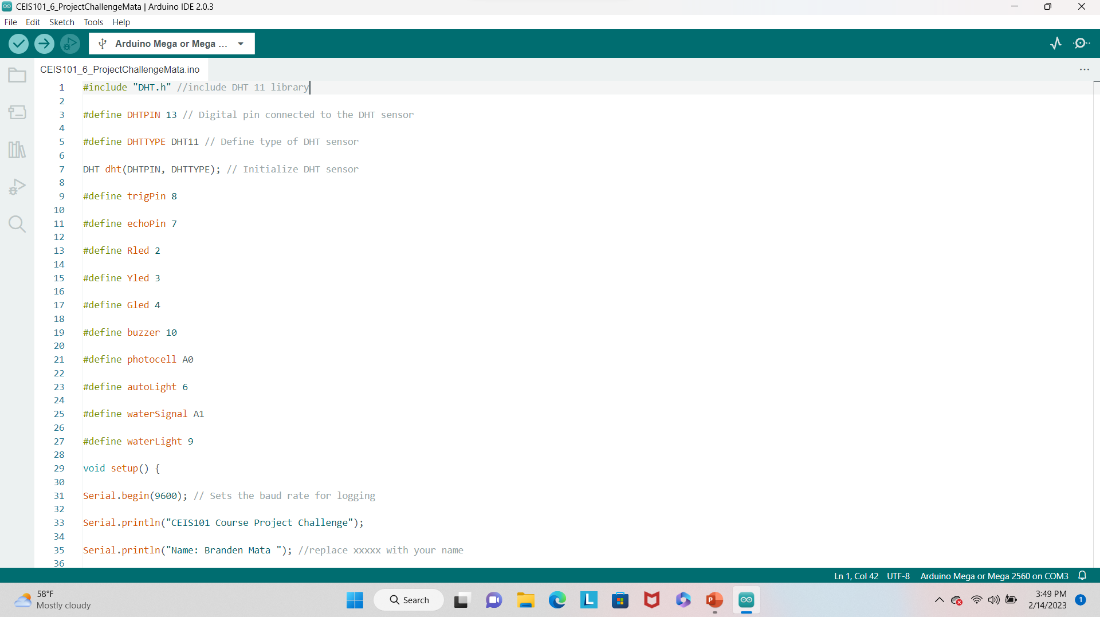
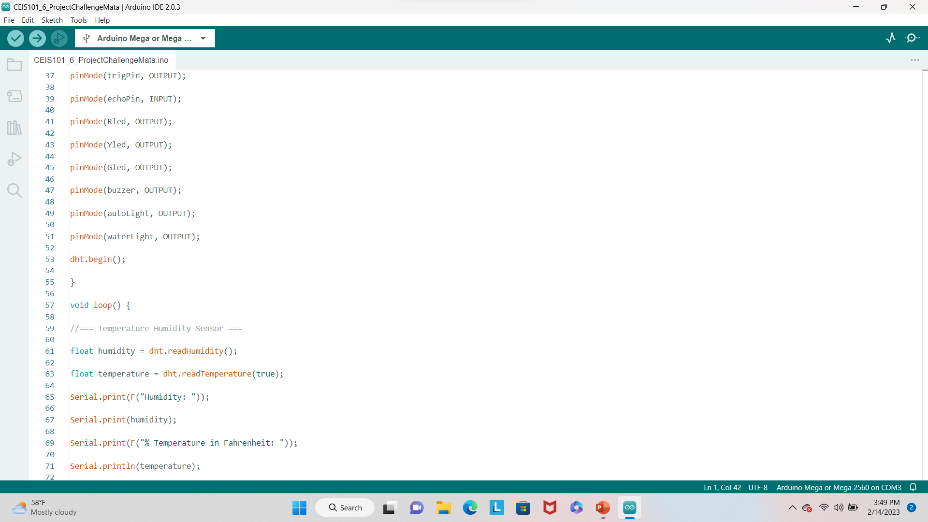
Arduino Code (screenshots)

Slide 34
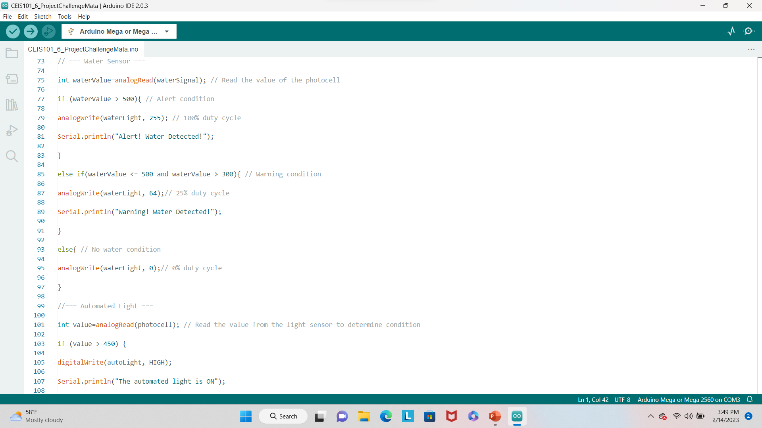
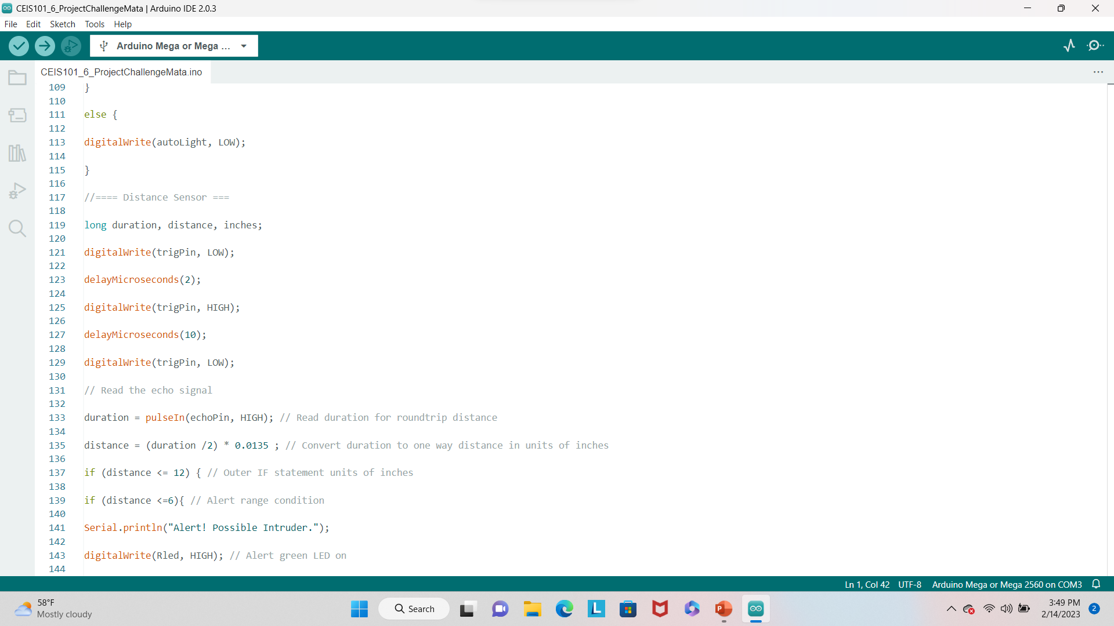
Arduino Code (screenshots)

Slide 35
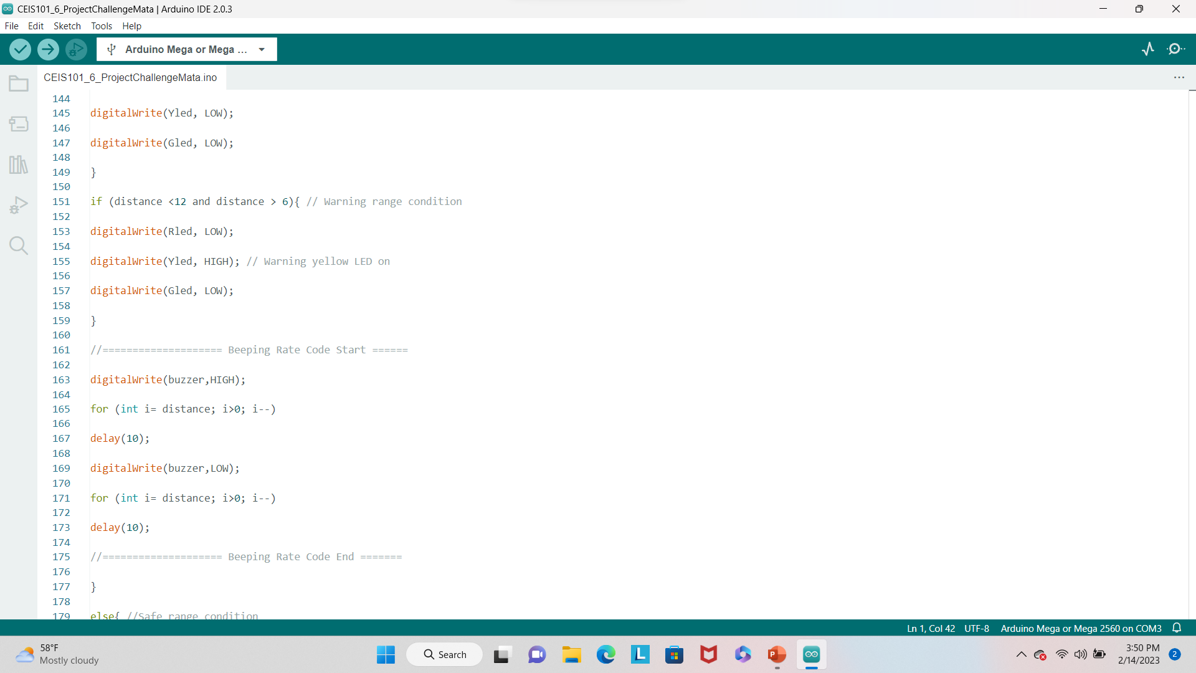
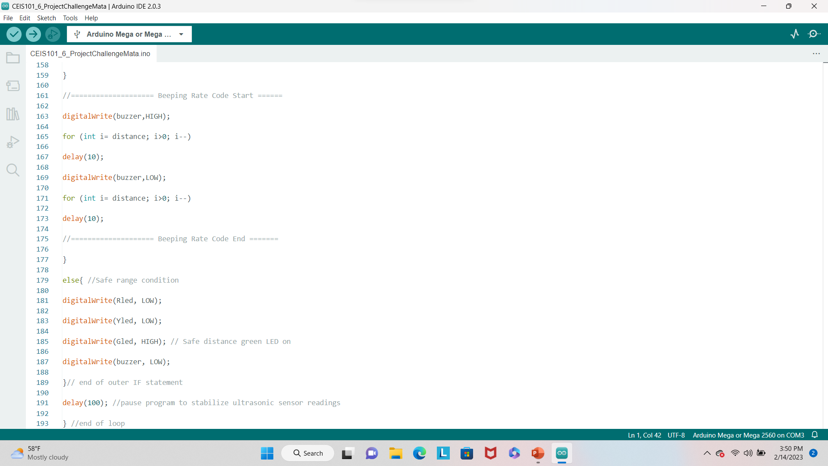
Arduino Code (screenshots)

Slide 36
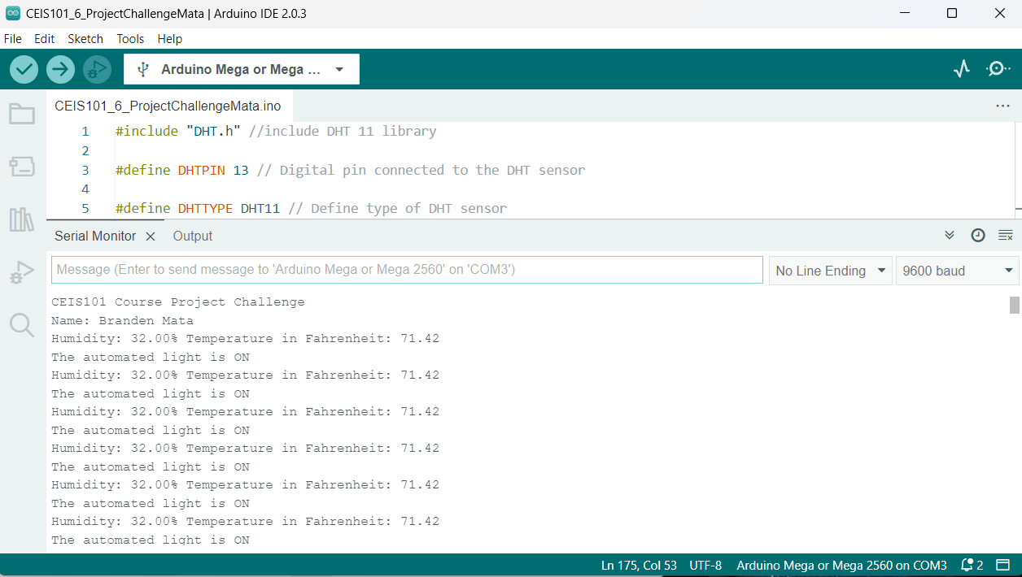
Serial monitor (screenshot)

Slide 37
Challenges
Some of the challenges that came up are:
Trying to find the 5V pin and ground pin on the DTH11 sensor because they are not labeled.
I had a wire disconnect from the mega board 2560 pin 7 and I didn’t realize until I went over my notes to see why the distance sensor wasn’t working properly.
Receiving a “nan” message for my temperature and humidity sensor until I downloaded and included Adafruit to my library.

Slide 38
Career skills acquired
Coding/programming
Understanding of the IoT
Automation
Networking/connectivity ability
Operating system fundamentals
Security Awareness (at a minimum)
Basic business intelligence and data analytic knowledge
Hardware/device knowledge

Slide 39
conclusion
This project was beyond a reasonable doubt the greatest time I’ve had learning about the expanding world of IoT.
In this project, I had to follow many different steps to create a Home Security system.
I feel like I have a great basic understanding of the pin of the Arduino Mega Board and the ESP32 Board and how to connect them the right way and I’m one step closer to my career.
I l

Slide 40

Thank You
bmata3@my.devry.edu

