Slide 1


PHYS204
Final Course Project
Branden Mata
Bachelor of Science,
Information Technology & Networking,
DeVry University
Professor Adib
October 26th, 2024

Slide 2
Introduction
The best way to learn physics is to do physics. Not only does this teach the physical principles behind the workings of the universe, but also it helps solve complex logical problems.
This course project is based on the scientific method and is divided into six parts. Each deliverable builds from the previous resulting in a full scientific experiment. The development process of the project includes critical thinking, hardware setup, and programming.
The tools used: Ultrasonic Sensor HC-SR04, Rotary Encoder KY-040, Hall Effect Sensor in ESP32, Snipping Tool, and Microsoft Excel.

Slide 3
PHYS204
Project Part 1
Inventory of Parts and Software
Branden Mata

Slide 4
Ultrasonic Sensor HC-SR04
Describe the working principles of ultrasonic sensors in detail.
  Answer:
  The ultrasonic sensor is an electronic device with two transducers that are used to detect an object within its range. The range of the sensor is from 3 cm to 3 m. When activated, one transducer sends a burst of ultrasounds by converting electric pulses into sound waves emitting them with frequency 40kHz above the human hearing threshold. The other transducer other listens for the echo of the ultrasounds to bounce off an obstacle and come back. The sensor measures the round-trip time between the outburst of ultrasound and the reception of the echo. With the known round-trip times and speed of sound, the ultrasonic device can measure the distance that the sound traveled. The ultrasonic sensor in my IoT kit has four pins. The Vcc pin is the operating voltage pin and the GND pin is the ground pin. The Trig pin is used to trigger the outgoing ultrasonic burst and the Echo pin is used to detect the returning echo from a nearby obstacle.

Slide 5
Rotary Encoder KY-040
Describe the working principles of rotary encoders in detail.
  Answer:
  The rotary encoder is an electro-mechanical device that generates an electrical signal according to rotational movement. There are many different types of rotary encoders but the one in my IoT kit is an incremental rotary encoder with five pins that generates a series of square wave pulses. The encoder has a disk with evenly spaced contact zones that are connected to the common pin SW (switch) and two other separate contact pins CLK (clock) and DT (data). As the disk rotates, pins CLK and DT will make on and off contact the common SW pin and two square wave output signals will be generated accordingly. The + pin is the operating voltage pin and the GND pin is the ground pin. If the encoder rotates clockwise, then CLK square wave will lead and if the encoder rotates counter-clockwise then DT square wave will lead.

Slide 6
Hall Effect Sensor in ESP32
Describe the working principles of the Hall Effect Sensor in detail.
  Answer:
  The ESP32 is a microcontroller that will be used to gather data for the final experiment in our course project. Under the metal lid of the ESP32, there is a Hall effect sensor. A hall effect sensor can detect variations in the magnetic field in its surroundings. The greater the magnetic field, the greater the sensor’s output voltage. The measurements from the sensor can increase or become negative depending on the magnet pole facing the sensor.

Slide 7
Screenshots
What tool will you used to take screenshots? How does it work?
  I will be using the Snipping Tool to take custom screenshots. It works by searching for the Snipping Tool in the Cortana search and then pinning the Snipping Tool to my taskbar for quick access. When I open Snipping Tool, click New, and my screen will dim. I can drag my mouse to select a portion of the screen to capture. The screenshot will then appear in the Snipping Tool window. When I am done, I click "File" and then click "Save As“ to save the completed screenshot to my computer. I can also click the copy button in the Snipping Tool window (shown below) to copy the image to my clipboard.

Slide 8

Required Software
Screenshot of Microsoft Excel installed and running on your computer

Slide 9
PHYS204
Project Part 2
Precision of the Ultrasonic Sensor
Branden Mata

Slide 10
Data Collection
Trial | Ruler Distance (cm) | Total Roundtrip Distance (m) | Time from Serial Monitor (microseconds) | Roundtrip time (s) | Velocity = distance/time (m/s)
1 | 8 | 0.16 | 492 | 4.92 x 10-4 | 325.20
2 | 10 | 0.2 | 586 | 5.86 x 10-4 | 341.29
3 | 15 | 0.3 | 925 | 9.25 x 10-4 | 323.97
4 | 20 | 0.4 | 1187 | 11.87 x 10-4 | 336.98
5 | 30 | 0.6 | 1724 | 17.24 x 10-4 | 348.02

Slide 11
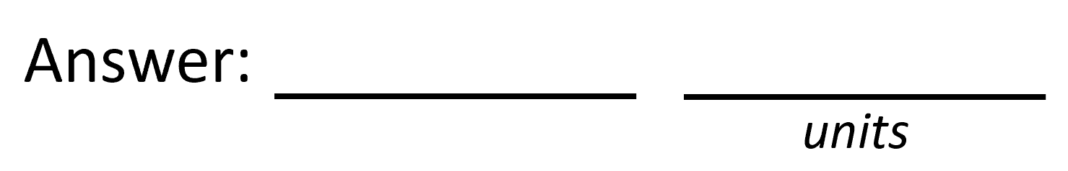
Data Analysis
Average velocity from table
Percent difference where $v_{sound}=343 m/s$
$$v_{avg}= \frac{v_{1}+v_{2}+v_{3}+v_{4}+v_{5}}{5}$$
335.09
m/s
$$Percent difference = \frac{\left|v_{avg}−v_{sound}\right|}{v_{sound}}×100$$
2.3
%

Slide 12
Conclusions
Briefly describe and explain the results.
  Answer:
  Ruler distance (cm): 8 cm
  Total Distance (m): 0.16 m
  Reading from serial monitor: 492 microseconds
  Roundtrip Time (s): 4.92 × 10-4 s
  Velocity m/s: 0.16 m/4.92 × 10-4 s = m/s
What is the dependence of temperature, humidity, and atmospheric pressure on the speed of sound? How does it affect the results?
  Answer:
  Determining the precision of the data gathering sensor is essential in experiments as sensors often drift over time and give incorrect readings due to circumstances such as temperature, humidity, and component fatigue.

Slide 13
PHYS204
Project Part 3
Gravitational Acceleration of a Free-Falling Object
Branden Mata

Slide 14
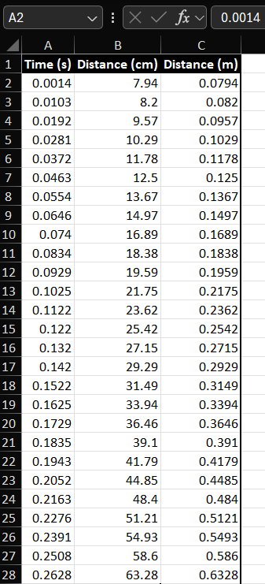
Excel Table
(Screenshot)
Include all values in the Excel table for a single trial showing the fall distance in centimeters and meters as a function of time

Slide 15
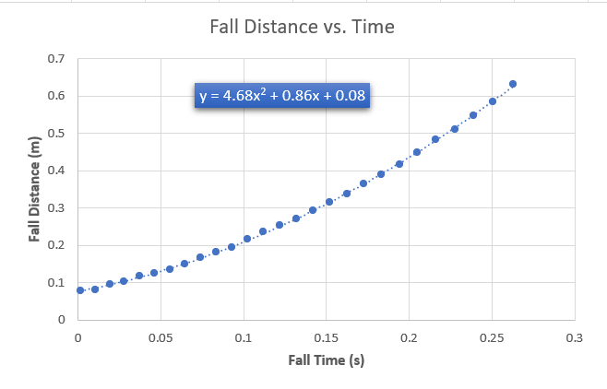
Excel Graph
(Screenshot)
Include Excel graph for a single trial showing the fall distance as a function of time.
Confirm that most data points fall along the curve fitting.
The x² coefficient should be between 2.5 and 7.5 such that its yields an acceleration value between 5 m/s² and 15 m/s²

Slide 16
Data Collection
Trial | x² coefficient value from curve fitting | Acceleration (m/s²) = 2* (x² coefficient)
1 | 4.68 | 9.36
2 | 5.02 | 10.04
3 | 4.66 | 9.32
4 | 4.62 | 9.24
5 | 4.73 | 9.46

Slide 17
Data Analysis
Average acceleration from table
Percent difference with $g=9.8 m/s^{2}$
$$a_{avg}= \frac{a_{1}+a_{2}+a_{3}+a_{4}+a_{5}}{5}$$
9.48
m/s²
$$Percent difference =\frac{\left|a_{avg}−g\right|}{g}×100$$
3.265
%

Slide 18
Conclusions
Briefly describe and explain the results.
  Answer:
  Using x2 coefficient from the fitted trendline in the graph above,
  g= 2×4.68 = 9.36 (m/s2)
How much variation is there from trial to trial? What does this indicate about the uncertainty of the result?
  Answer:
  There is about 0.04 - 0.80 m/s2 variation from trial to trial.
  This indicates that the initial position was different for each trial.

Slide 19
PHYS204
Project Part 4
Conservation of Energy of a Free-Falling Object
Branden Mata

Slide 20
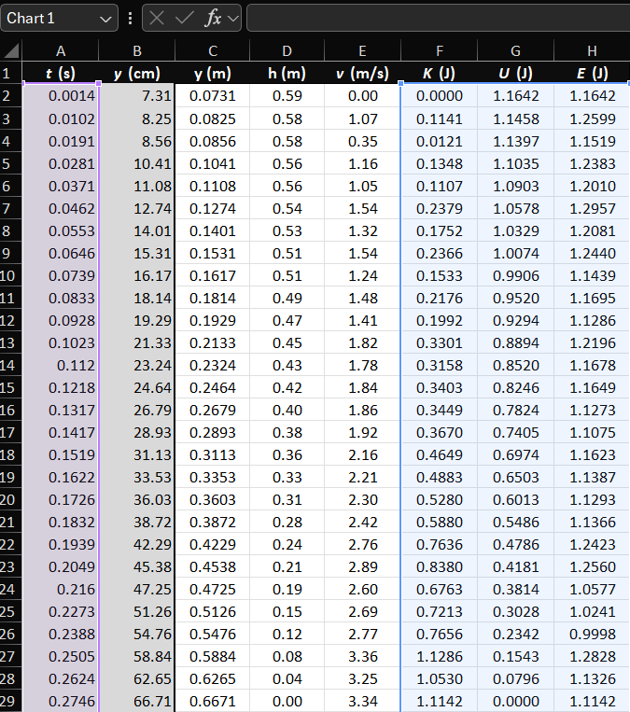
Excel Table
(Screenshot)
Include all values in the Excel table for a single trial showing the fall distance in centimeters and meters as a function of time with the values generated for kinetic energy K, potential energy U, and total mechanical energy E.

Slide 21
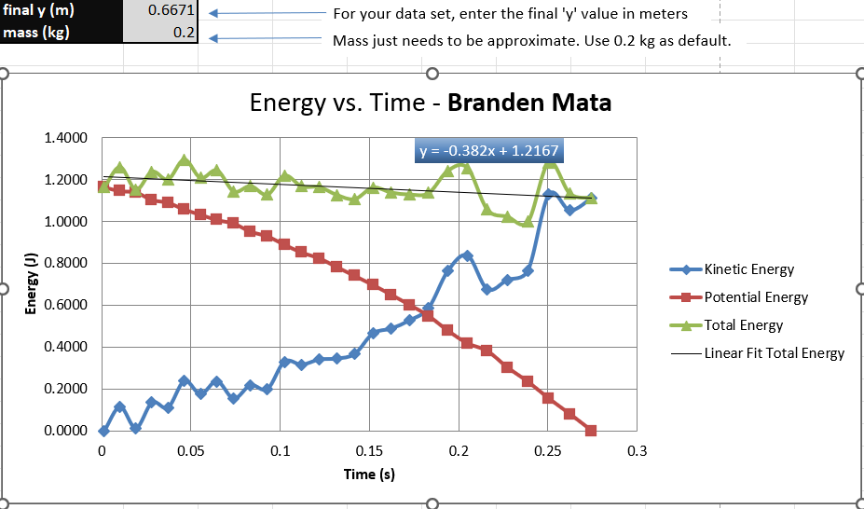
Excel Graph
(Screenshot)
Include Excel graph for a single trial showing the plots of the kinetic energy K, potential energy U, and total mechanical energy E as a function of time.
Must include your name in the title of the graph.

Slide 22
Data Analysis
Theoretical value of final velocity
Final velocity from experimental data (or largest velocity)
Percent difference
$h=y_{final}−y_{initial}=$
0.594
m
$v_{f}=\sqrt{2gh}=$
3.412
m/s
$v_{experimental}$ =
3.34
m/s
$$Percent difference =\frac{\left|v_{f}−v_{experimental}\right|}{v_{f}}×100$$
2.11
%

Slide 23
Conclusions
Discuss the key characteristics of the plot. Consider the points when potential energy U is maximum, U is minimum, kinetic energy K is maximum, K is minimum and when U and K are the same value. What is the significance of these points?
  Answer:
  Theoretically, the lines should intersect at the midpoint of the fall.
  When potential energy U is maximum , kinetic energy K is minimum and vice versa.
  When potential energy U is minimum, kinetic energy K is maximum.

Slide 24
Conclusions
What is the trend of the best fit line for the total energy E in your data? If the data is accurate, the total mechanical energy should decrease slightly. Why is that?
  Answer:
  The trend of the best fit line for the total energy E in my data is that the total mechanical energy decreased slightly, because it is time invariant (constant).

Slide 25
PHYS204
Project Part 5
Relationship between Linear and Rotational Motion
Branden Mata

Slide 26
Data Collection
7
cm
Object diameter: d =
Object radius: r =
Number of pulses for one revolution: x =
Resolution = $\left(\frac{1 }{x } \frac{Revolution}{pulses}\right)∙\left(\frac{2∙π radians}{1 Revolution}\right)=$
3.5
cm
40
0.157
radians/pulses

Slide 27
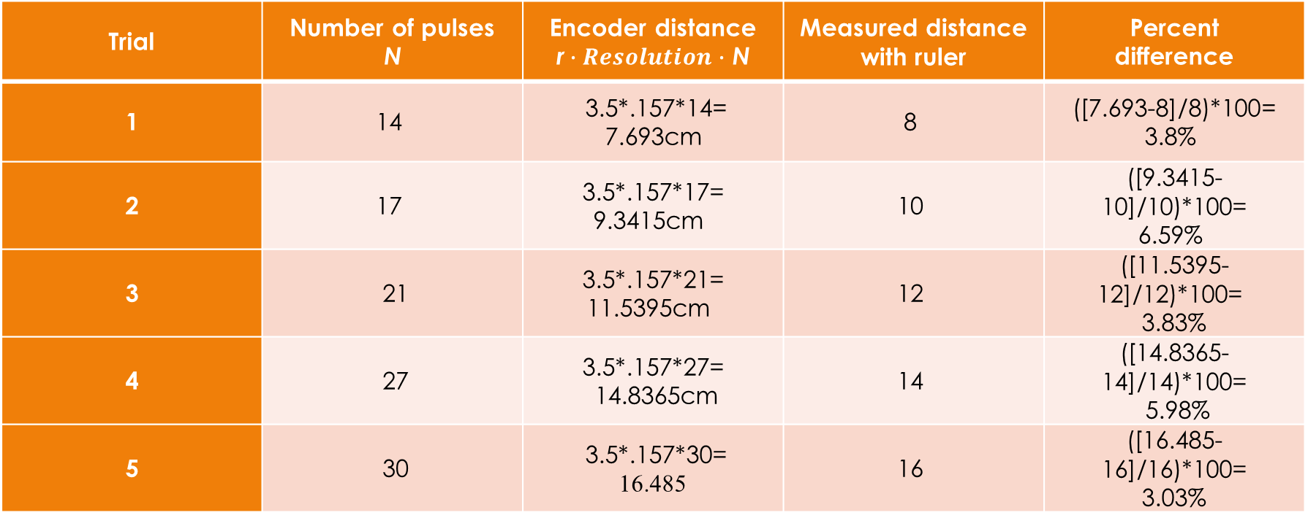
Data Analysis
Trial | Number of pulses N | Encoder distance r$∙Resolution∙$ N | Measured distance with ruler | Percent difference
1 | 14 | 3.5*.157*14= 7.693cm | 8 | ([7.693-8]/8)*100= 3.8%
2 | 17 | 3.5*.157*17= 9.3415cm | 10 | ([9.3415-10]/10)*100= 6.59%
3 | 21 | 3.5*.157*21= 11.5395cm | 12 | ([11.5395-12]/12)*100= 3.83%
4 | 27 | 3.5*.157*27= 14.8365cm | 14 | ([14.8365-14]/14)*100= 5.98%
5 | 30 | 3.5*.157*30= 16.485 | 16 | ([16.485-16]/16)*100= 3.03%

Slide 28
Conclusions
Briefly describe and explain the results.
  Answer:
  Consistent percentage difference may indicate a systematic error, the total pulse count accuracy, mechanical issues (e.g., knob coupling), and environmental factors (short wires, encoder signal issues). It is important to consider radial error motion from the rotating shaft, as it can result in angle measurement errors.
What are some applications of this measuring technique? Could this measuring system be used to measure surfaces that are not flat?
  Answer:
  Rotary encoders find extensive applications, such as in PLC’s for industrial conveyor control, providing both speed and direction. In robotics, they are primarily employed for feedback.
  Additionally, for measuring non-flat surfaces, rotary encoders can be utilized with a proper setup. To ensure measurement accuracy, the wheel surface structure should prevent slippage, for instance, by fitting it with soft rubber.

Slide 29
PHYS204
Project Part 6
Observing the Hall Effect
Branden Mata

Slide 30
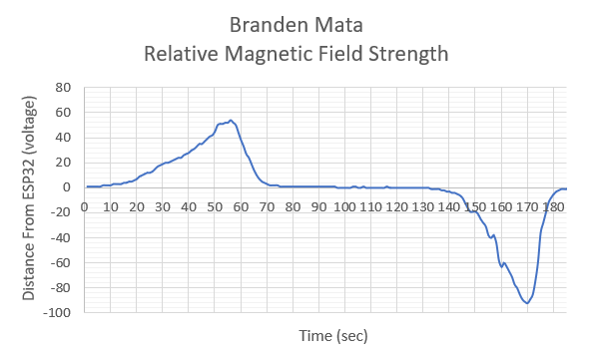
Excel Graph
(Screenshot)
Include Excel graph for a single trial of data plotted as a function of time.
Must include your name in the title of the graph.

Slide 31
Conclusions
Briefly describe and explain the results.
  Answer:
  Without any magnetic field near the ESP32, the measurement was near 0.
  When the magnet was brought close to the ESP32, the magnetic pole that was near increased was slowly pulled away then flipped over and brought close to the ESP32 again and decreased in value. The measurements from the sensor can increase or become negative depending on the magnetic pole facing the sensor.
Describe how the Hall sensor works. What are some applications for the Hall effect sensor?
  Answer:
  Hall sensor works by using a voltage regulator, a hall element and a high gain amplifier to measure proximity of magnetic field strength.
  Some applications for the Hall effect sensor:
  Wheel Speed Sensor – RPM
  Door open-closed sensor

Slide 32
Challenges
Analyzing the data from the Conservation of Energy of a Free-Falling Object project.
Drawing conclusions from the data on each project.

Slide 33
Career Skills
Analyze results of tests and experimentation utilizing mathematical and scientific methods, software, and or equipment.
Evaluate alternative solutions to problems.

Slide 34
Conclusion
The best way to learn physics is to do physics. Not only does this teach the physical principles behind the workings of the universe, but also it helps solve complex logical problems.

