Slide 1

SEC 285
Final Project
Branden Mata

Slide 2

Introduction
Fundamentals of Information Security
The configuration and testing process in the Microsoft Hyper-V environment include:
Asymmetric Key Encryption
Stateful Firewall
Multi-Factor Authentication (MFA)
Vulnerability Assessment

Slide 3

Asymmetric Key Encryption

Slide 4
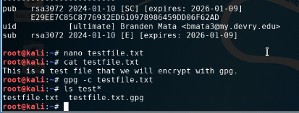
File Encryption
This screenshot should show the following.
Content of the plaintext file
Content of the encrypted file

Slide 5
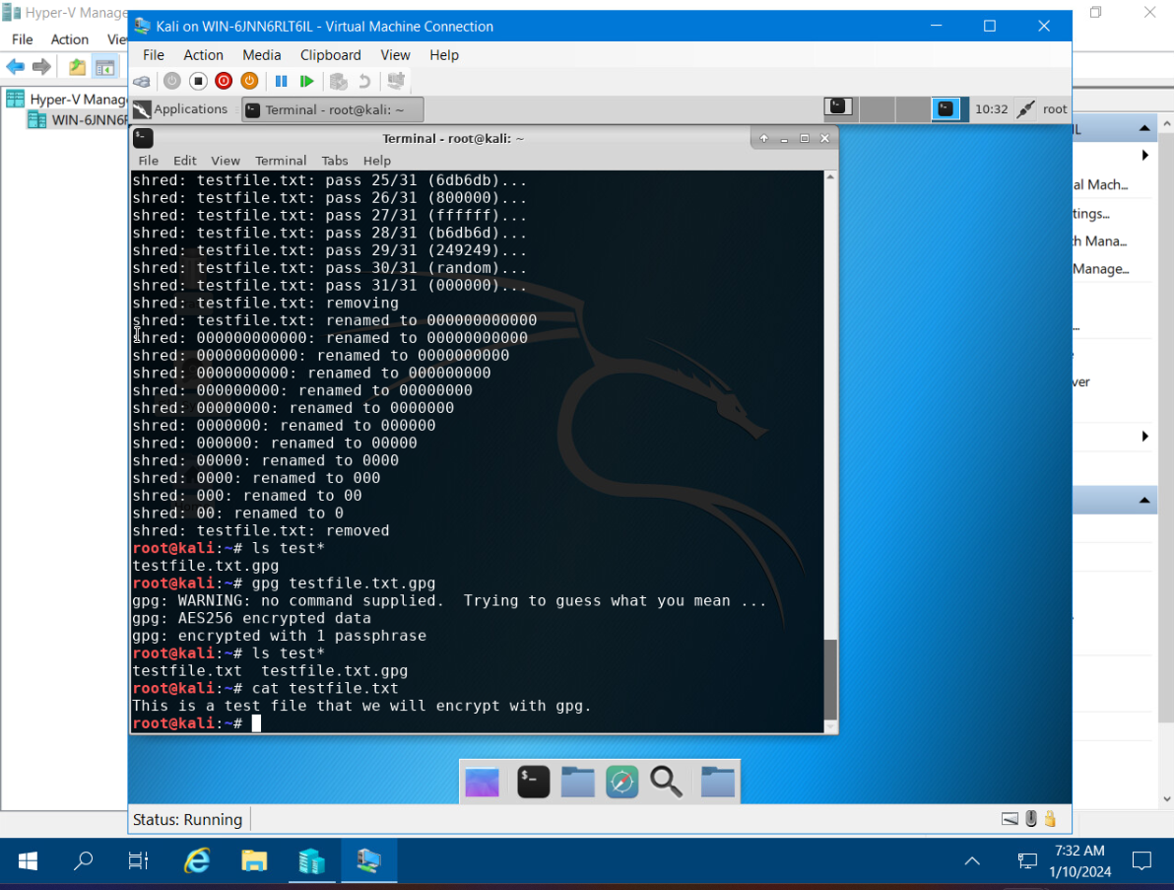
File Decryption
This screenshot should show the following.
The encrypted file being listed by itself
The decrypting process
Both the encrypted file and the original plaintext file being listed

Slide 6

Stateful Firewall

Slide 7

Question
What effect does the sudo iptables --policy INPUT DROP command have on the access to computing resources?
The sudo iptables --policy INPUT DROP command blocked incoming traffic to the network so that Nmap cannot tell whether the ports are open or closed. This allows System Administrators to block incoming traffic to computing resources.

Slide 8
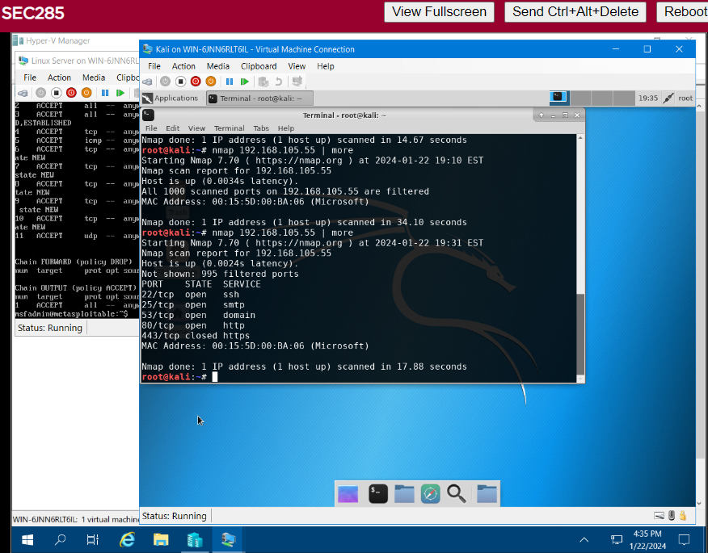
Nmap Scan
This screenshot should show the Nmap scan result of the Linux Server VM.

Slide 9

Bring Your Own Device (BYOD) Security Policy

Slide 10
Double-click on the file below to open the
Bring Your Own Device (BYOD) Security Policy

Slide 11

Multifactor Authentication (MFA)

Slide 12
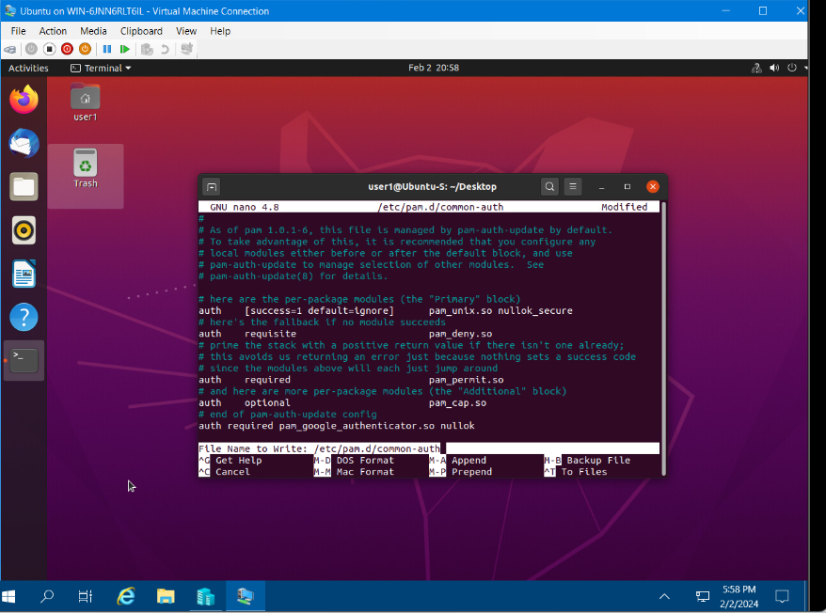
Common-auth Configuration File
This screenshot should show the entry that indicates the use of the Google Authenticator module.

Slide 13
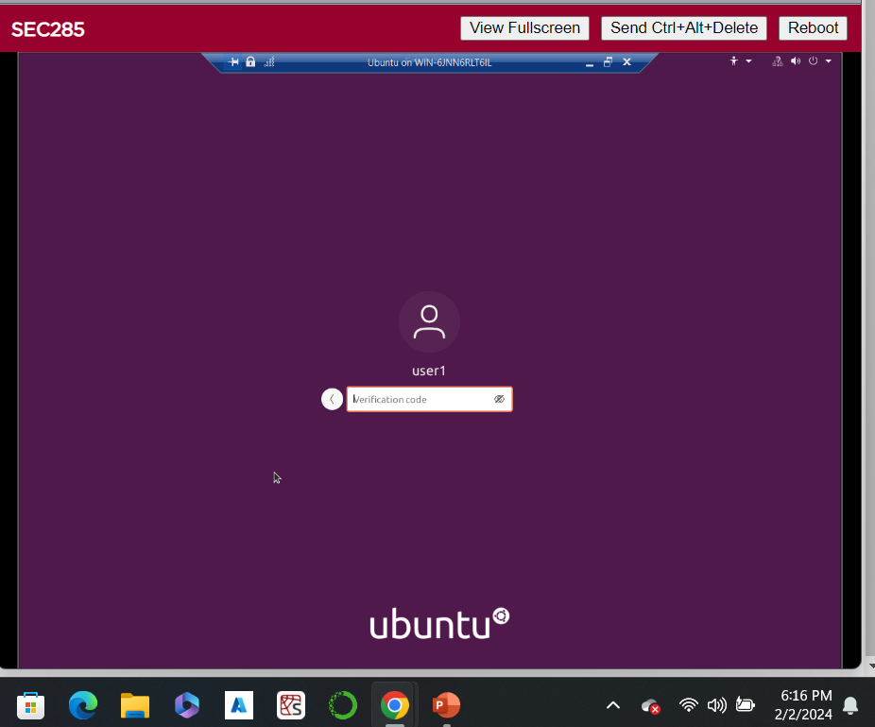
MFA Logon Screen
This screenshot should show the logon screen where a verification code is required.

Slide 14

Vulnerability assessment

Slide 15
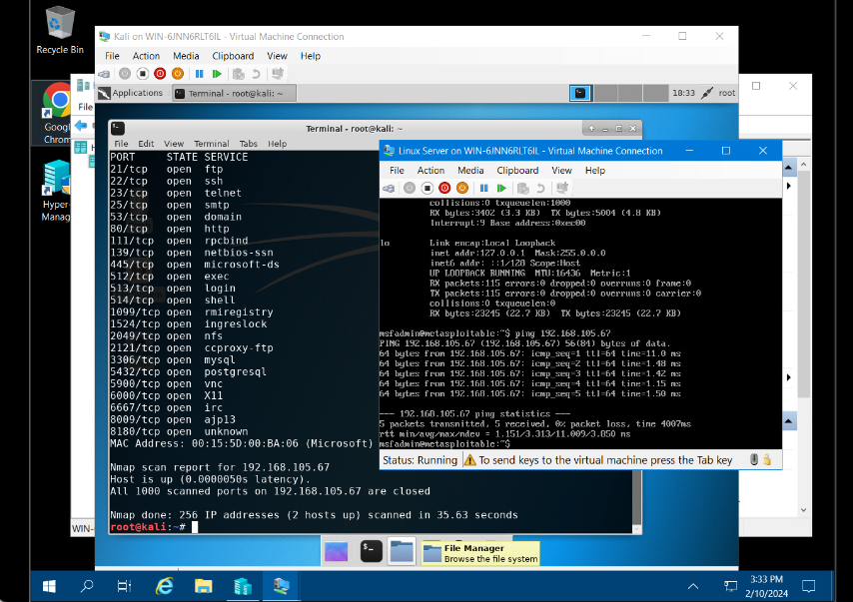
Nmap
This screenshot should include the scan result showing both the Kali and Linux Server VMs.

Slide 16
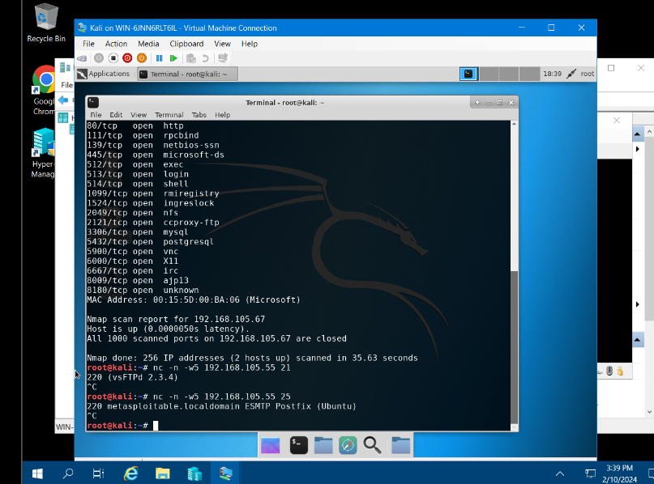
NetCat
This screenshot should include the scan result showing both the Kali and Linux Server VMs.

Slide 17
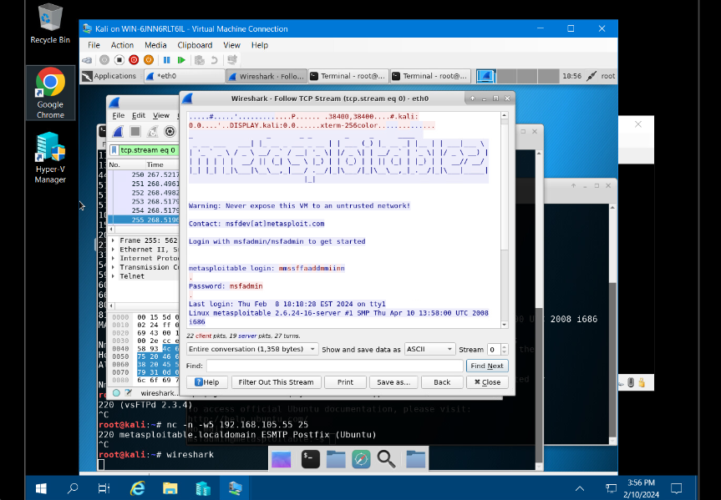
Wireshark
This screenshot should include the Wireshark—Follow TCP Steam window showing the Telnet username and password.

Slide 18
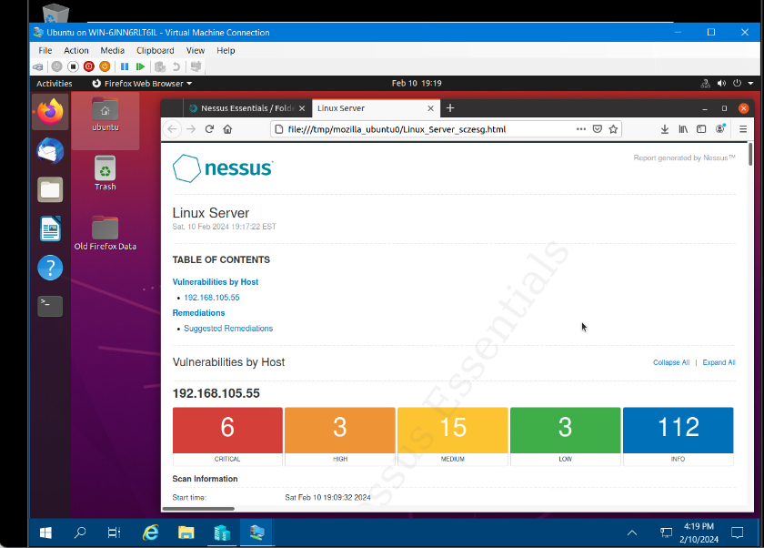
Nessus
This screenshot should include the high-level view of the Nessus vulnerability scan report (showing categories of vulnerability in different colors).

Slide 19

Challenges
Bring Your Own Device Security Policy

Slide 20

Career Skills
Analyze and identify unknown problems utilizing mathematical and scientific methods, software, and/or equipment.
Evaluate alternative solutions to problems.
Build, test, and operate a system utilizing principles of technology.

Slide 21

Conclusion
It is important to stay current with the skills required for this evolving job market as new technologies and applications are being developed on a regular basis.

Slide 22

References
CompTIA Security+ Guide to Network Security Fundamentals, Sixth Edition (M. Ciampa, 2018)
DeVry University course lessons and project videos

