Slide 1

Final Project
Netw191
Branden Mata

Slide 2

INTRODUCTION
MOTIVE
To have a better understanding of the concept of network addressing and network protocols for my future career in Information Technology.

Slide 3
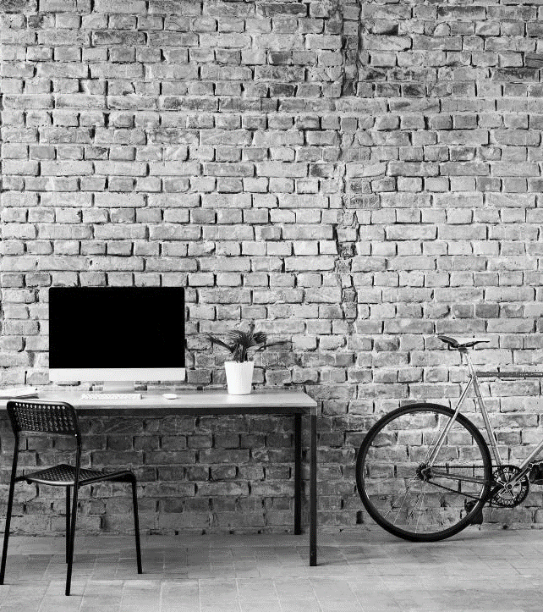
What’s next?
LOOKING AHEAD

Slide 4
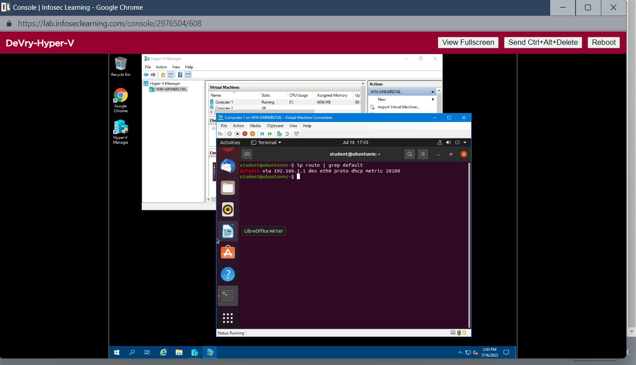
This screenshot should include the terminal window that shows the default gateway IP address.
Preparation

Slide 5
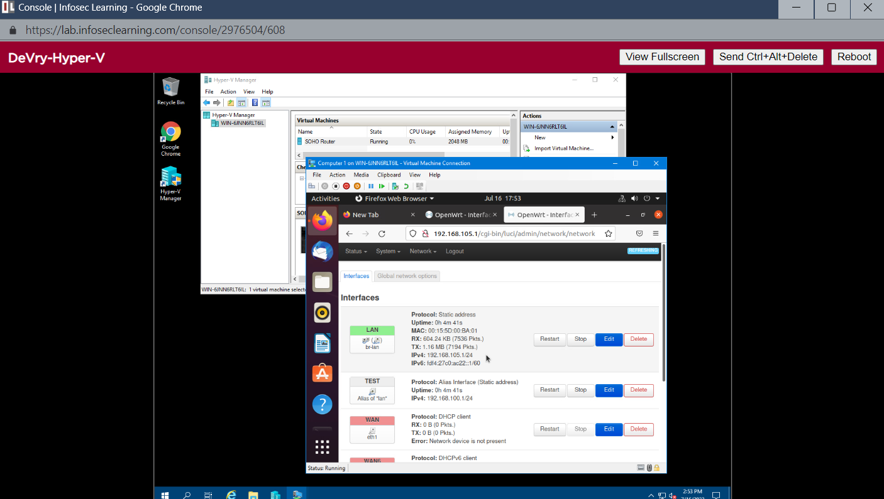
IPv4 Address Assignment
This screenshot should include the Interfaces page that shows the new IPv4 address on the LAN interface.

Slide 6
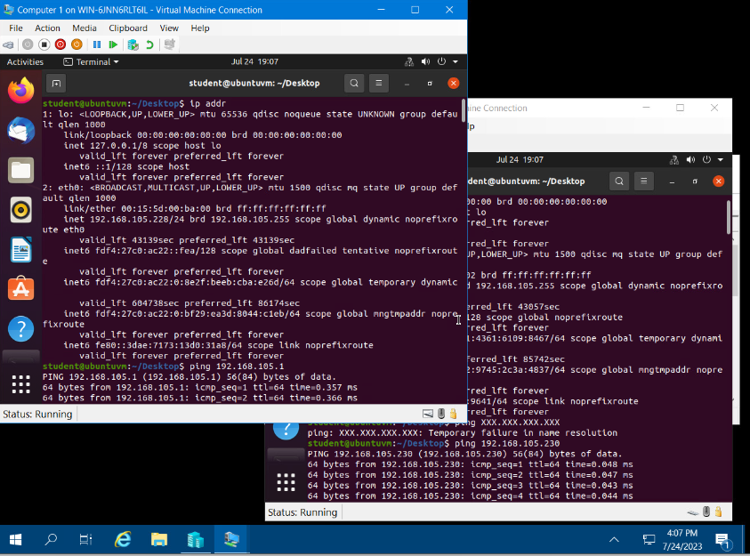
These 2 screenshots should show the IPv4 address of the Computer 1 VM and Computer 2 VM.
Dynamic IP Address Assignment

Slide 7
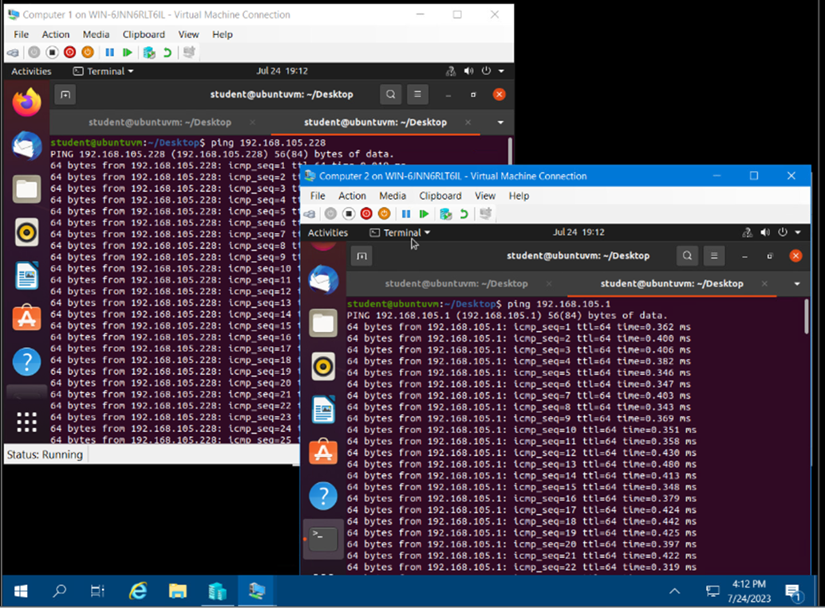
Connectivity Tests
These screenshots should show the connectivity tests between the Computer 1 VM and the other two devices (i.e., the SOHO Router VM and Computer 2 VM) and vice versa.

Slide 8
Subnetting Table
 | Subnet ID | Network Mask (/prefix) | Network Mask (Dotted decimal) | Network Address | First Usable Host Address | Last Useable Host Address | Broadcast Address
The First Subnet | 0 | /25 | Your Input | 192.168.5.0 | 192.168.5.1 | Your Input | 192.168.5.127
The Second Subnet | 1 | Your Input | 255.255.255.128 | Your Input | 192.168.5.129 | 192.168.5.254 | Your Input
This table should include two /25 subnets, listing the subnet notation, network address, first usable host address, last usable host address, and broadcast address of each subnet.

Slide 9
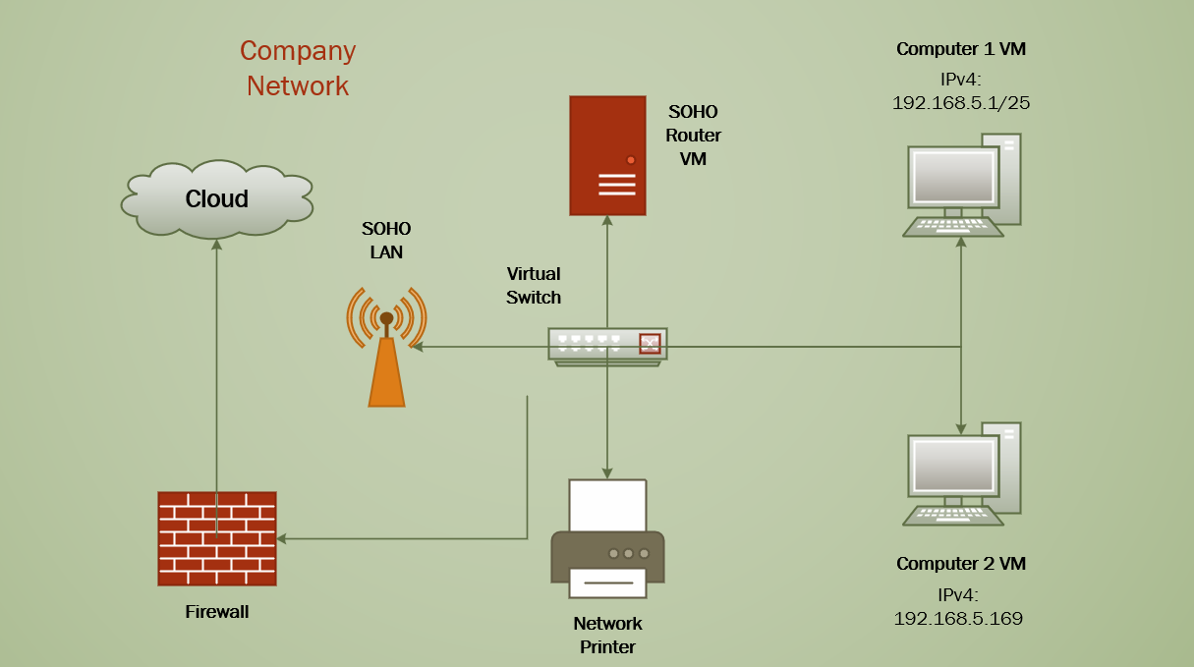
Microsoft Visio Network Diagram
This diagram should illustrate the interconnection of the Computer 1 VM, the Computer 2 VM, and the SOHO Router VM along with proper addressing and labeling.

Slide 10
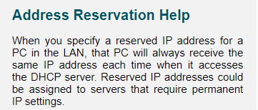
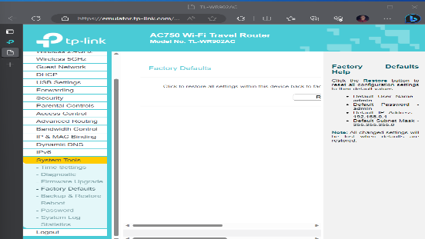
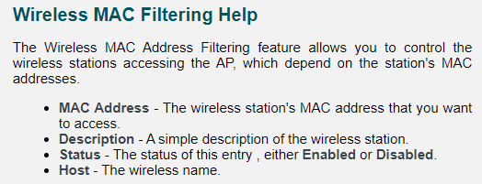
SOHO Wireless Network Security
1. What are the factory default username and password of a TP-Link router? Why is it important to change the default username and password of a SOHO router?
Answer:
Default User Name – admin
Default Password – admin
Default IP Address – 192.168.0.1
Default Subnet Mask – 255.255.255.0
It is important to change the default
username and password of a SOHO router, because it is
vulnerable for other devices to use your router.
2. To protect a SOHO wireless network with a small number of devices, which address management method provides more control, configuring the device IP addresses manually (static IP) or using a DHCP server (dynamic IP)? Why?
Answer:
A static IP address will protect a SOHO wireless network
with a small number of devices and provide more control,
because the IP address is reserved for those devices.
3. What does MAC filtering do? If needed, when would you use deny filtering rules and when would you use allow filtering rules? What happens to devices that want to connect, if the “Allow the stations specified by any enabled entries in the list to access” function is enabled but there are no entries in the list?
Answer:
The MAC filtering feature allows you to control the wireless
stations accessing the AP, which depend on the station’s MAC
addresses. If it is enabled and there are no entries in the list,
no wireless stations can access the AP.

Slide 11
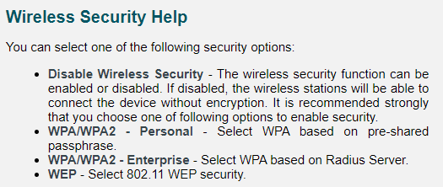
SOHO Wireless Network Security
1. What wireless security settings are displayed on the Wireless Security page? Which one is recommended by the vendor? Why?
Answer:
WPA/WPA2 – Personal, WPA/WPA2 – Enterprise,
WEP, and Disable Wireless Security are the settings displayed
on the Wireless Security page.
WPA/WPA 2 – Personal is recommended by the vendor,
because it is based on pre-shared passphrase.
2. Among the configurations you explored in this module, which one is a true security function? Why?
Answer:
The configuration I explored in this module
that I consider a true security function is setting a WPA/WPA 2 passphrase,
because it is pre-shared, and only devices that know it can connect.
3. What would you do to protect your wireless network at home? Why?
Answer:
I would set a WPA/WPA 2 –personal passphrase to protect my wireless network at home,
because any device at home can connect only by knowing the passphrase.

Slide 12


Challenges
Creating the Microsoft Visio Network Diagram with an easy-to-read layout of the company network’s components.
Connectivity Tests due to a slow internet bandwidth.

Slide 13


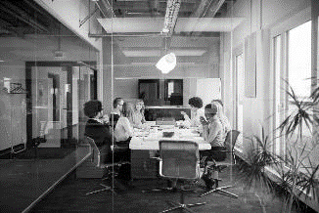
Career skills
Identify and analyze user needs and incorporate them in the creation, integration, evaluation, and administration of information technology and networking systems.
Segment a network into multiple LANs or multiple VLANs.
Understand networking fundamentals, including network types, hardware devices, topologies, the OSI model, structured cabling, and documentation.
Implement security into the design of a network
Produce a network to a specification

Slide 14

SUMMARY
The fundamentals of networking that play a vital role in the world of (IoT) Internet of Things that require designing, developing, building a network are better understood after this class. Learning SOHO router configurations, subnetting, connectivity testing, network documentation and SOHO wireless network security will prepare me for my future career in Information Technology.

Slide 15
References
Virtual Machine Guide
Emulator Help Settings
Final Deliverable Expectations

Slide 16



THANK YOU
BRANDEN MATA
+1 (747) 588-1118
brandenmata1@gmail.com
https://brandenmata1.wixsite.com/cybertech

