Slide 1
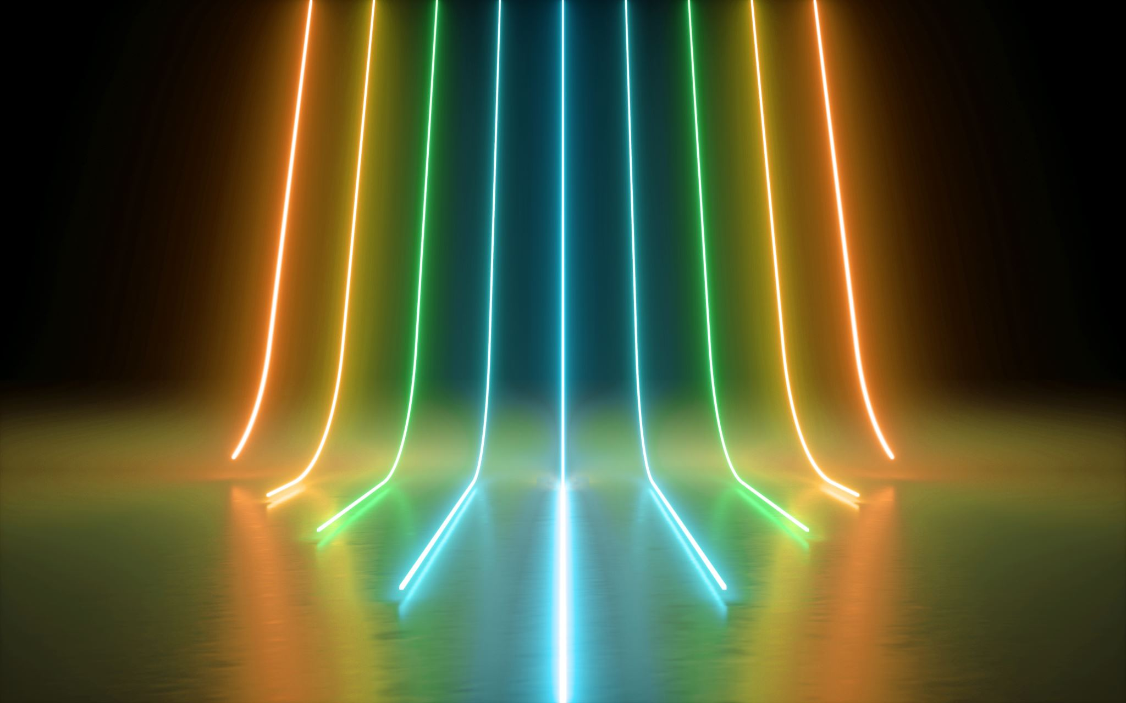
Final Course Project
CEIS114
Branden Mata
Bachelor’s Information Technology & Networking
DeVry University
Professor Kavianpour

Slide 2
Introduction
Designing and implementation of intelligent tragic light systems is the key focus in the field of transportation engineering. This project has provided me with hands-on experience in creating a Multi-Intersection Traffic Light System using Wokwi Lab.
I chose to work on option 1, Multiple Traffic Light Controller with Cross Walk, Buzzer, and LCD Display with IOT Access, displaying the circuit simulations from "Wokwi".

Slide 3
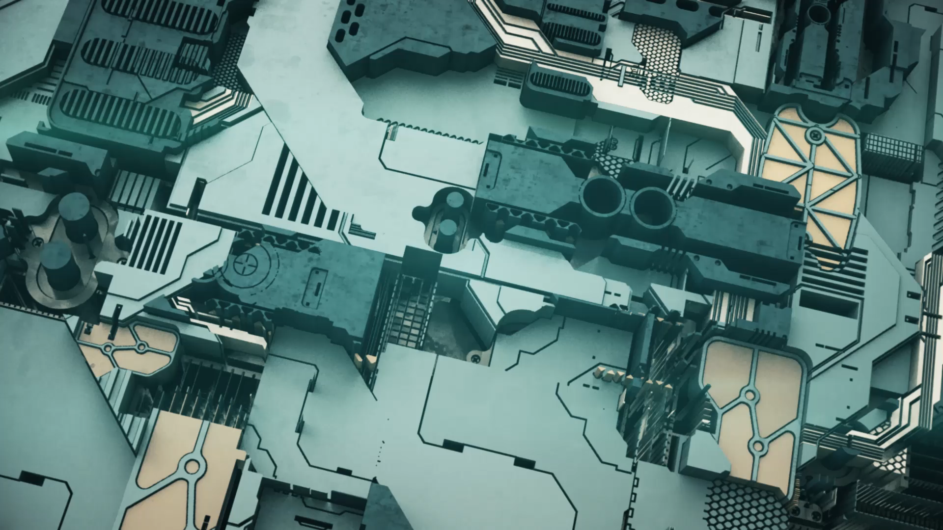
CEIS 114
Module 2
Project Plan for IoT Traffic Controller

Slide 4
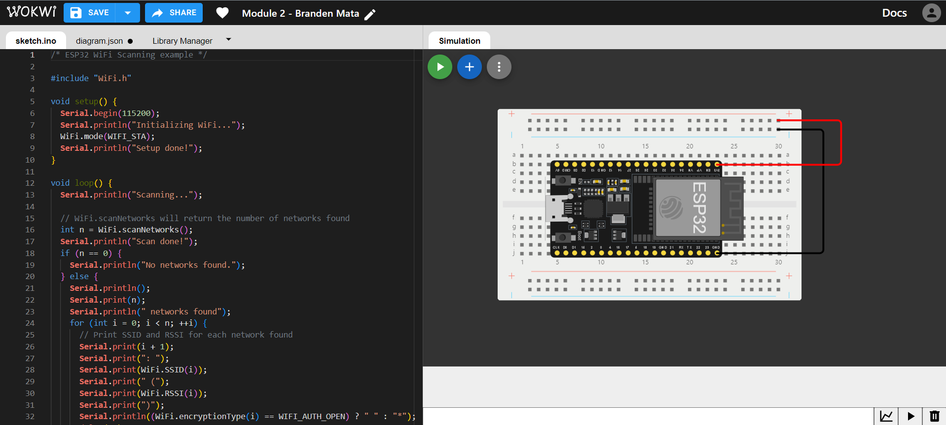
ESP32 (Screenshot)
Microcontroller mounted and powered ON

Slide 5
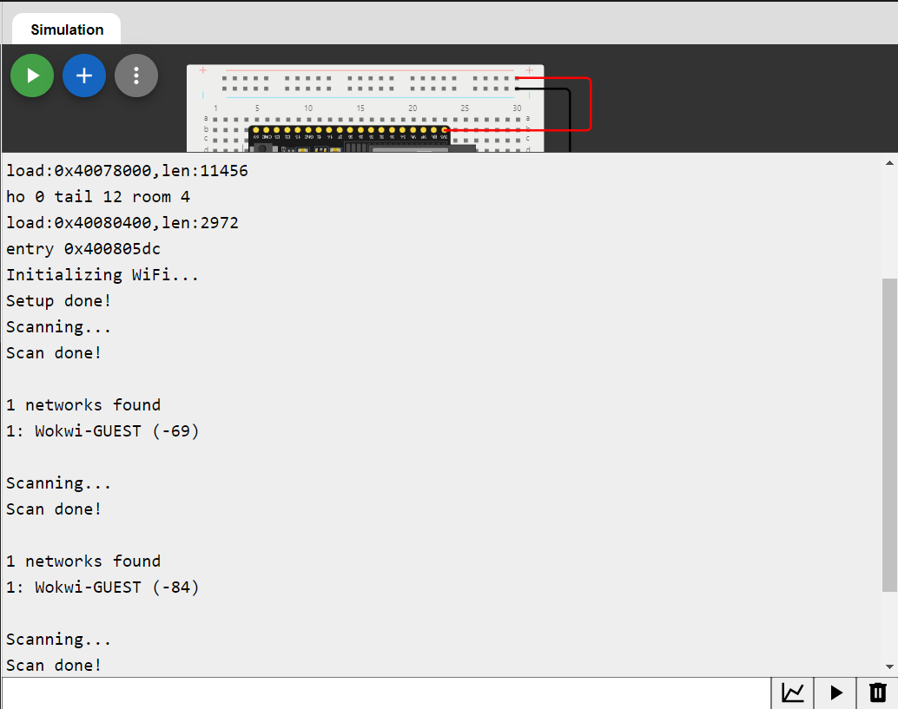
ESP32 WiFi Scan
Screenshot of Serial Monitor showing the available networks

Slide 6
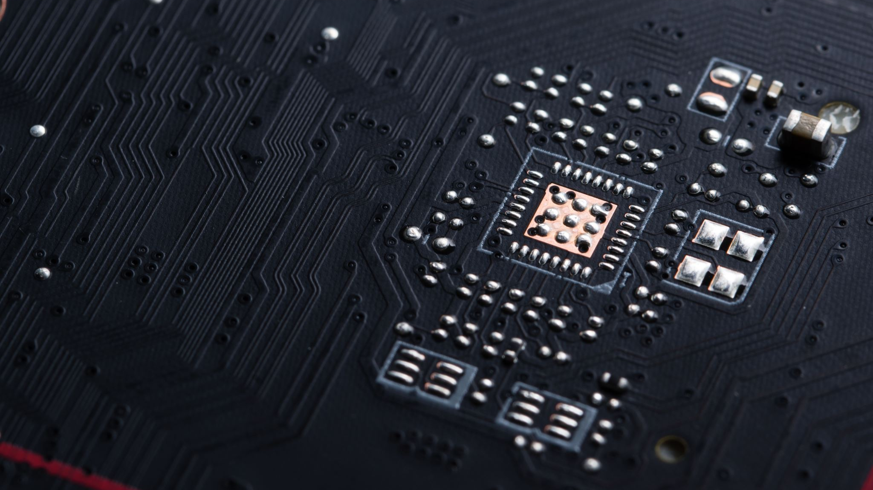
CEIS 114
Module 3
Creating the Traffic Controller

Slide 7
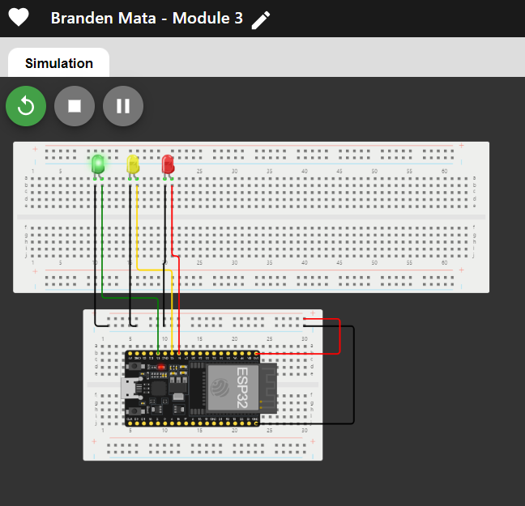
Picture of circuit with working LEDs
ESP 32 Board
Colored LEDs: Red, Yellow and Green
Wires
Breadboard

Slide 8
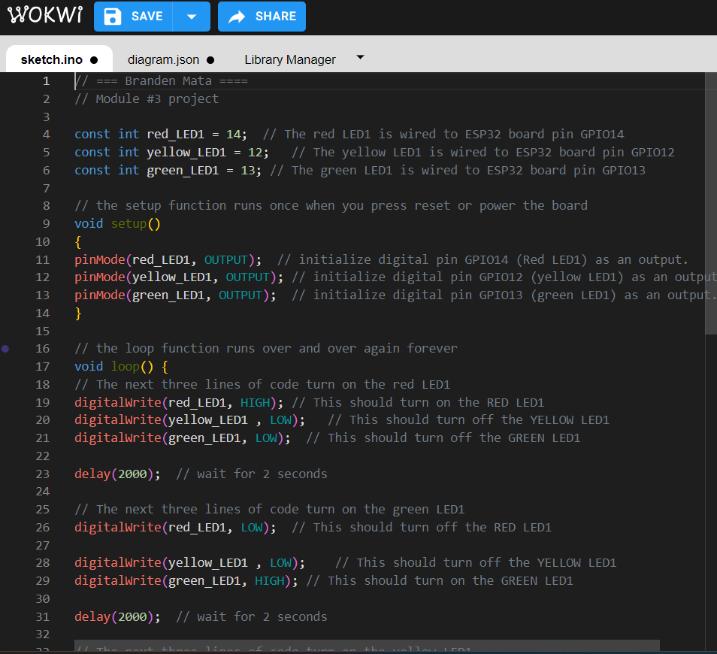
Screenshot of code in the Code Editor
Screenshot of code in the Wokwi Code Editor showing your name in the comment

Slide 9
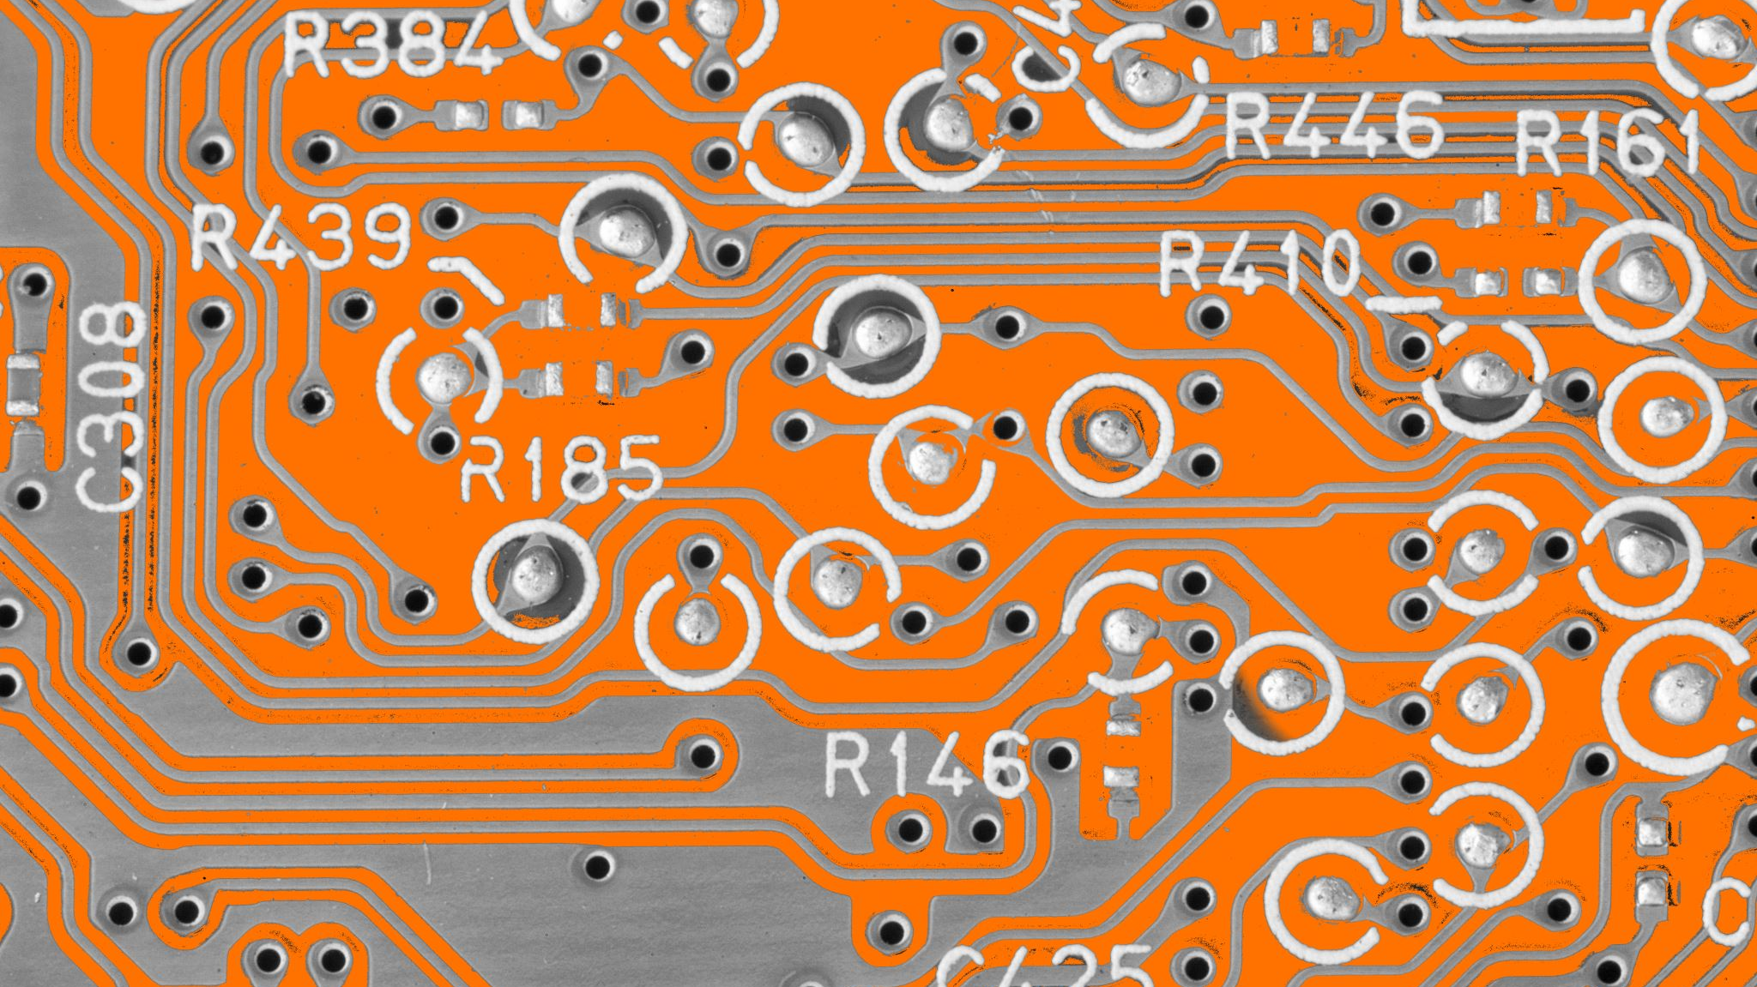
CEIS 114
Module 4
Creating a Multiple Traffic Light Controller

Slide 10
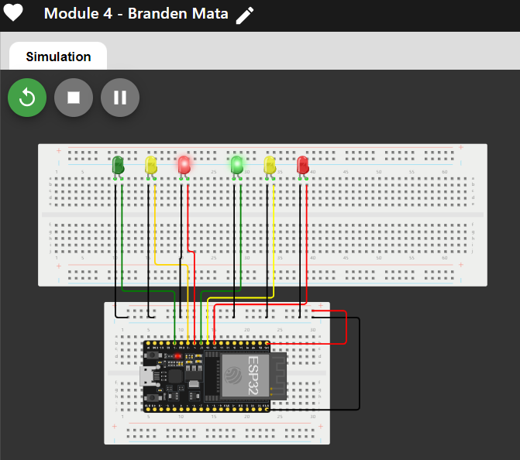
Picture of circuit with working LEDs
ESP 32 Board
Colored LEDs: Red, Yellow and Green (two sets)
Wires
Breadboard

Slide 11
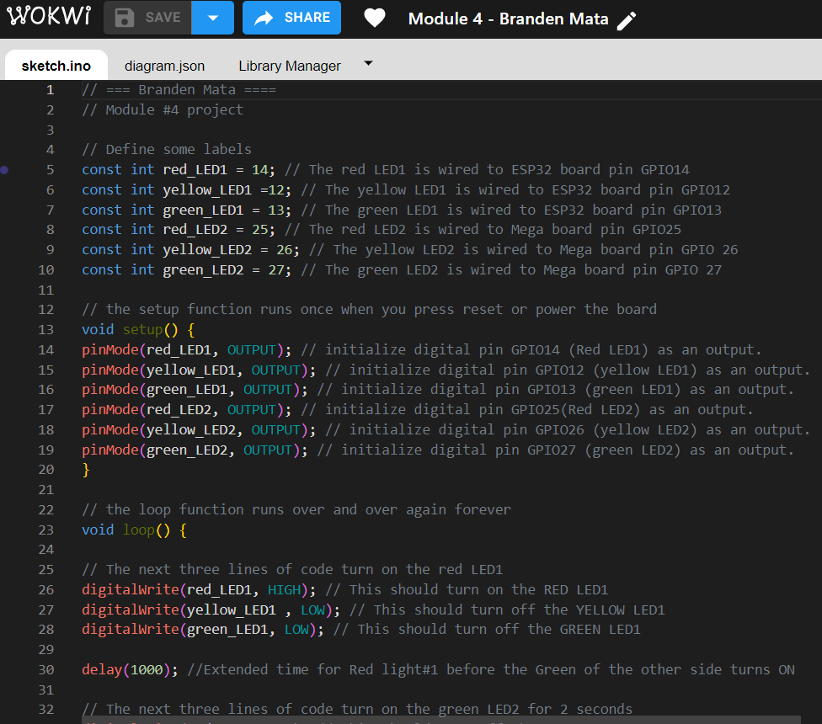
Screenshot of code in Wokwi
Screenshot of code Wokwi Code Editor showing your name in the comment

Slide 12
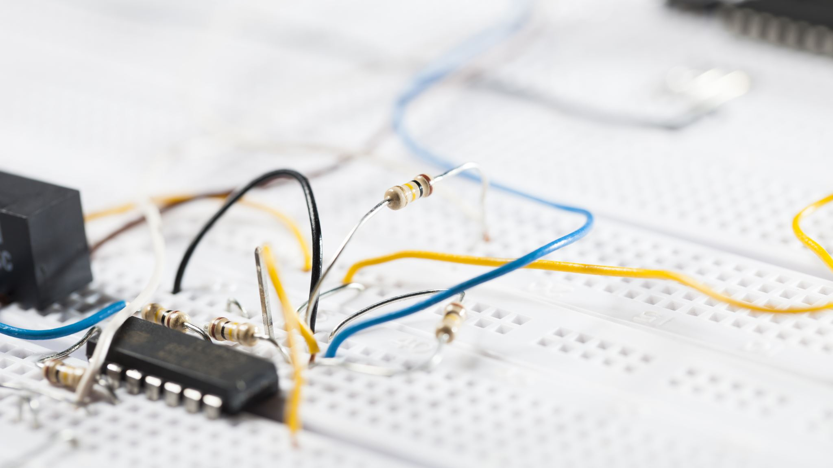
CEIS 114
Module 5
Creating a Multiple Traffic Light Controller with a Cross Walk

Slide 13
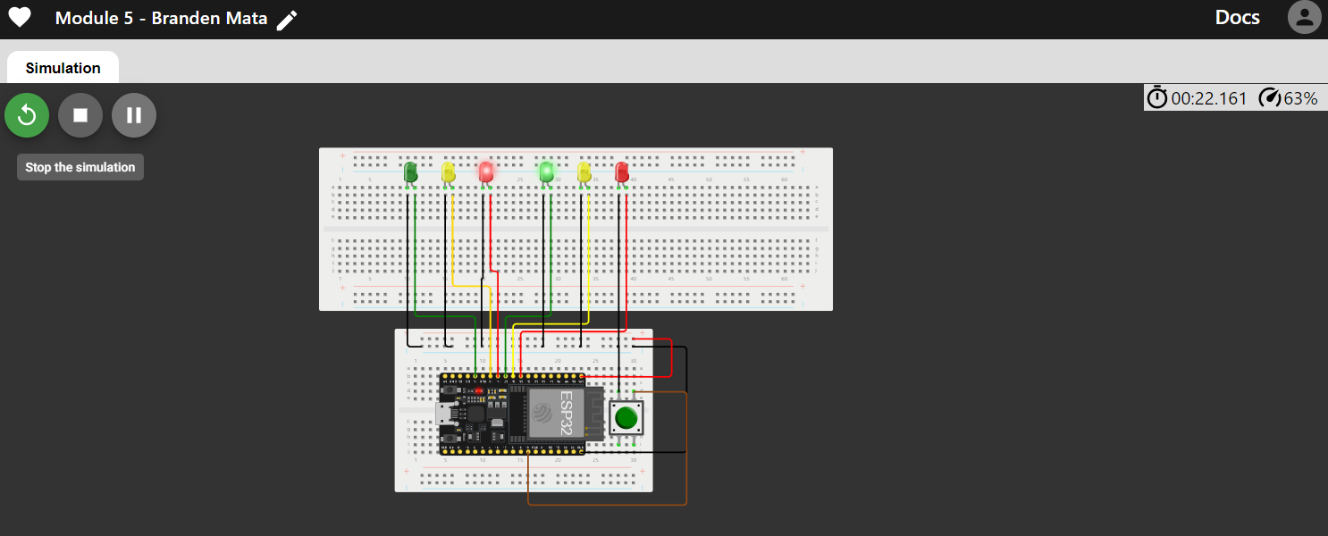
Screenshot of circuit with working LEDs
ESP 32 Board
Colored LEDs: Red, Yellow and Green (two sets)
220 Ohm Resistors (optional)
Push Button
Wires
Breadboard

Slide 14
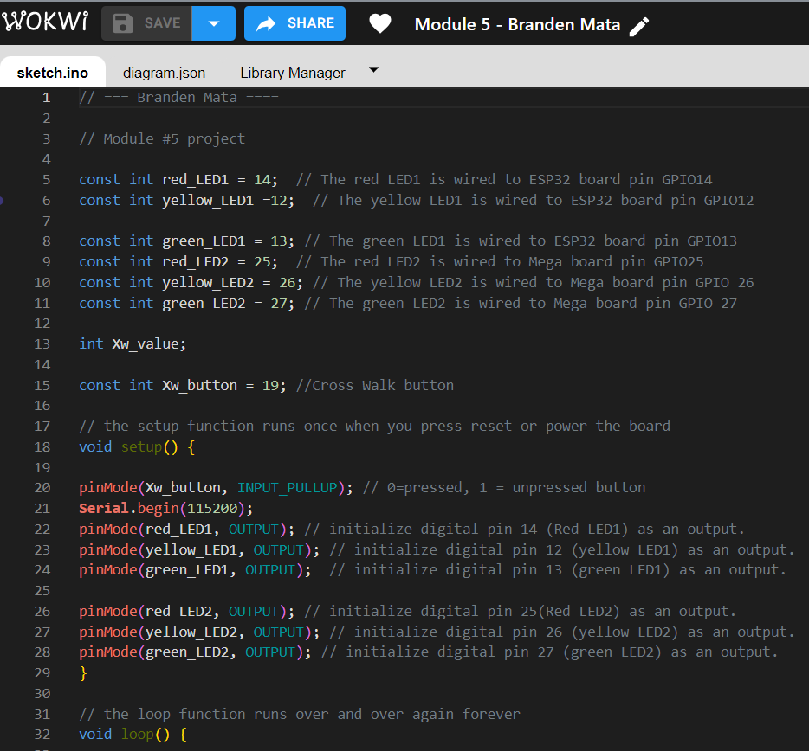
Screenshot of code in Wokwi
Screenshot of code in Wokwi Code Editor showing your name in the comment

Slide 15
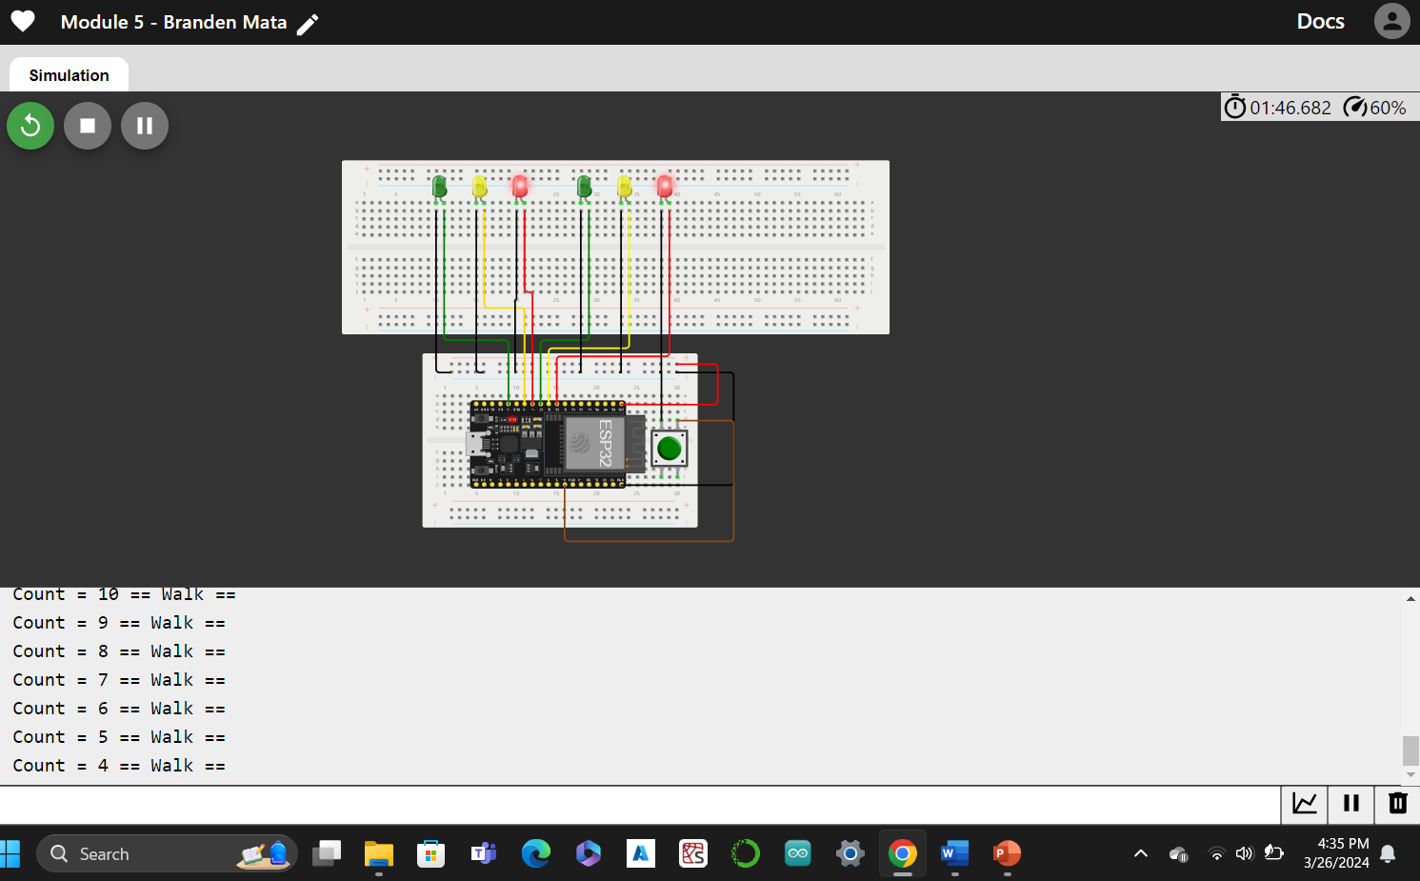
Screenshot of Serial Monitor in Wokwi
Screenshot of output in Serial Monitor

Slide 16

CEIS 114
Module 6
Creating a Multiple Traffic Light Controller with a Cross Walk and an Emergency Buzzer

Slide 17
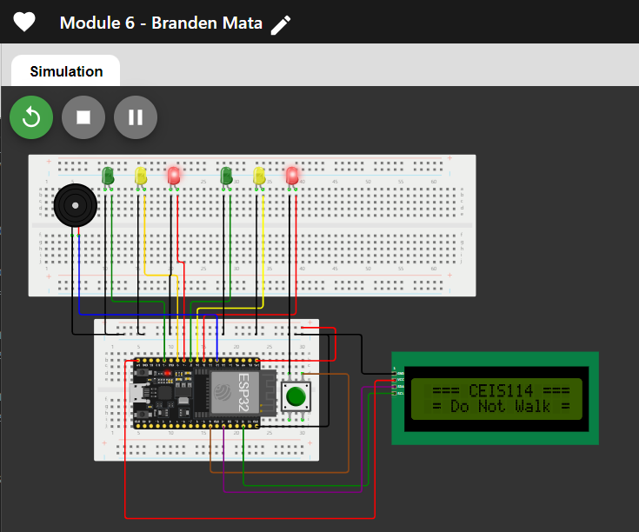
Picture of circuit with working LEDs and LCD display
ESP 32 Board
Colored LEDs: Red, Yellow and Green (two sets)
220 Ohm Resistors (optional)
Push Button
LCD Unit with Message Display
Wires
Breadboard

Slide 18
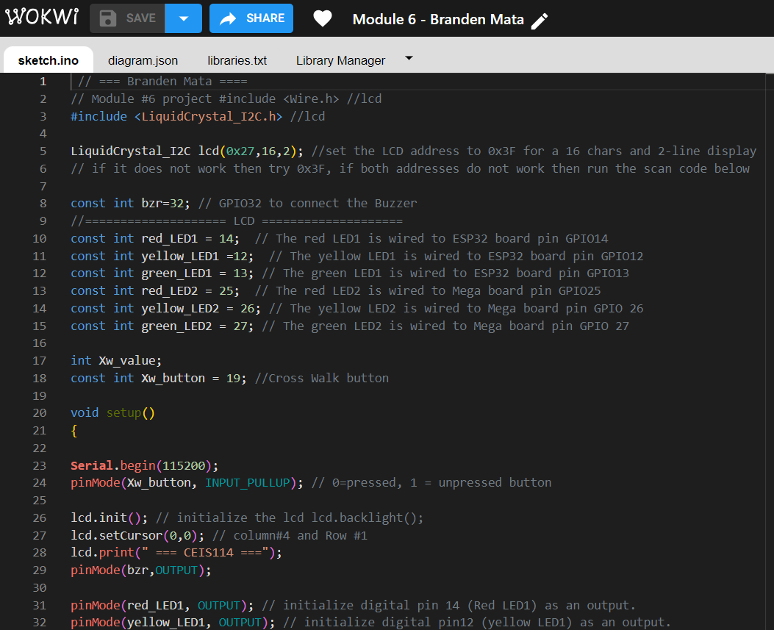
Screenshot of code in Code Editor
Screenshot of code in Code Editor showing your name in the comment

Slide 19
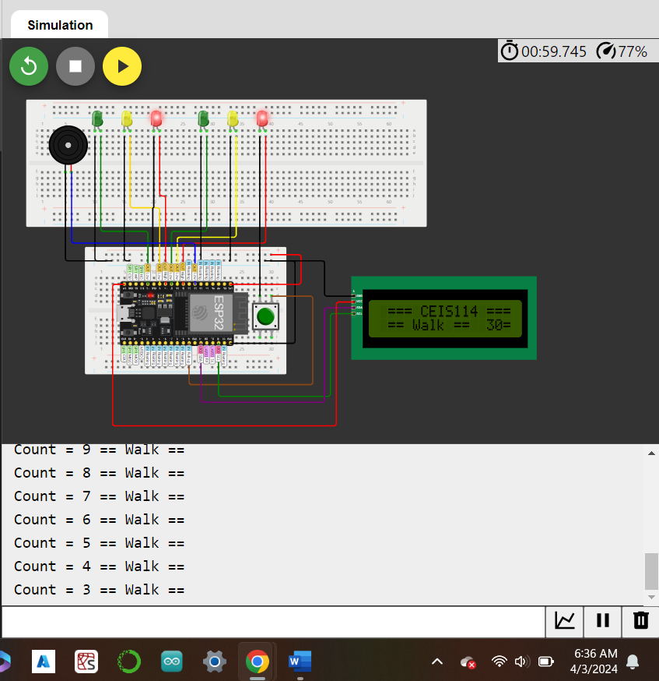
Screenshot of Serial Monitor
Screenshot of output in Serial Monitor

Slide 20
CEIS 114
Final Project Component
Creating a Multiple Traffic Light Controller with a Cross Walk and an Emergency Buzzer with secured IoT Control via Web

Slide 21
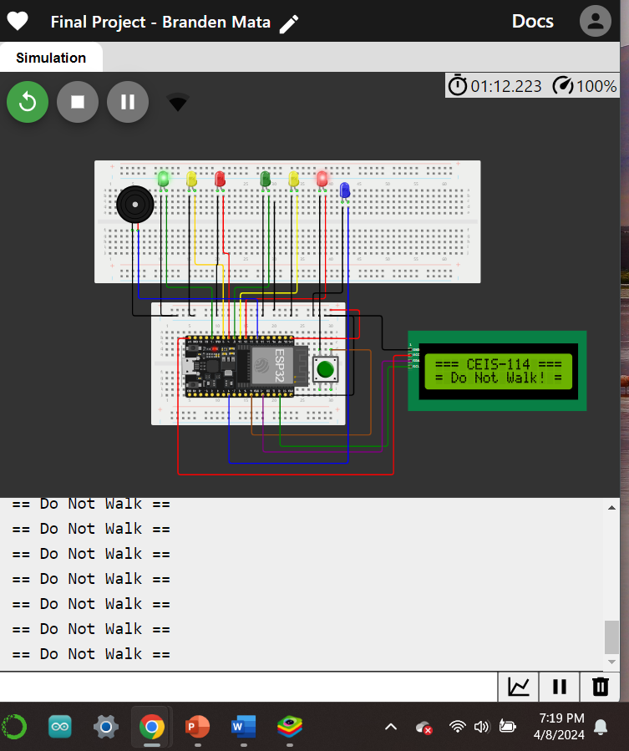
Screenshot of circuit with working LEDs and LCD display (Building/Operation)
ESP 32 Board
Colored LEDs: Red, Yellow and Green (two sets)
One Blue LED – Emergency Light
Push Button
LCD Unit
Buzzer
Wires
Breadboard

Slide 22
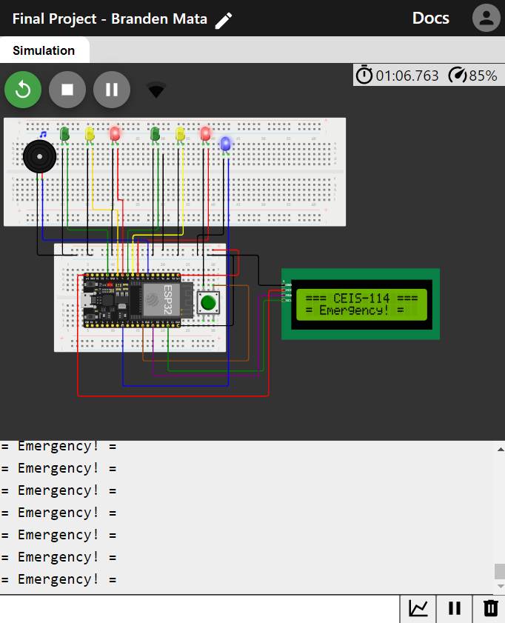
Screenshot of resources (Identification)
Resources needed to build a smart traffic controller.

Slide 23
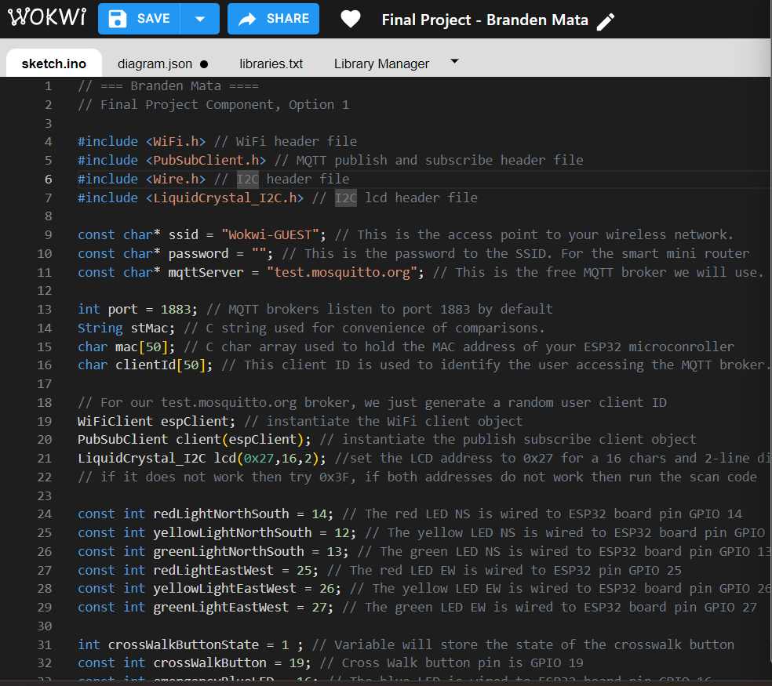
Screenshot of code in Code Editor (Testing)
Screenshot of code in Code Editor showing your name in the comment

Slide 24
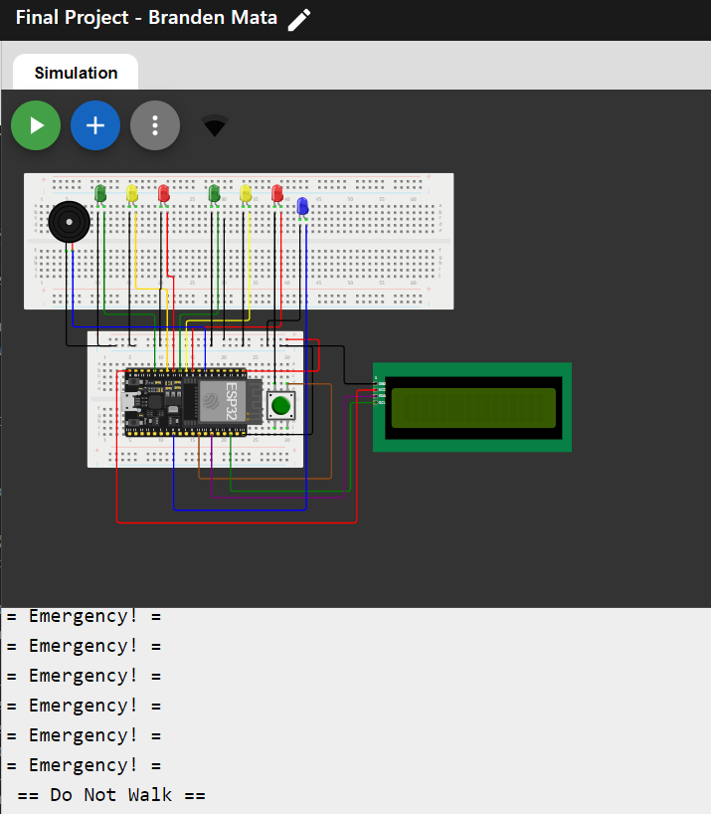
Screenshot of Serial Monitor (Testing)
Screenshot of output in Serial Monitor

Slide 25
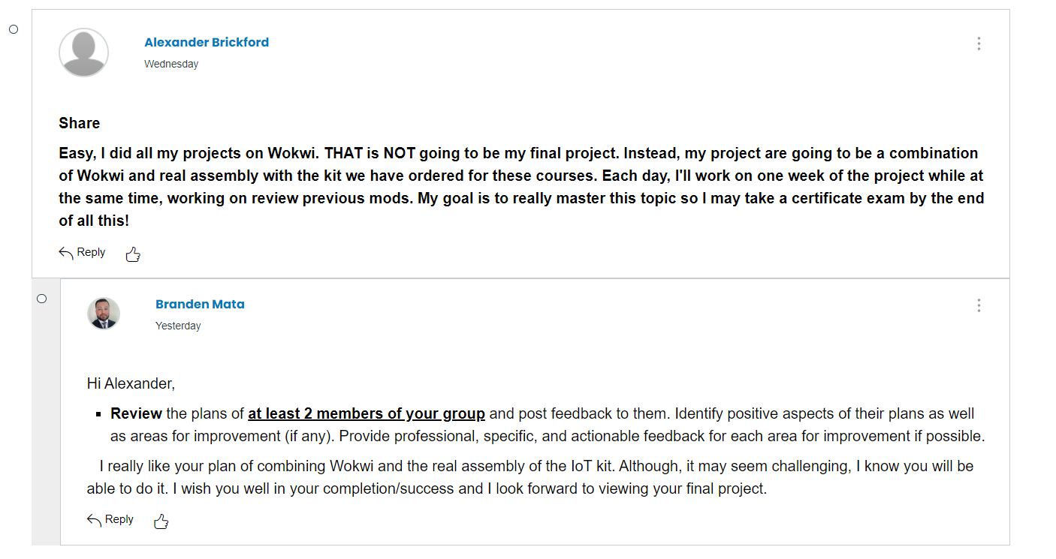
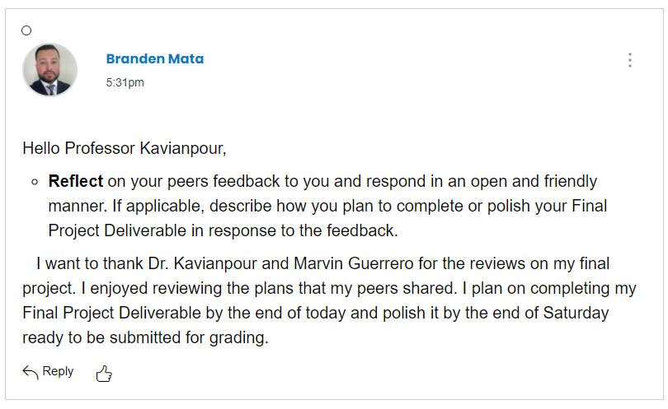
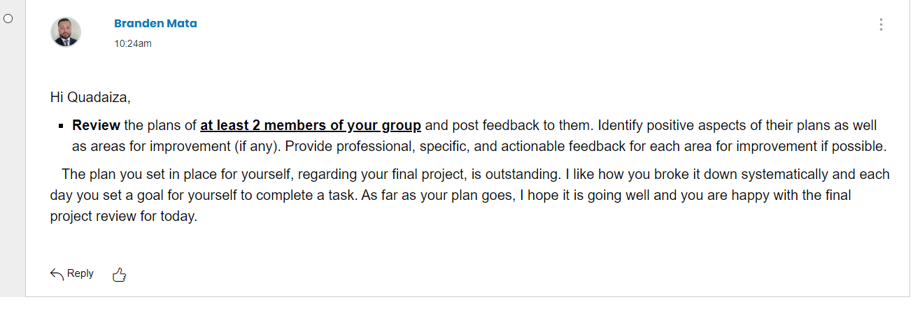
Peer Review
Reflection
Review #1 (screenshot)
Reflection (screenshot)
Review #2 (screenshot)

Slide 26
Challenges
I had trouble at first, downloading the correct link for the Google Play emulator on my PC while working on the Final Project Component.
The Google Play emulator allowed me to download the IoT MQTT Panel application and complete my project.

Slide 27
Career Skills
Create a Multi-Intersection Traffic Light System using Wokwi Lab.
Build the traffic lights by integrating IoT control using the cloud service.
Exercise emergency personal access to the traffic light control.

Slide 28
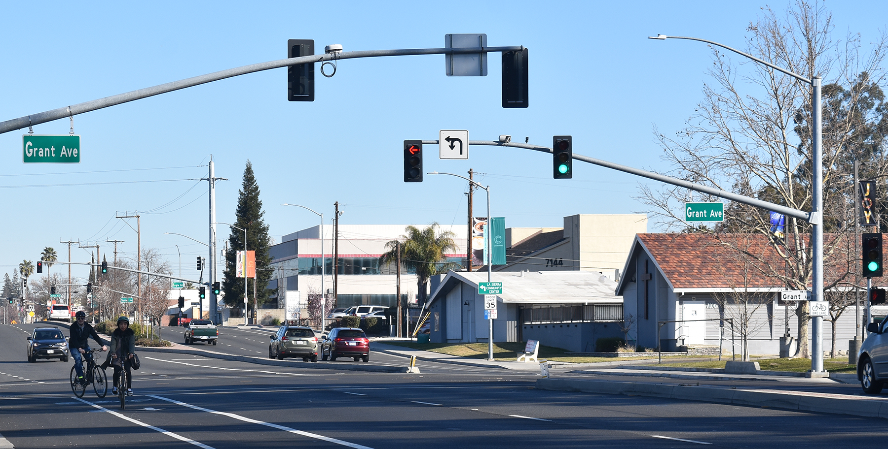
Conclusion
Designing and implementation of intelligent tragic light systems is the key focus in the field of transportation engineering. This project has provided me with hands-on experience in creating a Multi-Intersection Traffic Light System using Wokwi Lab.

Slide 29
References
  Project Files
  Final Project Guide
  Final Course Project Template
  Project Guide Walkthrough Videos & Final Course video

