Slide 1




NETW310 COURSE PROJECT
Rules of 10’s & 3’s
Branden Mata
Bachelor of Science,
Information Technology & Networking,
DeVry University
NETW310: Wired, Optical and Wireless Communication with Lab
Professor Halsey
October 26th, 2024

Slide 2

Introduction
The project introduces modulation mechanisms, encoding schemes, characteristics of wireline and wireless transmission media that make digital transmission possible.
The implementation and analysis of simulations involve baseband signals, AM/FM signals, Pulse Code Modulation (PCM), line codes, antenna gain, free space path loss, and fading channels.

Slide 3

NETW311 Course Project
Module 2
Baseband Signals and AM/FM Signals
Branden Mata

Slide 4
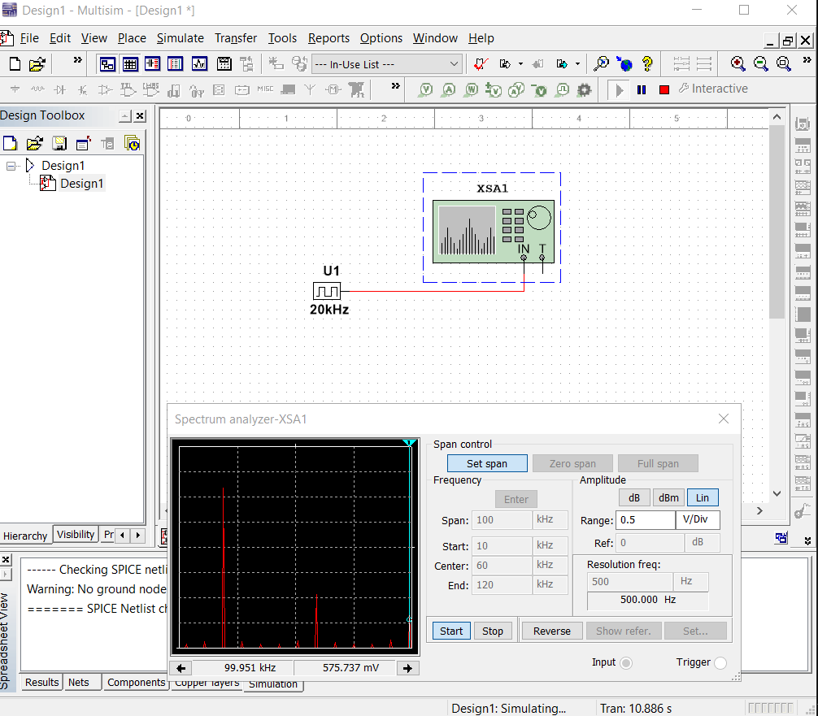
Baseband Signals
The screenshot should show the spectrum analyzer displaying the signal’s harmonic spectrum and its panel settings. Record the signal voltage at each of the frequencies in the table.
Harmonic Frequency | Signal (Volts)
20 kHz | 2.427 V
40 kHz | 2.03 uV
60 kHz | 866.7 mV
80 kHz | 1.656 uV
100 kHz | 575.737 mV

Slide 5
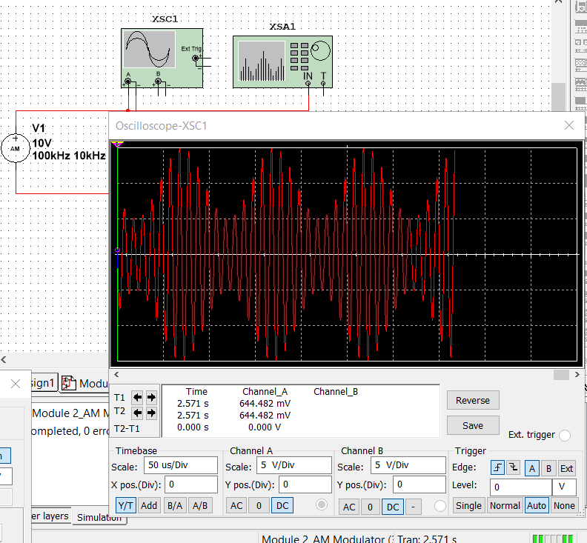
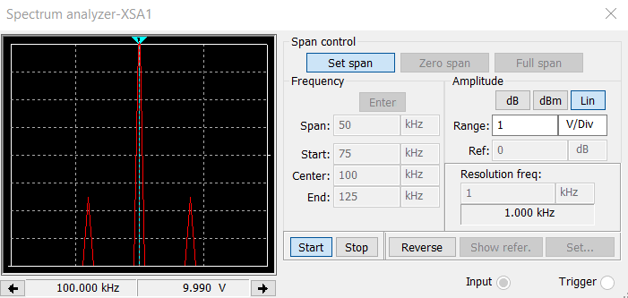
AM Signals
The screenshot of the Oscilloscope should include the signal and the panel settings of the oscilloscope. The screenshot of the Spectrum Analyzer should include the signal and the panel setting of the analyzer.
AM Modulation | Frequency (kHz)
Lower side band | 90
Carrier | 100
Upper side band | 110

Slide 6
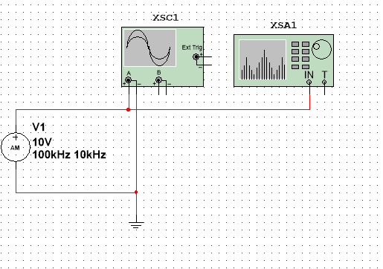
AM Signals Cont.
Develop equations for the carrier and modulating signals and plot the equation for the composite modulated signal V_{AM .}
Equations here:
In 9, the equation for the carrier signal is:
𝑣𝑐= 10𝑠𝑖𝑛(2𝜋∗100𝐾)𝑡 = 10𝑠𝑖𝑛(200𝐾∗𝜋)𝑡
The equation for the modulating signal is:
𝑣𝑚= 5𝑠𝑖𝑛(2𝜋∗10𝐾)𝑡 = 10𝑠𝑖𝑛(20𝐾∗𝜋)𝑡
In 12, using the trigonometric identities given in the Lab, the composite equation for the modulated AM signal is:
𝑣𝐴𝑀= 10sin(2𝜋𝑓𝑐𝑡)+5(12)[(𝑐𝑜𝑠2𝜋(𝑓𝑐−𝑓𝑖)𝑡−cos 2𝜋(𝑓𝑐+𝑓𝑖 )t]
Assume that 𝑓𝑐=100𝐾𝐻𝑧 𝑎𝑛𝑑 𝑓𝑖=10𝐾𝐻𝑧. Sketch a graph of the Frequency Spectrum (Frequency Domain) of the composite modulated signal in terms of the amplitude (Volts) versus frequency (KHz). Compare this result with the Multisim simulation.
Therefore, the equation is:
𝒗𝑨𝑴= 10𝐬𝐢𝐧(𝟐𝝅(𝟏𝟎𝟎𝐊)𝒕)+𝟓(𝟏𝟐)[(𝒄𝒐𝒔𝟐𝝅(𝟗𝟎𝐊)𝒕−𝐜𝐨𝐬 𝟐𝝅(𝟏𝟏𝟎𝐊 )t]
or
𝒗𝑨𝑴= 10𝐬𝐢𝐧((𝟐𝟎𝟎𝐊∗𝝅)𝒕)+𝟓(𝟏𝟐)[(𝒄𝒐𝒔(𝟏𝟖𝟎𝐊∗𝝅)𝒕−𝐜𝐨𝐬 (𝟐𝟐𝟎𝐊∗𝝅 )t]
Now, substituting 3.14 for Pi and multiplying through and substituting the appropriate variables we have:
y= 10*sin(628000x) + 2.5*cos(565200x) - 2.5*cos(690800x)
Plotted diagram:

Slide 7
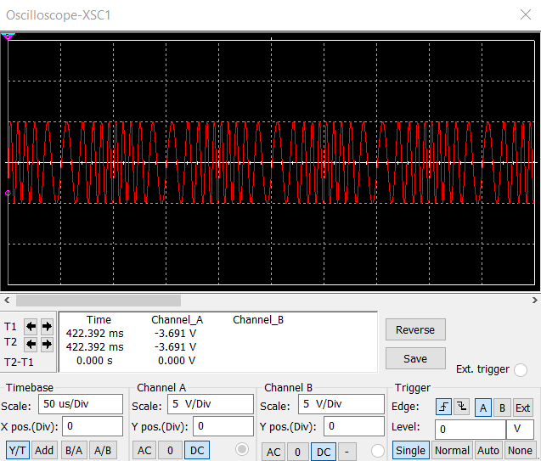
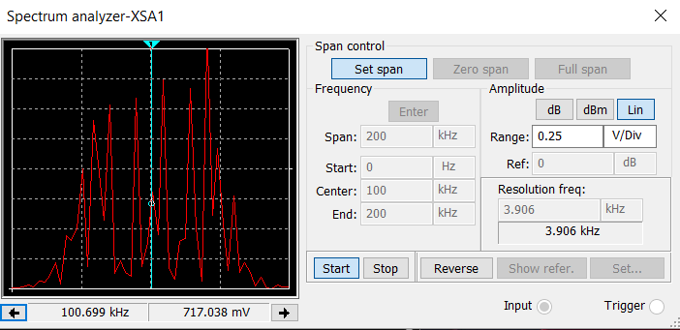
FM Signals
The screenshot of the Oscilloscope should include the signal and the panel settings of the oscilloscope. The screenshot of the Spectrum Analyzer should include the signal and the panel setting of the analyzer.
Oscilloscope
Spectrum Analyzer
What’s the carrier frequency?
100khz

Slide 8
NETW310 Course Project
Module 3
Pulse Code Modulation (PCM) and Line Codes
Branden Mata

Slide 9
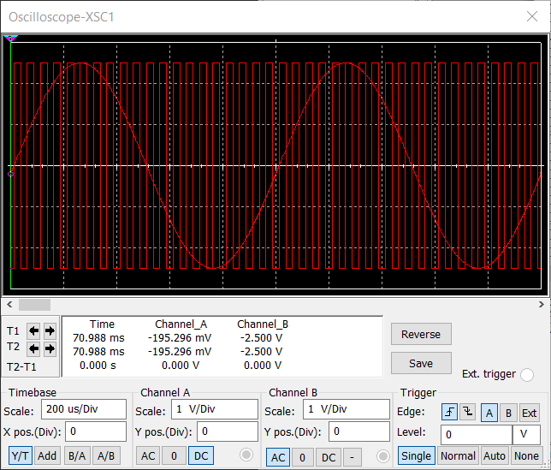
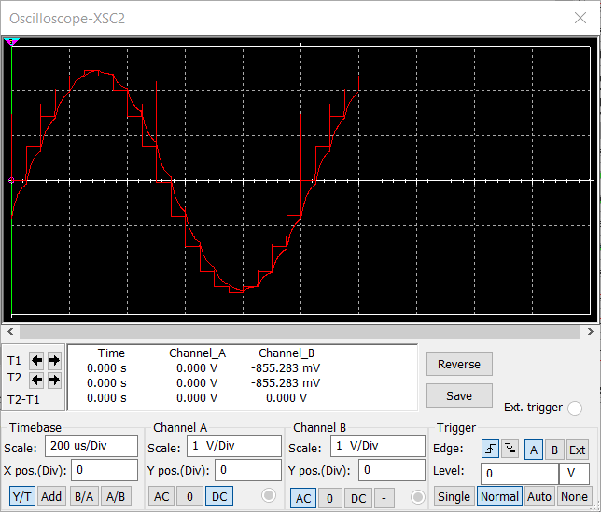
Pulse Code Modulation (PCM)
The first screenshot should show the Oscilloscope-XSC1 display with the analog input signal and sampling clock at the input to the ADC. The second screenshot should show the Oscilloscope-XSC2 display with the output of the DAC.

Slide 10
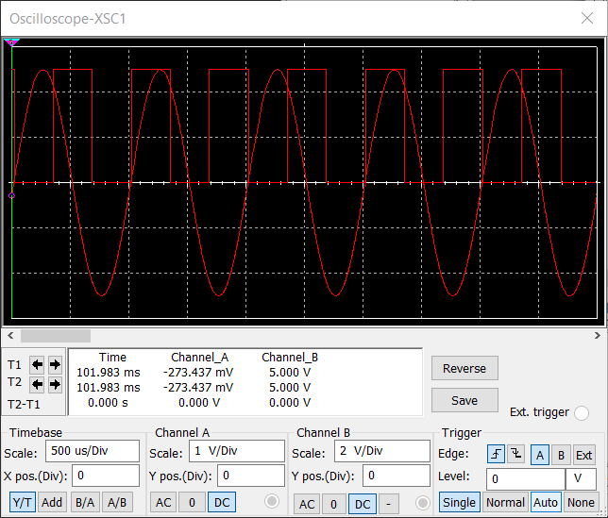
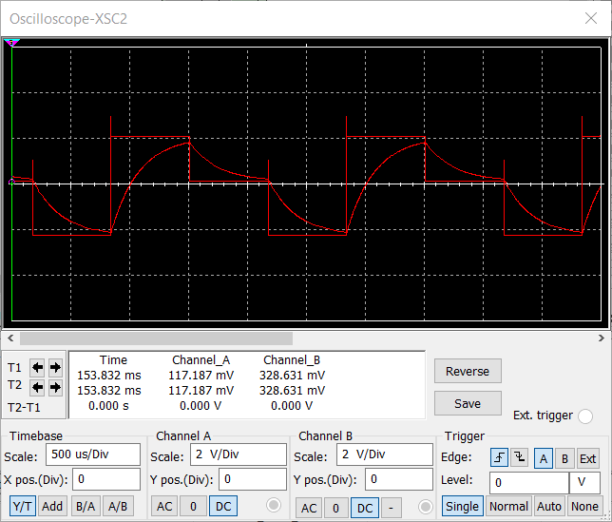
Pulse Code Modulation (PCM)
The first screenshot should show the Oscilloscope-XSC1 display with the analog input signal and sampling clock at the input to the ADC. The second screenshot should show the Oscilloscope-XSC2 display with the output of the DAC.
What are the effects of increasing or decreasing the sampling rate?
Answer: The effect of decreasing the sampling rate will expand the data and increasing will tighten it.

Slide 11
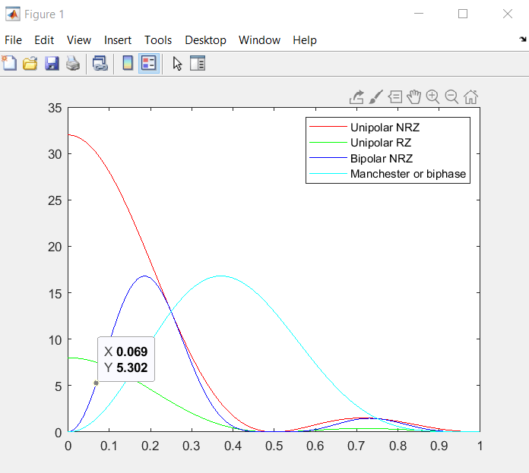
Line Codes
This screenshot should show the power spectral densities of four-line codes: NRZ-Polar, NRZ-Unipolar, NRZ-Bipolar, and Manchester-Polar.
MATLAB Diagram
Compare the NRZ-Bipolar and Manchester polar codes in the diagram.
Which one requires more bandwidth?
Answer:
Bipolar NRZ (Blue) has most of it’s energy between 0 and 0.5 Bit Rate, and Manchester (light blue) has most of it’s energy between 0 and 0.9 Bit Rate. Therefore, Manchester (light blue) requires more bandwidth.

Slide 12
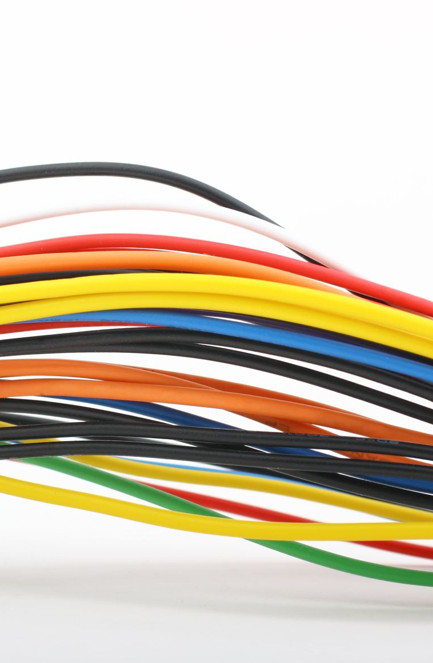
NETW310 Course Project
Module 4
Cables and Structured Cabling
Branden Mata

Slide 13
Questions
1. Why must the twisting in the individual wires be maintained in a UTP cable?
Answer:
The twisting in the individual wires must be maintained in a UTP cable, because the performance can only be achieved with the use of compliant components.
2. How many inches should UTP cable be separated from 110 volts electrical cable?
Answer:
The UTP cable should be separated by at least 12 inches from 110 volts electrical cable.
3. Horizontal cabling connects what areas to each other?
Answer:
Horizontal cabling connects the work area telecommunications information outlet to the telecommunications room.
Horizontal cabling
Cable Terminations
Telecommunications outlet
Cross-connections
Patch Cords

Slide 14
Questions
4. What is a plenum rated cable?
Answer:
A plenum rated cable is a cable with UL 2043 rated plugs to ensure building safety and gives a cleaner look in open ceilings.
5. What is a riser tube used for?
Answer:
A riser tube is used for vertical applications, which transmit signals and power between different floors of a building.
6. Is the grounding of equipment mostly a safety or a performance concern?
Answer:
The grounding of equipment is mostly a safety concern as specified in the J-STD-607-A standard.

Slide 15
References
1.
Vincent. (n.d.). Network Cable Standards: TIA 568 vs ISO 11801 vs EN 50173 | FS Community. Knowledge. https://community.fs.com/article/network-cable-standards-tia-568-vs-iso-11801-vs-en-50173.html
2. https://web.anixter.com/AXECOM/AXEDocLib.nsf/(UnID)/8F2E0839A6190F4986257309005757CC/$file/ANSI-TIA-EIA-568-B.pdf
3.
https://www.bicsi.org/docs/default-source/conference-presentations/2018-fall-conference/new-cabling-standards-for-the-buildings-of-today-and-tomorrow.pdf?sfvrsn=d3647f7e_2
4.
What are riser cables. (n.d.). Tektel.com. https://tektel.com/blogs/cable-university/what-are-riser-cables

Slide 16

NETW310 Course Project
Module 5
Antenna Gain and Free Space Path Loss
Branden Mata

Slide 17
Antenna Gain
1. What is the maximum theoretical antenna gain of a common dish antenna at the 2.4 GHz band? [4 points]
Answer:
The maximum theoretical antenna gain of a common dish antenna at the 2.4 GHz band with a diameter of 0.5 meters is 22.379 dB.
2. What is the maximum theoretical antenna gain of a common dish antenna at the 5 GHz band? [4 points]
Answer:
The maximum theoretical antenna gain of a common dish antenna at the 5 GHz band with a diameter of 0.5 meters is 29.079 dB.
3. Given the same sized reflector, which signals, high-frequency, or low-frequency, can be more efficiently focused by a common dish antenna (i.e., result in a higher antenna gain)? [5 points]
Answer:
Given the same sized reflector, high-frequency signals can be more efficiently focused by a common dish antenna.
4. What is the maximum theoretical antenna gain of the dish antenna used in the VLA radio telescopes in New Mexico at the 5 GHz band? [4 points]
Answer:
The maximum theoretical antenna gain of the dish antenna used in the VLA radio telescopes in New Mexico at the 5 GHz band with a diameter of 25 meters is 63.056 dB.
5. Given the same signal frequency, which dish antennas, large-sized or small-sized, are more efficient at focusing the signal (i.e., result in a higher antenna gain)? [5 points]
Answer:
Given the same signal frequency, large-sized dish antennas are more efficient at focusing the signal.

Slide 18
Free Space Path Loss
1. What is the free space path loss in dB at the 2.4 GHz band? [4 points] Answer:
The free space path loss at the 2.4 GHz band with 0.1 kilometers is -80.4 dB
2. What is the free space path loss in dB at the 5 GHz band? [4 points] Answer:
The free space path loss at the 5 GHz band with 0.1 kilometers is -87.2 dB
3. How does the free space path loss at a higher frequency (e.g., the 5 GHz band) compare with that at a lower frequency (e.g., the 2.4 GHz band)? [5 points]
Answer:
The free space path loss at a higher frequency compares with that at a lower frequency by 6.8 more gain.
4. What is the free space path loss in dB over 20 meters at the 2.4 GHz band? [4 points]
Answer:
The free space path loss in dB over 20 meters at the 2.4 GHz band is -66.421 dB.
5. What is the free space path loss in dB over 40 meters at the 2.4 GHz band? [4 points]
Answer:
The free space path loss in dB over 40 meters at the 2.4 GHz band is -72.441 dB.
6. What is the free space path loss in dB over 80 meters at the 2.4 GHz band? [4 points]
Answer:
The free space path loss in dB over 80 meters at the 2.4 GHz band is -78.462 dB.
7. When the distance doubles, how does free space path loss in dB change approximately? [5 points]
Answer:
When the distance doubles, the free space path loss in dB change approximately by -6.02 dB.

Slide 19

Free Space Path Loss Cont.
8. Use a scientific calculator to calculate Delta $L_{fS}$ for D1 = 20 meters and D2 = 40 meters. [4 points]
Delta $L_{fS }$= -6.02 dB
9. Is your calculation approximately the same as the result from Part 1 Step 2? [4 points]
Answer:
My calculation using the quotient rule is approximately the same result from Part 1 Step 2.

Slide 20
References
1. NETW310 Live Session 10/03/2024
2. NETW310 CP Guide Module 5
3. Convert m to km. (n.d.). https://www.unitconverters.net/length/m-to-km.htm
4. Desmos | Scientific Calculator. (n.d.). https://www.desmos.com/scientific

Slide 21
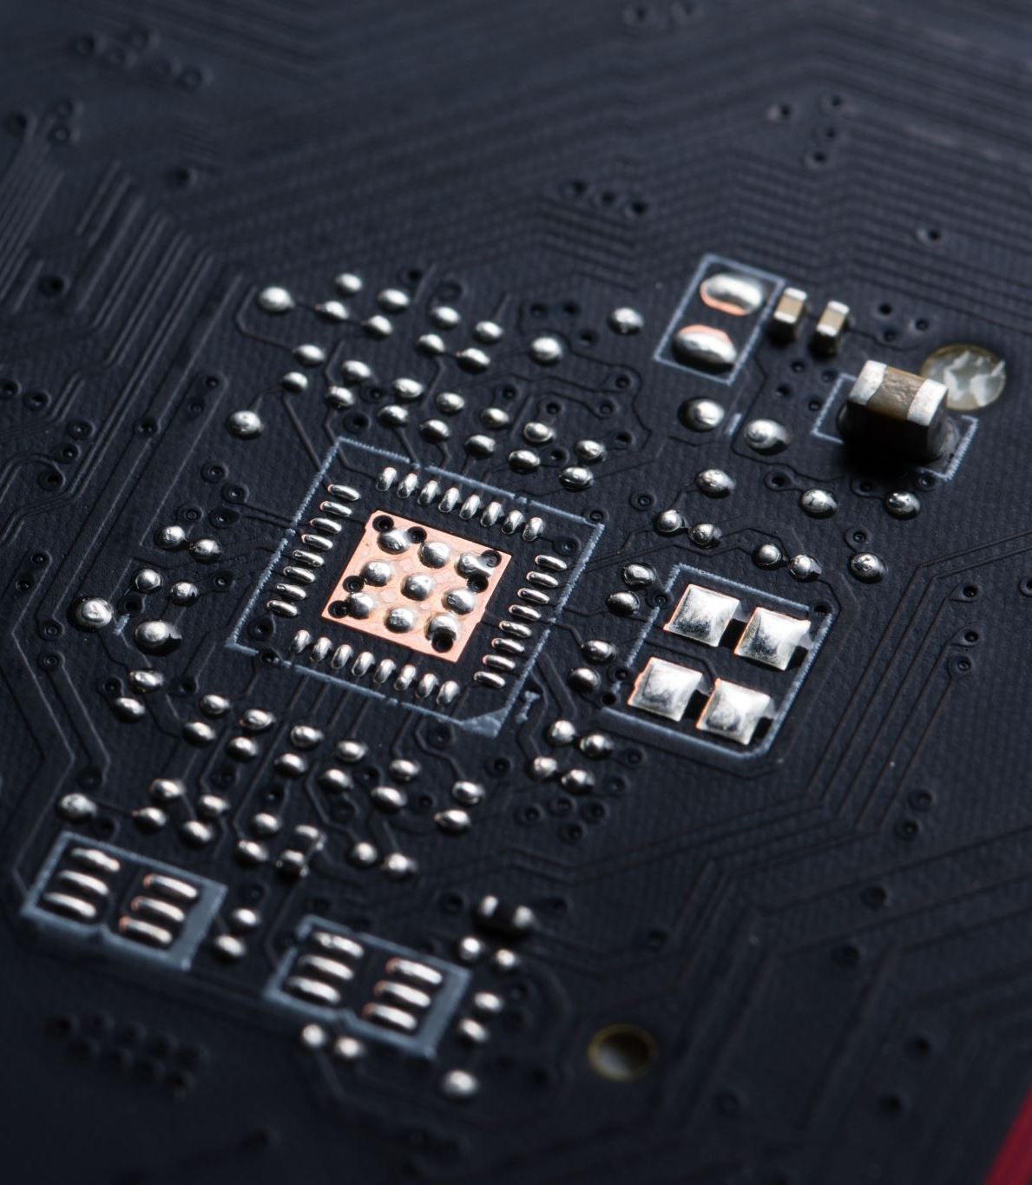
NETW310 Course Project
Module 6
Bit Error Rate of Fading Channels
Branden Mata

Slide 22
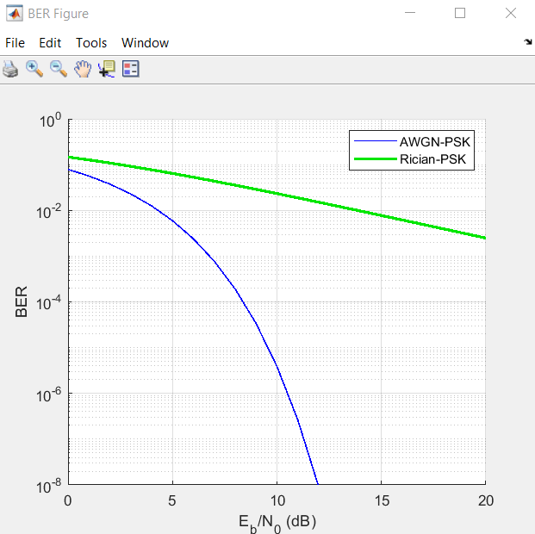
AWGN Channel and Rician Channel
This screenshot should show the bit rate error performance of both AWGN and Rician fading channels.

Slide 23
AWGN Channel and Rician Channel
Compare and contrast the BER performance of PSK over a noise limited (AWGN) transmission channel to the performance of PSK over a Rician channel at 5- and 10-dB Signal to Noise Ratio (E_{b}/N₀), respectively.
Is there a significant difference in BER performance of PSK between the AWGN channel and Rician channel?
Answer:
BER Performance of PSK of the AWGN channel:
At a 5dB SNR, the BER of FSK is approximately 4 bits in error for every 100 bits transmitted (BER = 4*10‐2). The BER of DPSK at a 5dB SNR is approximately 2 bits in error for every 100 bits transmitted (2*10‐2). The BER of PSK at a 5dB SNR is approximately 5 bits in error for every 1000 bits (5*10‐3) transmitted. Therefore, at a 5dB SNR, DPSK performs marginally better than FSK, and PSK performs marginally better than DPSK. However, at SNR’s of 10dB or more, the BER falls‐off dramatically and the differences in performance of each modulation type becomes more dramatic. For example, at a 10 dB SNR the BER is approximately 3*10‐6 for PSK (on average, 3 bits are in error for every million bits transmitted), versus 2*10‐5 (on average, 2 bits are in error for every hundred thousand bits transmitted) for DPSK, and approximately 8*10‐4 (on average, 8 bits in error for every 10 thousand bits transmitted) for FSK.
BER Performance of the Rayleigh channel:
At a SNR of 10dB, the BER rate of the AWGN channel is approximately 3*10‐6 (three bits in error for every one‐million bits transmitted) versus approximately 2*10‐2 (two bits in error for every hundred bits transmitted) over the Rayleigh channel. Therefore, at a SNR of 10dB, with PSK modulation, the AWGN channel outperforms the Rayleigh channel by a factor of approximately 7000!
BER Performance of the Rician channel:
If the transmission medium is wireless (e.g., a radio link like cellular communications), the performance of the transmission channel is dominated by Rician or Rayleigh fading. As we can observe on the plot, Rician channel dominated in BER performance of PSK over the AWGN channels.

Slide 24
References
1. NETW310 – Module 6: Course Project Guide
2. NETW310 – Live Session Recording

Slide 25
Challenges
Developing equations for the carrier and modulating signals and plot the equation for the composite modulated signal VAM .
Compare and contrast the BER performance of PSK over a noise limited (AWGN) transmission channel to the performance of PSK over a Rician channel at 5- and 10-dB Signal to Noise Ratio (Eb/N0).

Slide 26
Career Skills Obtained
Set up, Run and test simulations on a cloud platform utilizing principles of technology.
Analyze and Identify unknown problems utilizing mathematical and scientific methods, software, and/or equipment.

Slide 27
Conclusion
The project introduces modulation mechanisms, encoding schemes, characteristics of wireline and wireless transmission media that make digital transmission possible.

