Slide 1

CEIS 106
Operating Systems
Branden Mata

Slide 2

Introduction
This project covers fundamentals of the Linux operating system in a virtualized environment. It includes activities such as navigating the Linux file system, writing shell scripts, managing users and groups, understanding IP configurations, and monitoring system performance. It lays the foundation for understanding of emerging technologies such as Virtualization and Cloud Computing.

Slide 3
Navigate the Linux filesystem tree
1. What is the pwd command an acronym for? What about the cd command?
Answer here:
pwd – print working directory – shows our current location in the filesystem
cd – change directory – change the directory that you give it
2. Explain the differences between a relative path and an absolute/full path in Linux.
Answer here:
Relative path is the path based on where you are currently located – relative to your current location
cd Documents
Absolute path is the entire path from the very top of the filesystem, which is called the root
cd /home/student/Documents
Reference:
1. Project Recording

Slide 4
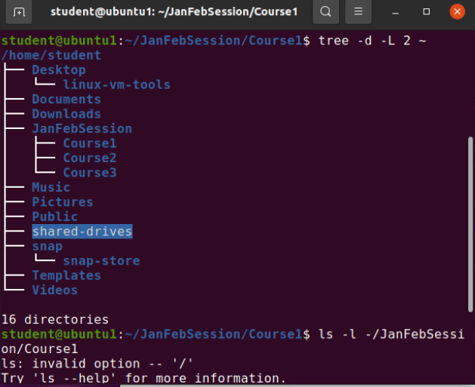
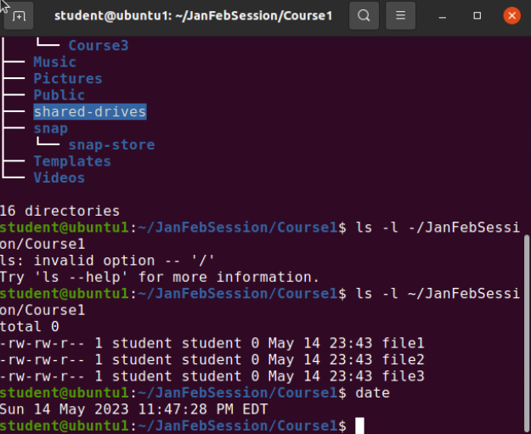
Create directories and files
Take a screenshot of the output in Part 2: Create Directories and Files

Slide 5
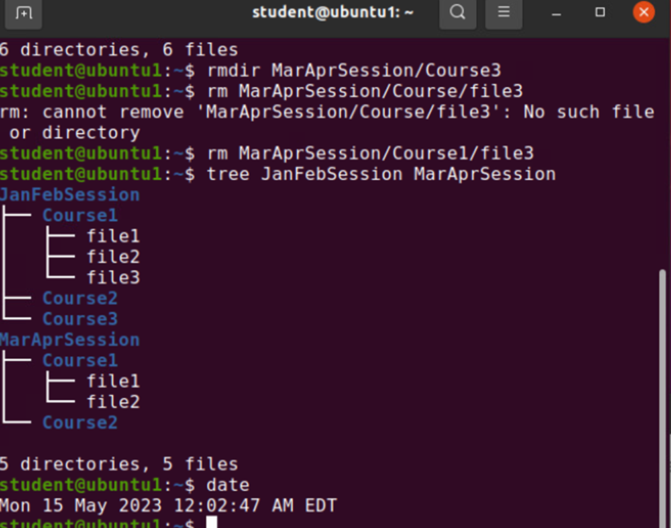
Copy and remove directories and files
Take a screenshot of the output in Part 3: Copy and Remove Directories and Files

Slide 6
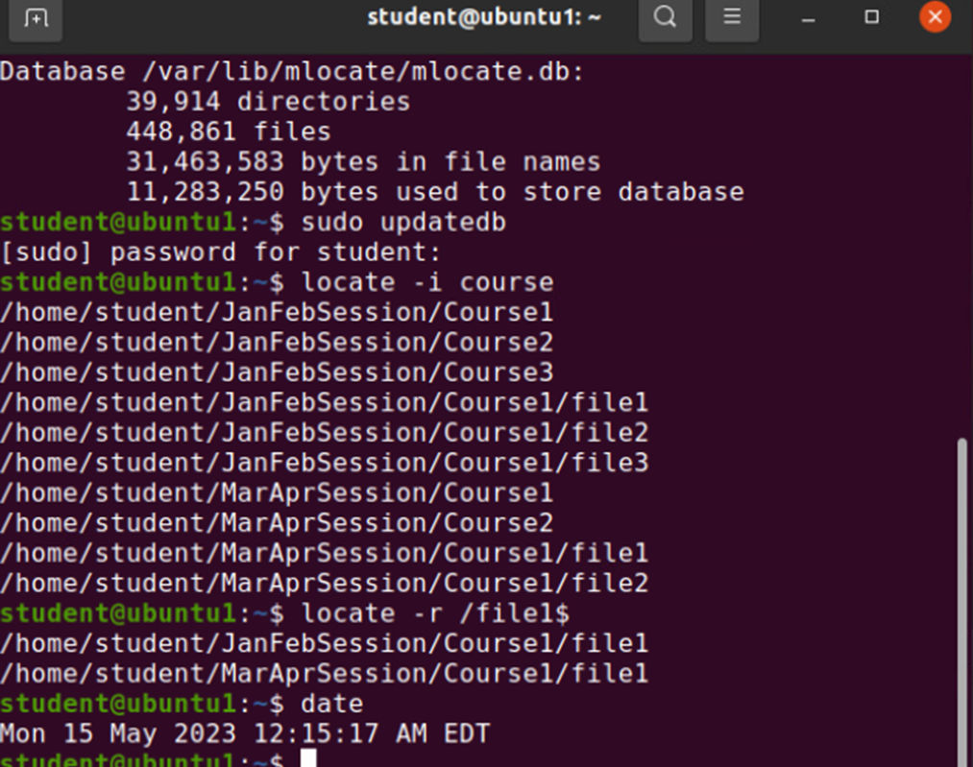
Locate directories and files
Take a screenshot of the output in Part 4: Locate Directories and Files

Slide 7
Create a shell script
1. What are the file permissions of the script?
Answer here:
-rw –rw- r--
2. What’s the name of the user-defined variable in the script?
Answer here:
3. Which redirection meta-character is used in the script? What does it do?
Answer here:
>> - append the output to the end of the title and retain the content of the file
References:
1. Live Session

Slide 8
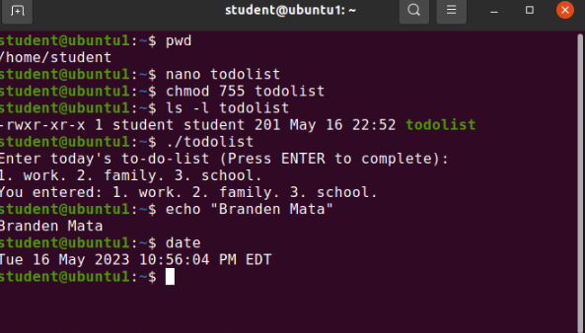
Change script file permissions
Take a screenshot of the output in Part 2: Change Script File Permissions

Slide 9
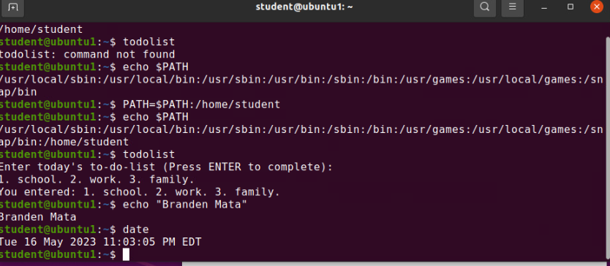
Set the PATH variable
Take a screenshot of the output in Part 3: Set the PATH Variable

Slide 10
Add users and groups in CLI
1. What does the –m option in the useradd command do?
Answer here:
-m -- tells useradd command to create a home directory for this new user
2. What does the -3 option in the tail command do?
Answer here:
-3 – tells tail command how many lines to show from the end of the file
3. Which line of the /etc/group file lists members of the “students” group? Copy it here.
Answer here:
References:
1.Project Video

Slide 11
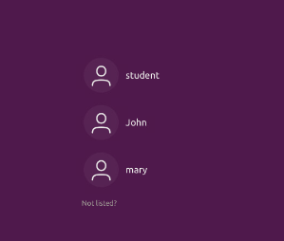
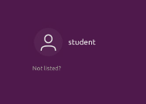
Remove users and groups
Two screenshots are required here.
First, take a screenshot of the log on page with all three accounts from Part 3.
Second, take a screenshot of the log on page with only your user account (i.e., student) from Part 4.

Slide 12
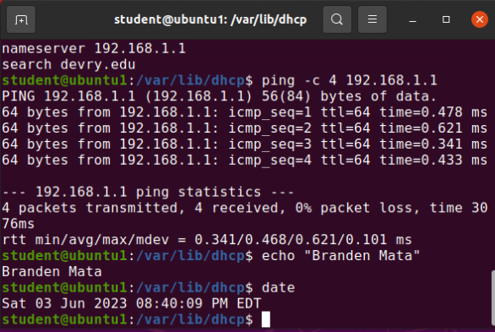
Discover host IP configurations
Take a screen capture of the output in Step 12.
1. What is the IP address of your Ubuntu machine?
Answer here:
192.168.1.107
2. What is the IP address of its default gateway?
Answer here:
192.168.1.1
3. What is the IP address of its DHCP server?
Answer here:
192.168.1.1
4. What is the IP address of its DNS server?
Answer here:
192.168.1.1

Slide 13
Manage network interfaces
1. Which DHCP message is shown in the output of the sudo dhclient –v –r ens33 command?
Answer here:
DHCPRELEASE
2. Which four DHCP messages are shown in the output of the sudo dhclient –v ens33 command?
Answer here:
DHCPDISCOVER
DHCPOFFER
DHCPREQUEST
DHCPACK

Slide 14
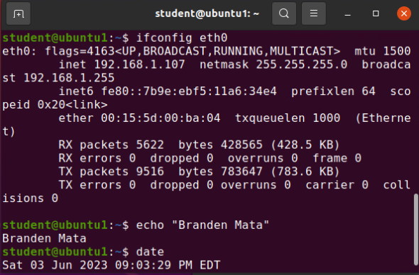
Use network utilities
Take a screen capture of the output in Step 7 and Step 8.

Slide 15
Monitor Linux processes
1. What is the default action of the 15 SIGTERM kill signal?
Answer here: Kill the highlighted process.
2. In the System Monitor window, click on % CPU to sort the processes by CPU load. Which process shows the highest percentage of CPU usage?
Answer here: gnome-shell (GUI)
References:
1. Project Assistance Video

Slide 16
Monitor user activities
Issue the sudo accton on command to turn on GNC accounting. Run the sudo updatedb command. Enter lastcomm updatedb to check if the updatedb command was executed before. Remember to turn off GNC accounting (sudo accton off) after answering the questions.
1. What flag value is displayed in the output?
Answer here: S -- “super user”
2. Why is the name of the user who ran the processes shown as root, not student?
Answer here: superuser – since we typed sudo in front of the command
References:
1. Project Assistance Video

Slide 17
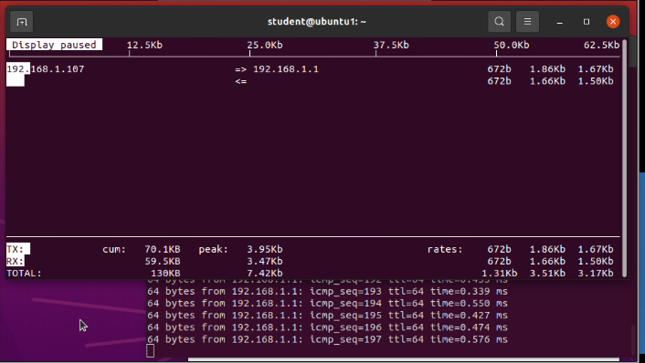
Monitor network bandwidth usage
Take a screenshot of the output in Step 4.

Slide 18


Challenges
Inputting data exactly as written to execute commands properly
Internet connection would freeze at times while using ubuntu, but it will reload, and I would continue my progress

Slide 19

Career Skills
navigating the Linux file system
writing shell scripts
managing users and groups
understanding IP configurations
monitoring system performance.

Slide 20

Conclusion
this project lays the foundation for understanding of emerging technologies such as Virtualization and Cloud Computing.

