Slide 1
CEIS 110
Programming with Data
Branden Mata

Slide 2
Introduction
Data is growing exponentially.
This project uses a cloud-based system to gather temperature and humidity data.
Then, the data is analyzed using programming and data analytics.

Slide 3
Software Inventory
Before developing this programming with data project, all software must be downloaded and installed.
Software needed included Microsoft Excel and Python.

Slide 4
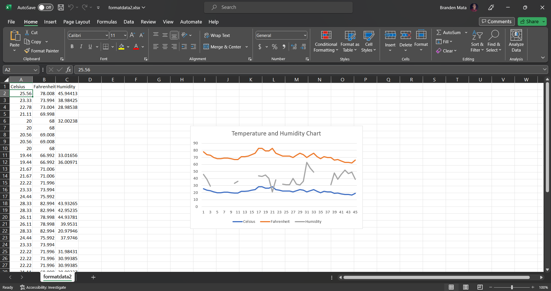
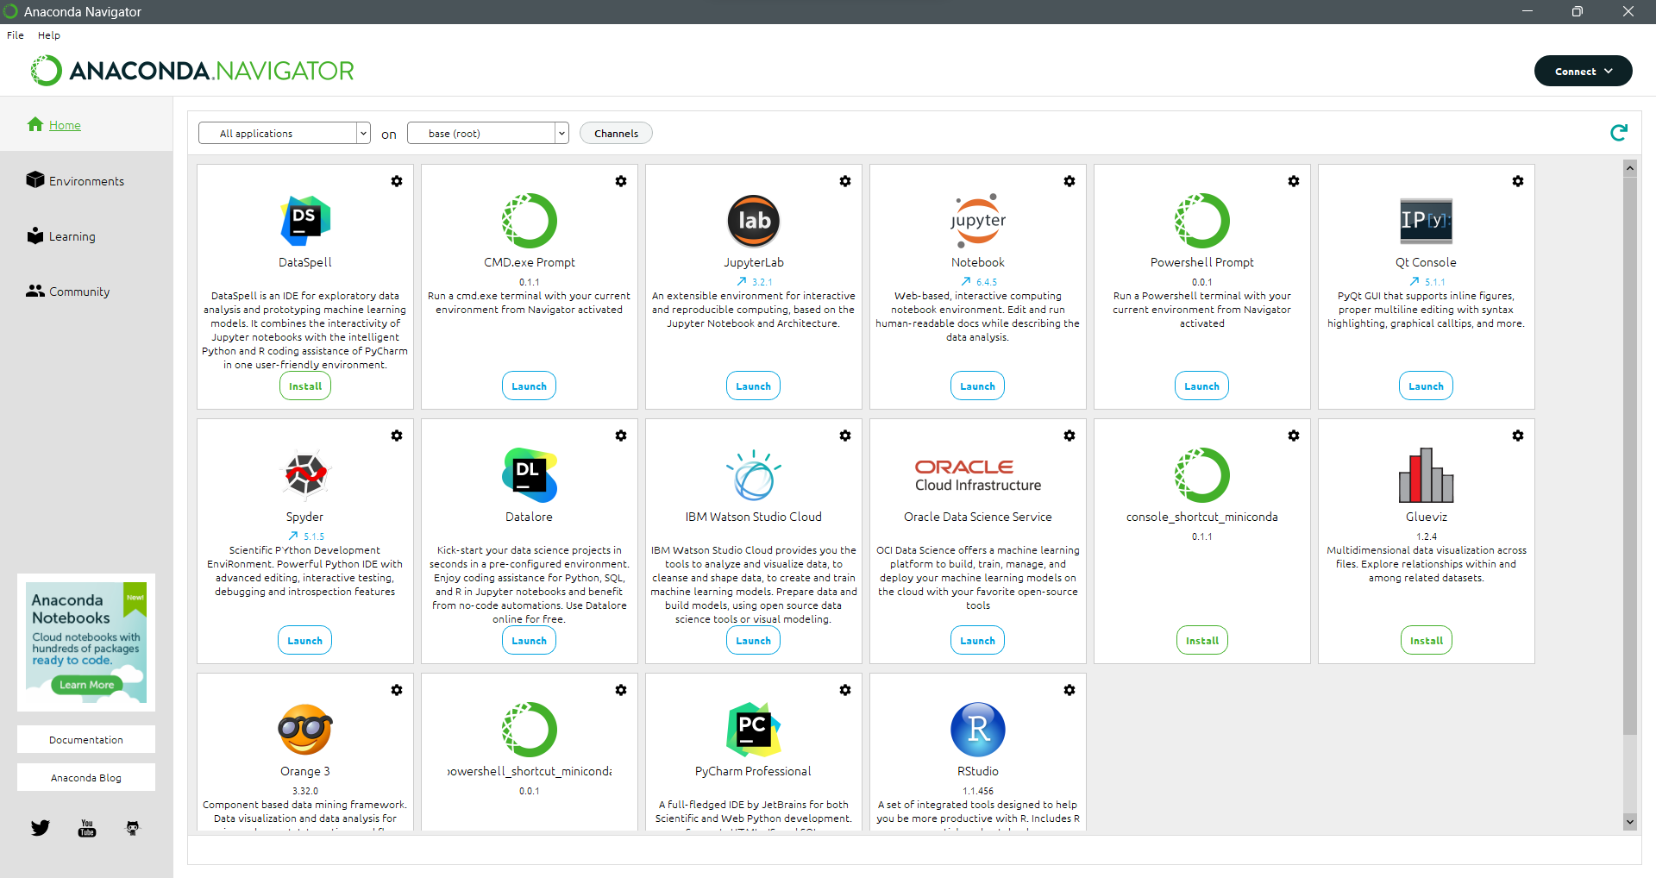
Software
The software needed for this project includes: Microsoft Excel.
Anaconda Navigator with Spyder or Replit.

Slide 5
Planning and design
After performing an inventory of the software needed for the project, a plan was created for the temperature data project.
To plan the design of the project, a flowchart was generated.
Planning and design of the project are crucial steps to understanding the development process.

Slide 6
What are flowcharts?
Flowcharts are graphical presentations of processes or workflows, and the flowchart developed illustrates the process and the output of this software development project.
Many companies use flowcharts as simple narratives.

Slide 7
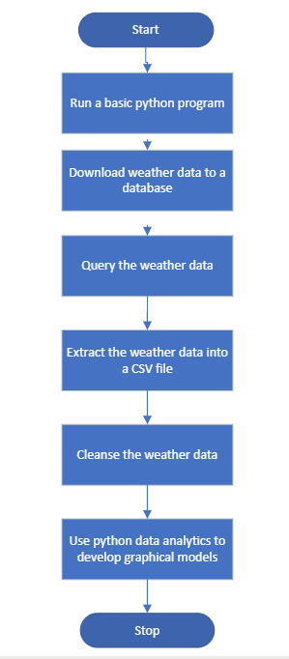
FLowcharts
Install Python
Download weather to a database
Extract weather data from database into a comma separated file with Python
Cleanse weather data
Use Excel to manipulate data
Use Python data analytics modules to develop graphical models

Slide 8
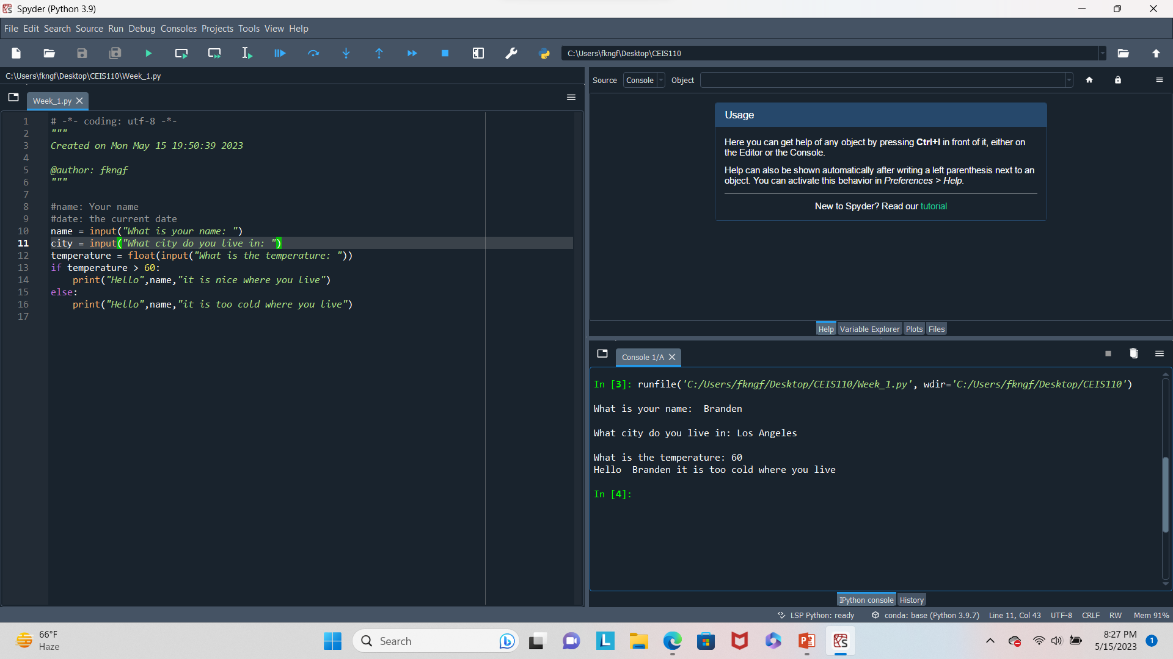
Introduction to Python
Python is a popular programming language used for business, web, data analytics, and scientific analysis. This program illustrates a selection control structure in Python.

Slide 9
Gathering temperature and humidity data
After planning and design, the code was developed to download a set of weather observations
This data was stored on a local database in a table for later analysis

Slide 10
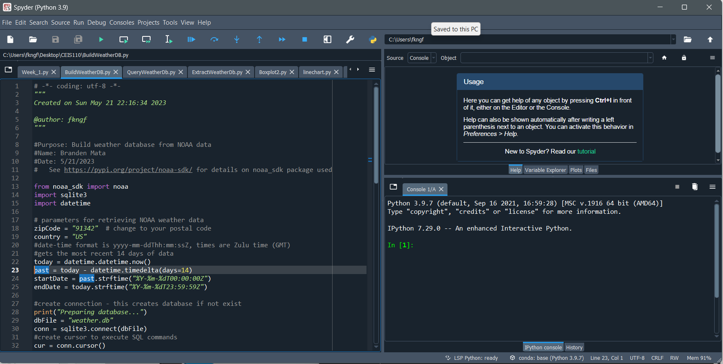
BuildWeatherDB.py Code
(screenshot)
Screenshot of code in Spyder
The code will create a table named Observations with the fields: timestamp, WindSpeed, temperature, relativeHumidity, windDirection, barometricPressure, visibility, and textDescription
The database will be named weather.db and stored in the same directory as the Python code

Slide 11
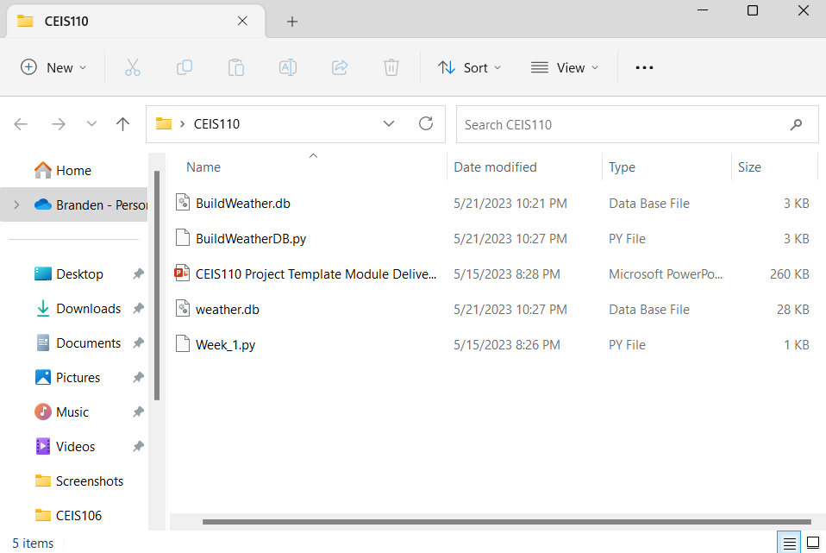
Weather.db File
(screenshot)
Screenshot of Windows Explorer showing database file Weather.db was created

Slide 12
Querying the database
Structured Query Language (SQL) is a programming language used for working with relational databases
SQL was used to query the database and view the results

Slide 13
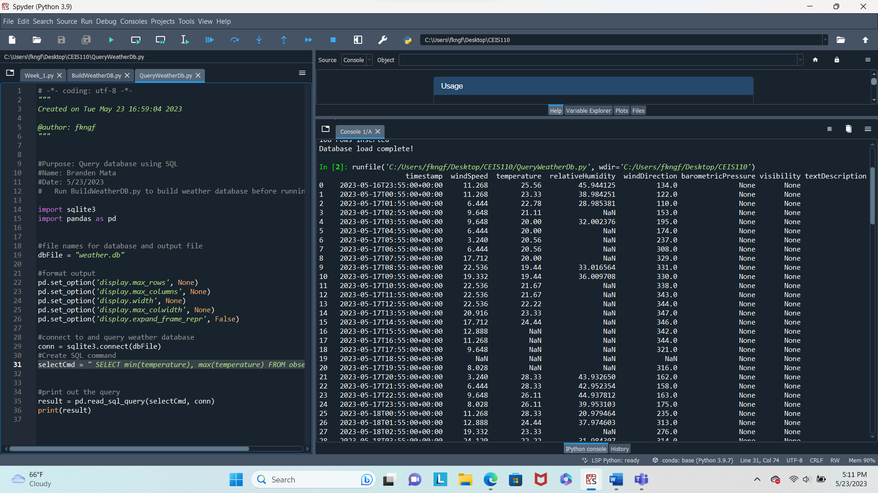
Query to retrieve all columns and all rows (Screenshot)
The SQL command “select* from observations” was executed to retrieve all rows and columns from the observations table

Slide 14
Query to Retrieve lowest and highest temperature (Screenshot)
The min and max temperatures were retrieved. These temperatures are captured based on the Celsius scale

Slide 15
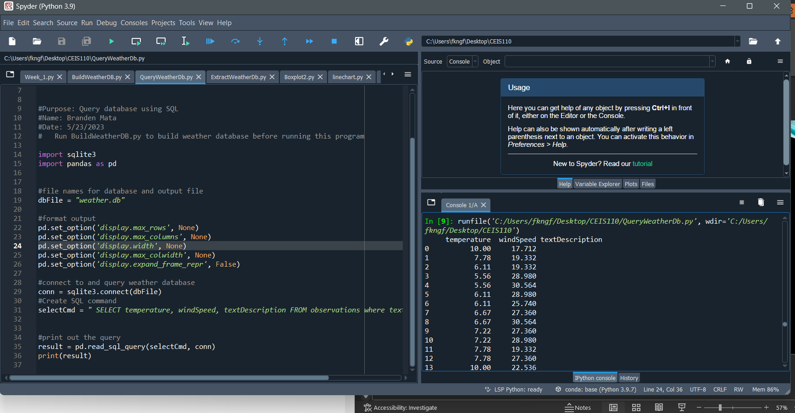
Query to retrieve the data when the weather is clear
(screenshot)
Another query was performed to retrieve the temperature, windspeed, and textdescription when the weather is clear.

Slide 16
Data cleansing
Data output from machines may have errors or extraneous data. When cleansing the data, programs can automatically put it in the format needed to be read by other programs.
A python program is reading in the data output by the python program a saving it in a csv file so that it can be read by Excel.
Often data must be cleansed of spurious or missing values in a dataset. The data must be complete, valid, and standardized.

Slide 17
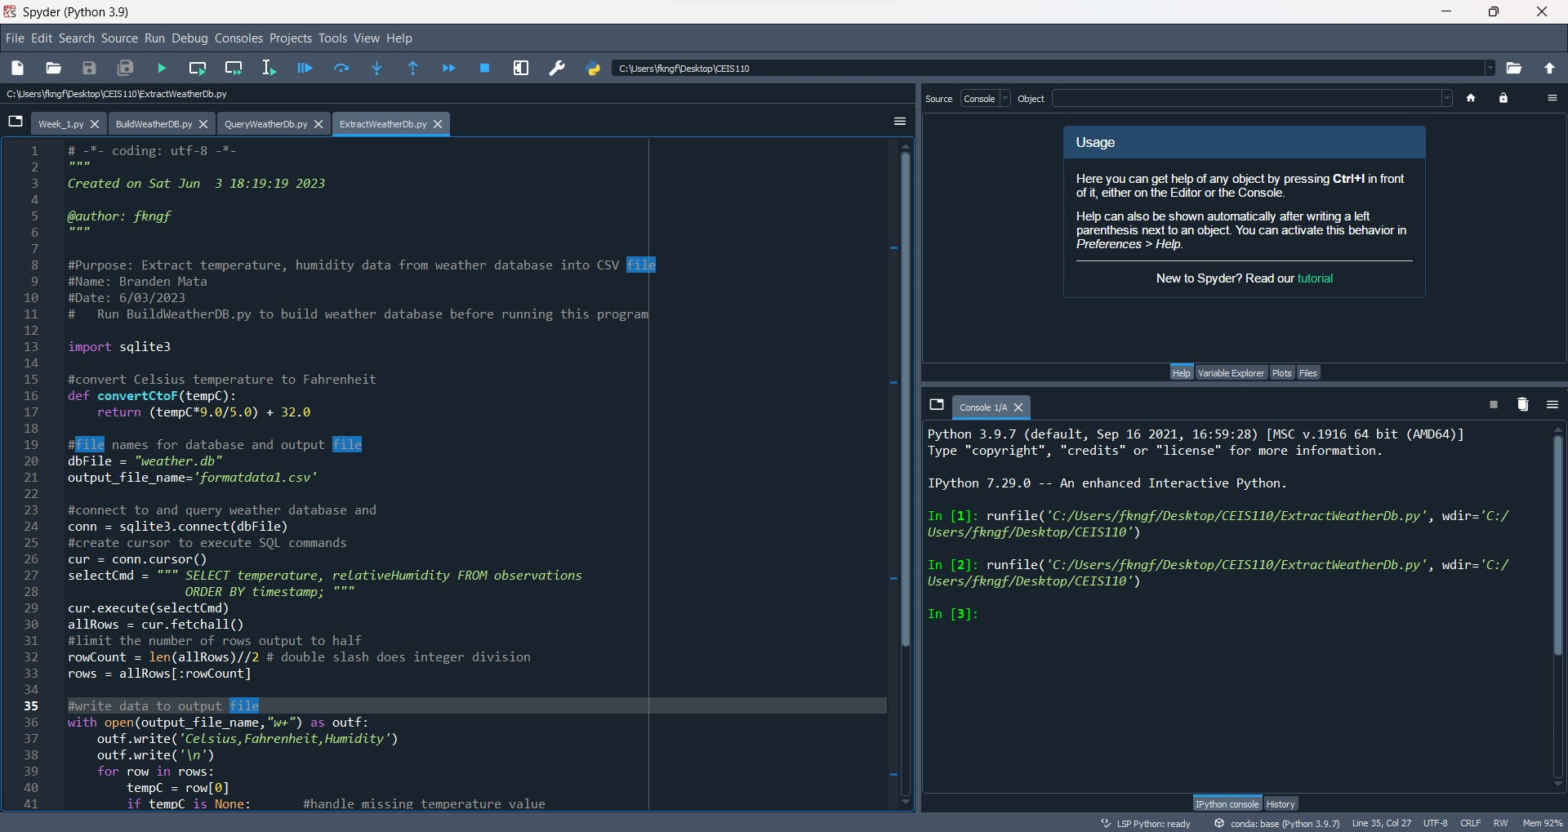
Extracting temperature and humidity using python code
The weather.bd database may contain null or missing values. The code used retrieves only the temperature nd humidity values and writes them to a comma separated values (CSV) file. Two files are created– a formatdata.csv and a formatdata2.csv that each contain half of the rows. Missing or invalid values are not written to the file.

Slide 18
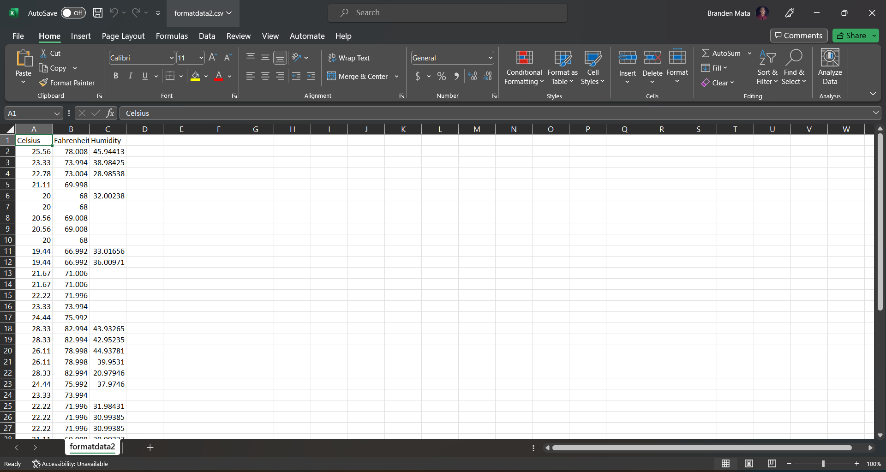
Data formatted in an excel spreadsheet
The python program created a formatdata.csv file
This file contains 3 columns: Celsius, Fahrenheit, and Humidity.
Statistics can be performed on this spreadsheet

Slide 19
Data Visualization
A line chart was developed in Excel showing the Temperature and Humidity over Period 1

Slide 20
Data Analytics
Python Data analytics modules allows users to develop charts and graphs depicting data.
The data can be manipulated as well and saved into tabular format.
The data analytics modules are available as part of Anaconda.
Several plots were generated looking at humidity and temperature.
Then a prediction was made about the data.

Slide 21
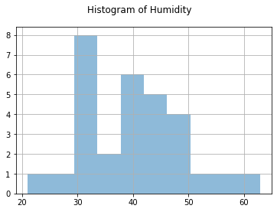
Histogram of humidity
#Purpose:
#Name: Branden Mata
#Date: 06/11/2023
Import pandas as pd
Import matplotlib.pyplot as plt
df1=pd.read_csv(“formatdata.csv”)
df2=pd.read_csv(“formatdata2.csv”)
dfs2[‘Humidity’].hist(bins=10, alpha=0.5);
plt.suptitle(‘Histogram of Humidity’)
plt.show()

Slide 22
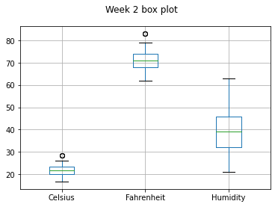
Period 2 box plot
#Purpose: Create box plot for week 2 data
#Name: Branden Mata
#Date: 06/11/2023
import pandas as pd
import matplotlib.pyplot as plt
df2 = pd.read_csv("formatdata2.csv")
df2.boxplot(); plt.suptitle('Week 2 box plot')
#plt.show()
print(df2.info())
print(df2.describe())

Slide 23
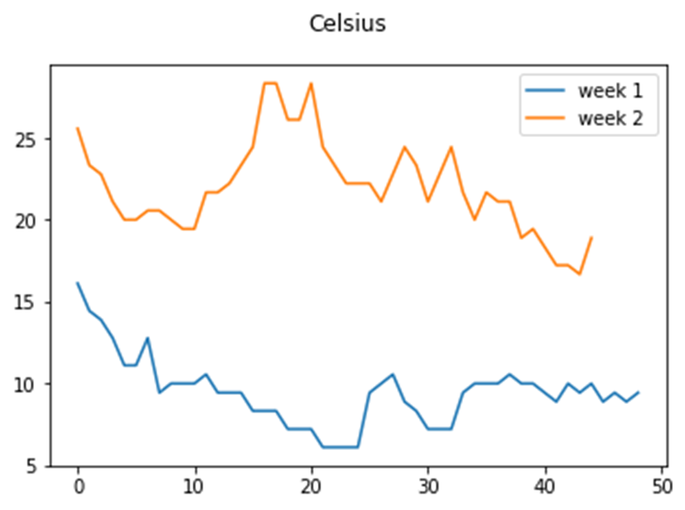
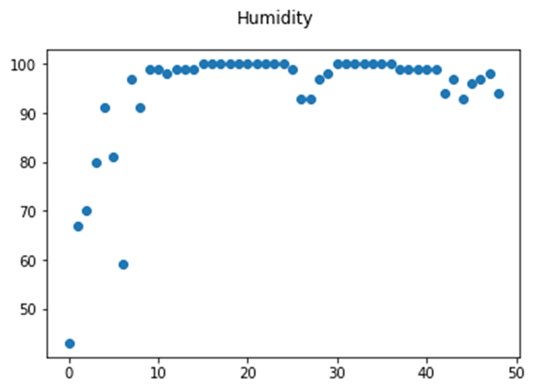
Analysis
The next step in analysis is developing a question and reviewing the data to answer the question. A chart can be used to look at the data.
My question: What will be the weather for next week?
Answer supported by charts: It will continue to rain throughout next week.

Slide 24
Code
The code to create the line chart is below:
#Purpose: Create Celsius plot comparing period 1 and period 2 (week 1 and week 2)
#Name: Branden Mata
#Date: 06/11/2023
import pandas as pd
import matplotlib.pyplot as plt
df1 = pd.read_csv("formatdata1.csv") #baseline data is period 1 (older)
df2 = pd.read_csv("formatdata2.csv") #data for period 2 (more recent)
plt.figure(); df1.Celsius.plot(label = 'week 1 '); df2.Celsius.plot(label = 'week 2'); plt.legend(loc='best'); plt.suptitle('Celsius')
plt.show()

Slide 25
Prediction
My prediction for the weather in my area based on the data is cold and cloudy with rain in the evening.
The variations in temperature and humidity are steady and I don’t see any change soon.
The humidity will change if the temperature goes up or down by increasing the temperature, the humidity will decrease.

Slide 26
Challenges
When importing the weather data from formatdata 1 and 2 csv files into Excel, some data was lost to form the line chart. The problem was fixed once they were converted into xlsx files.

Slide 27
Career Skills
Several career skills are gained in this project:
Communication – using flowcharts to depict the plan of a project
Database development
Programming using Python
Troubleshooting errors in the code and Data cleansing
Analysis – Reviewing charts and graphs to make predictions on the data

Slide 28
Conclusion
This project covered the fundamental topics of programming with data by using data gathered from a cloud service to perform data analytics operations.
Building this project provided a hands-on learning opportunity to put into practice the topics covered in the course.

